Slide 1
Why your math textbook SUCKS
Holden Lee

Slide 2
Overview
Why your math textbook SUCKS!
Politics in the textbook industry
How to write a math textbook
What you can do

Slide 3
Overview
Why your math textbook SUCKS!
Politics in the textbook industry
How to write a math textbook
What you can do

Slide 4
Overview
Why your math textbook SUCKS!
Politics in the textbook industry
How to write a math textbook
What you can do

Slide 5
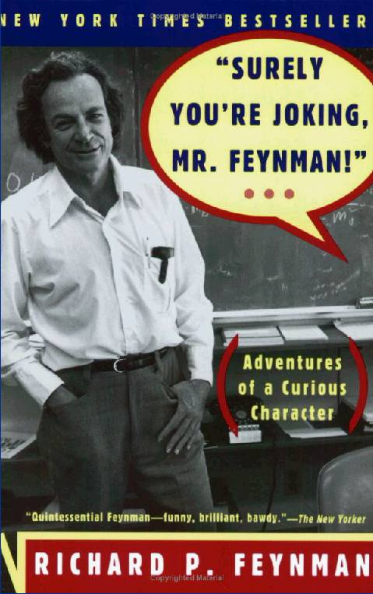
Richard Feynman
Notes:
http://www-scf.usc.edu/~kallos/feynman.htm, http://www.textbookleague.org/103feyn.htm
Richard Feynman was a physicist; he won the Nobel prize in 1965, contributed to quantum mechanics, investigated the Challenger disaster. He was a very good observer too, of many of the little ridiculous things that plagued us, he wrote down his experiences in academia and in life in some autobiographical books, Surely You're Joking, Mr. Feynman! I'll recount one of the stories there.
Being a famous physicist, Feynman got a call from a lawyer on the California State Board of Education. Would you serve on the State Curriculum Commission? Mr. Norris asked. I mean, who better to make decisions about the math and science textbooks our kids learn from than a practicing scientist, who uses this stuff every day?
Immediately, textbook publishers started flooding him with calls. "We're so glad you're on the committee because we wanted a scientific guy," and also: "We'd like to explain what this book is about; we'll help you in any way we can to judge the books...“ He said, “You don’t have to explain; I’m sure the books will speak for themselves.” After all, he should be impartial.
A lady from the LA school system introduced Feynman to the process: The members of the commission would get lots of the copies of the book, give them to teachers and administrators in their district, and get reports back on what the people thought.
Feynman didn’t know any teachers or administrators, so he’s like, I’ll just read everything myself. A few days later, a guy from the book depository said, “We’re ready to send you the books, they’re 300 pounds.” He was overwhelmed. “It’s all right,” the person said, “We’ll get you someone to help you read them.”
But he wasn’t buying any of this stuff. Either you read them or you don’t.
He worked for long hours in the basement. His wife said he was like a volcano at the time: mostly quiet but sometimes he would just explode. Why? The books were lousy.
[
The textbook authors were trying to teach something they didn’t understand very well; they tried to be rigorous but weren’t smart enough to understand what that meant. They taught stuff that was useless. How were kids supposed to learn anything?
They tried to teach “modern concepts” of math that were useless without the proper foundations. "Translate these numbers, which are written in base seven, to base five.” There’s some cool math about other bases but the textbooks made these topics rote.
The books didn’t say anything about arithmetic in science. Just buying stamps.]
"Mathematics is used in science in many ways. We will give you an example from astronomy, which is the science of stars Red stars have a temperature of four thousand degrees, yellow stars have a temperature of five thousand degrees. Green stars have a temperature of seven thousand degrees, blue stars have a temperature of ten thousand degrees, and violet stars have a temperature of (some big number). John and his father go out to look at the stars. John sees two blue stars and a red star. His father sees a green star, a violet star, and two yellow stars. What is the total temperature of the stars seen by John and his father?” These books are written by people who have no idea what they’re talking about. It makes NO sense to talk about the sum of two temperatures.
In the first meeting, he found his ratings were very different from the others. “Why did you rate that book low?” they asked. He would say, this is the problem, see page so-and-so. He asked them why they rated the book high, and they never answered, “What did you think about this other book?”
They came to one of a set of 3 books published by one company. “What do you think of it?” “The book depository didn’t send me that book.” “What do you think of it?” one person repeated. “I said they didn’t send me that one, so I don’t have any judgment on it.”
The man from the book depository was there. He explained, “It wasn’t completed yet by deadline, so the publisher sent the book with the covers, blank in between.”
Some of the other members had rated the book! They were flabbergasted that it was blank. In fact, the rating for the blank book was higher than the other two books! They didn’t even read the book! They just gave books to other people (many of whom didn’t read it either) and got reports back, and listened to the publishers explain what was in the books, and Feynman was the only one who read them all.
[Compare to this fable. Nobody has seen the Emperor of China. To find the length, you go around China asking everyone what they thought was the length, and then you average. Because you asked so many people, it must be accurate, right?]
People sent Feynman stuff when he was on the board. A package of dried fruit, “From our family to yours, Happy Thanksgiving.” He didn’t know who the sender was, so he got the guy’s phone number and called, “Who are you?” “Oh hi Feynman, I’m Pete Pamilio.” “I’m sorry I don’t remember who you are.” He worked for one of the textbook publishers.
Each book seemed to have its failures: no applications to real life? No word problems? Too much abstraction? Suggest a bunch of books as supplementary, try to cover each others’ failures. Don’t look at the price, they said. They chose a bunch of books, and then the Board said, oops, we don’t have that much money, you need to go into committee again and discuss and cut a bunch of these! And they wanted Feynman to appear before the State Senate to support the choice of books—books he thought were all crap.
Next year we’re going to talk about science books, they said. He looked at them—maybe they were better? There’s a picture of a windup toy, a car, a boy riding a bicycle. “What makes it go?” the book asked.
For the toy: “Energy makes it go.” For the car: “Energy makes it go.” For the bike: “Energy makes it go.” The kid doesn’t learn anything—just a vocab word! There’s no science behind it.
He resigned.
One year later he found the “energy-makes-it-go book” got chosen. So, although he said he’d quit, he went to the meeting and declared why he thought the book bad.
The next person got up: “That book was approved by 65 engineers on the such-and-such aircraft company!” The book was approved.
[amusing story at the end, no time to include]
[If a state agency really wanted to obtain legitimate evaluations of textbooks, the agency could achieve this by using a process that is very well known: Send each book to a knowledgeable reviewer who will appraise it, who will write a report to set forth and explain his appraisal, and who will sign his name to his report. This is the process employed by the book-review editors of newspapers, magazines and professional journals throughout the land.]

Slide 6
Politics
Corruption
Money
Useless ratings
“Standards” that keep competitors away
“The search is over… Jeans that fit!”

Slide 7
What else is bad?
Recipe-book format → memorization without understanding.
Too many ideas/problems induce headaches.
“Alternative assessment”
Reflective of traditional teaching practice?

Slide 8
Writing a textbook is hard!
Time + energy
Teaching experience, technical knowledge, creative writing
Entry barrier
Notes:
Often start over.
Short solutions

Slide 9
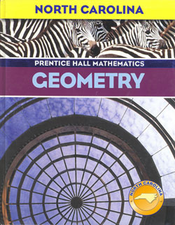
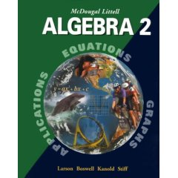
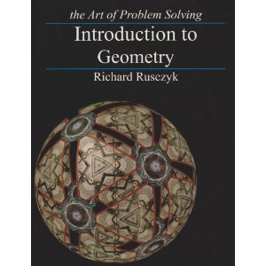
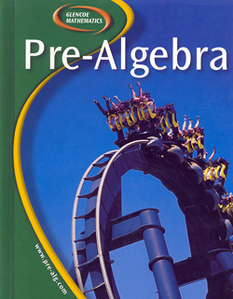
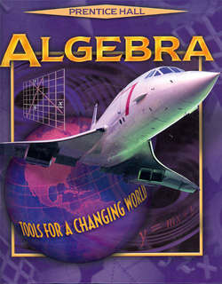
Entry barrier

Slide 10
Overview
Why your math textbook SUCKS!
Politics in the textbook industry
How to write a math textbook
What you can do

Slide 11
How to write a textbook
Exploratory learning
Empowerment promise
Organization, road maps
Relevant narrative
Complete
Notes:
Empowerment:
For instance, rather than "In the following problems you will use proportions to find side lengths" say "You'll put to use the proportions you get from similar triangles to compute side lengths."
Rather than say "The diagram is as follows" say "We first draw the diagram:"
"Besides just measuring shadows, there are many other ways to find the heights and lengths of objects you can't measure directly. Below you'll discover several ways to do so, all using AA similarity."
Now you're ready for some more complex problems. Use a bit more thought to find the correct pair of similar triangles!
Thales's theorems remain the earliest attributed theorems in mathematics. In this section you'll follow in Thales's footsteps yet again as you rediscover an important theorem on similar triangles for yourself.
Using "let's" in solutions.
We can create new information by [drawing a parallel line, extending a segment,...]
--
The 5 elements of a story are:
Plot
Characters: Each character should have a distinct personality. Think through the character's heritage (parents), dialogue (what makes it unique?), worldview, and daily life.
Conflict: This can be an outside problem the characters have to use their brains to solve, or just some friendly rivalry (which always works... for instance, Connie and Karen competing to see who can come up with more congruence criteria).
Theme: What's the overall message? (Ex. you can use similar triangles to measure things you can't measure directly)
Setting
A good curriculum should contain a narrative, that satisfies the following.
Relevant/natural: It seems like a exploration that could actually happen in real life (ex. using fractions in recipes, vs. shooting fractions dropping from alien invaders). The characters should build upon information that they have. Occasionally you can have a corny/far-fetched story IF it is...
Memorable: Have a key idea or bit of story (salient) that stands out. Even if students don't remember much of the chapter, they'll remember this, and hence a key idea of the chapter.
Worldbuilding: Develop the characters and the setting, and keep building upon the same set of characters and settings in future lessons.
Identification: Readers need to identify with the characters. Make them think, "Oh, that sounds like a problem I could encounter!" or "Oh, I could have come up with that too!"

Slide 12
Chapter openings
Empowerment promise

Slide 13
5 S’s
Slogan
Symbol
Salient
Surprise
Story

Slide 14
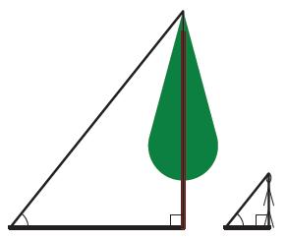
5 S’s
"Same shape but not the same size." "Too big to measure."
Slogan
Symbol
Salient
Surprise
Story
Connie and Eric
Thales of Miletos
There are so many different ways to measure lengths you can't measure directly

Slide 16
Technology to the rescue?
Not bounded by length
Nonlinear, student-adapted
Other media
Collaborative
Accessible

Slide 17
Overview
Why your math textbook SUCKS!
Politics in the textbook industry
How to write a math textbook
What you can do

Slide 18
How to learn math
Ask questions
Fill in the motivations
Articulate the key concepts
Explain to someone else

Slide 19
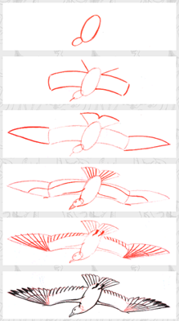
How to write a textbook
“Pencil, then ink.”
{
Questions
Motivations
Concepts

Slide 20
What you can do
Be critical!
Ask yourself: am I learning from this?

Slide 21
Summary
Writing textbooks take tremendous resources.
The textbook industry resists reform.
The landscape is changing.
Take charge of your learning.

