Slide 1
FTI-Lonarfarnib’s Potential for Progeria: Resurrection of a Failed Cancer Drug Jae Pukma B.Sc Biology/Mathematics April 23, 2013 Drug Discovery Seminar

Slide 2
Objectives
Unmet Medical Needs
Understand process of Prenylation
Understand the mechanism of Farnesyltransferase Inhibitors (FTIs)
Lonafarnib (SCH66336/Sarasar©)
Hutchinson-Gilford Progeria Syndrome (HGPS)
FTIs Trail in Cancer and FTIs Trail in HGPS
Benefits of Combinatorial Drug Treatment

Slide 3
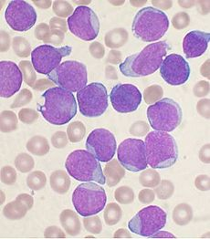
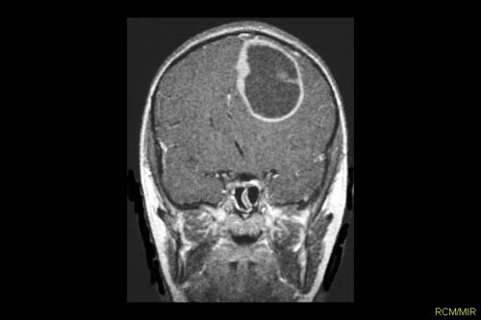
Unmet Medical Needs
Hutchinson-Gilford Progeria Syndrome
1/4mil live births
Genetic Disorder (LMNA)
Rapid aging in children
Problems in bones and cardiovascular health
Death at (averaged) 13
Cancer Treatment
Leukemia
Glioblastoma Maltiforme
Lung Cancer (SC/nonSC)

Slide 4
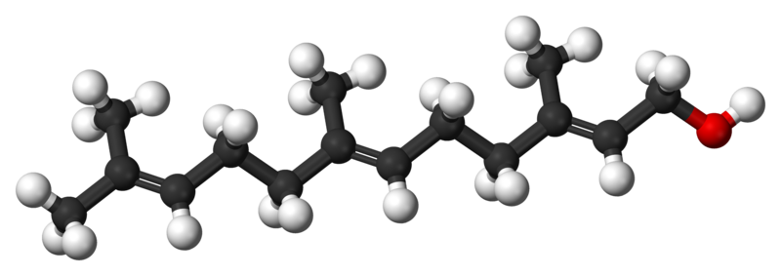
Prenylation & Farnesyl-Group
Farnesyl-Group
“Hydrophobic”
Farnesyl Diphosphate
FDP
Prenylation: Process of adding a hydrophobic-lipid group to a protein. (Post-Translational)
*Makes Proteins Hydrophobic “Water Fearing”

Slide 5
Farnesylation & Farnesyltransferase
Mature-Protein
15aa-C-OCH₃
Protein
C-AAX
FARNESYL
FARNESYLTRANSFERASE
ZMPSTE24
FARNESYL
Protein
Protein
C-OCH₃
C-AAX
-AAX
FARNESYL
FARNESYL

Slide 6
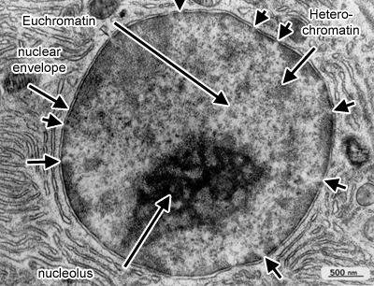
Cell Nucleus & Nuclear Envelope
Nuclear Envelope

Slide 7
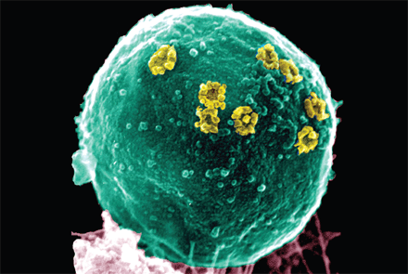
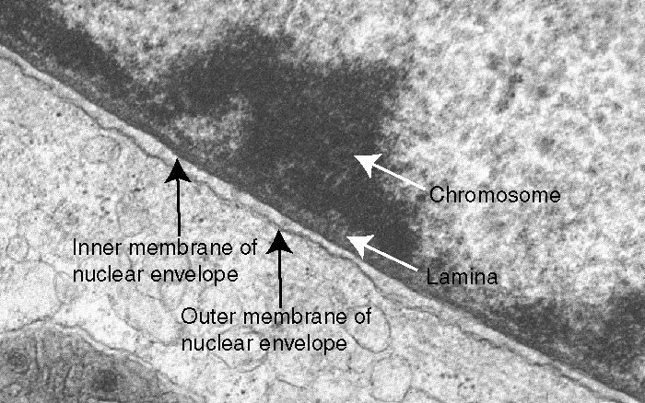
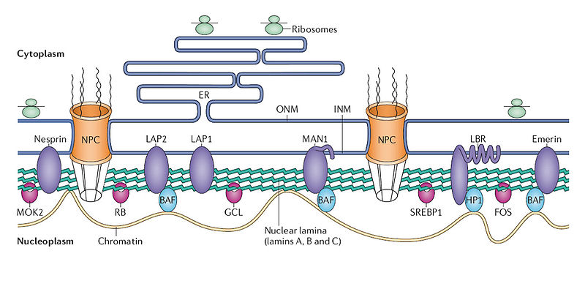
Nuclear Membrane Structure
Lamin A
Nuclear Lamina

Slide 8
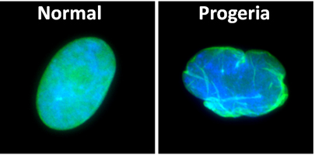
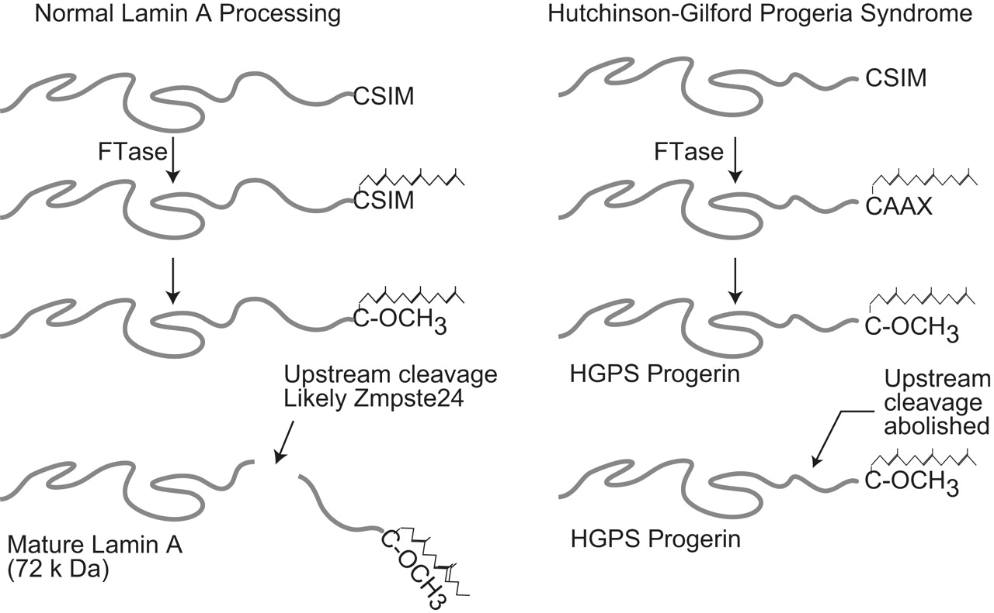
Progeria (LMNA)

Slide 9
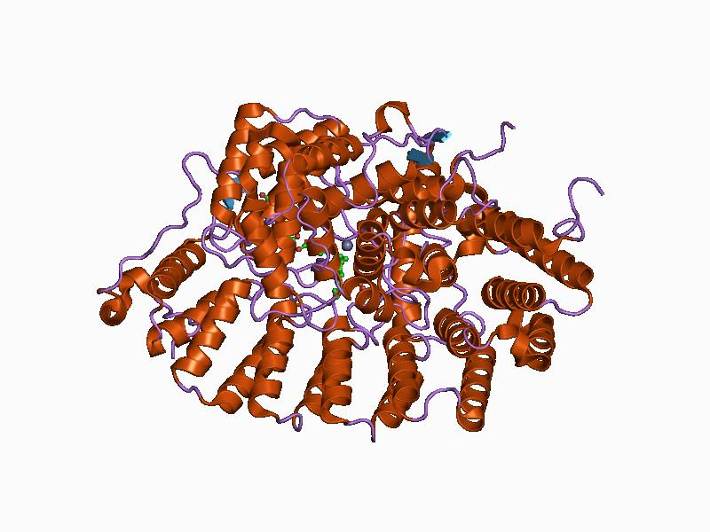
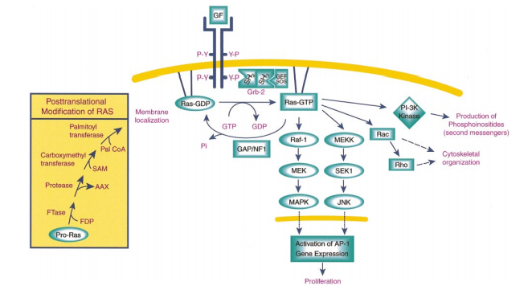
RAS Activation by FTase

Slide 10
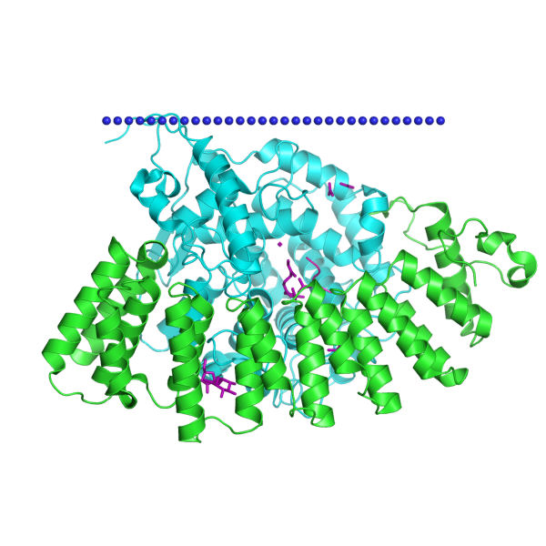
Target: Farnesyltransferase
-Zinc Metalloenzyme, alpha (48kDa)/beta (46kDa) subunits.
Catalyzes Prenylation process [15C isoprenoid] at CAAX.
Design a Drug that Targets the FTase (Inhibition)

Slide 11
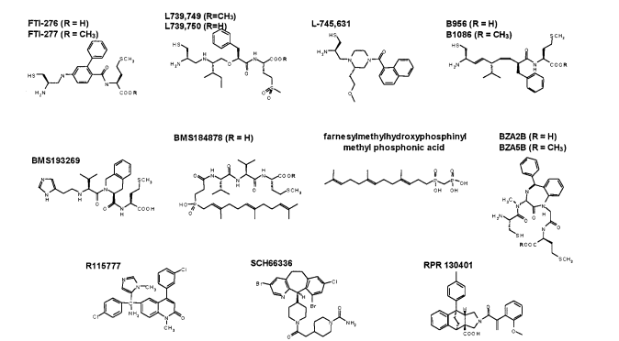
FTI: Drug Rational Design
Candidates/Categories
FDP Competitors, CAAX Competitors, or Both
Peptidomimetics, nonPeptidomimetics
Cyclic Structures (Homo/Hetero)
Thiol Features

Slide 12
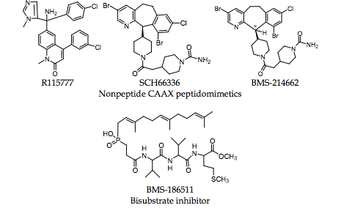
Lonafarnib (FTI) [Mechanism..Bench..Bedside]
SCH66336:
Tricyclic, heterocyclic,
Non-thiol, Nonpeptidomimetic
Lonafarnib Preclinical Phase (Cancer)
-Shown to inhibit the growth of Tumor in trans-genetic mice under MMTV (Kohl et al, 1995)
-Inhibit growth of chemically induced lung tumor with K-ras Mutation in immunocompetent mice (Lantry et al, 2000)
-Induces tumor regression in p53 lack mice with oncogenic H-ras mice (Barrington et al, 1998)

Slide 13
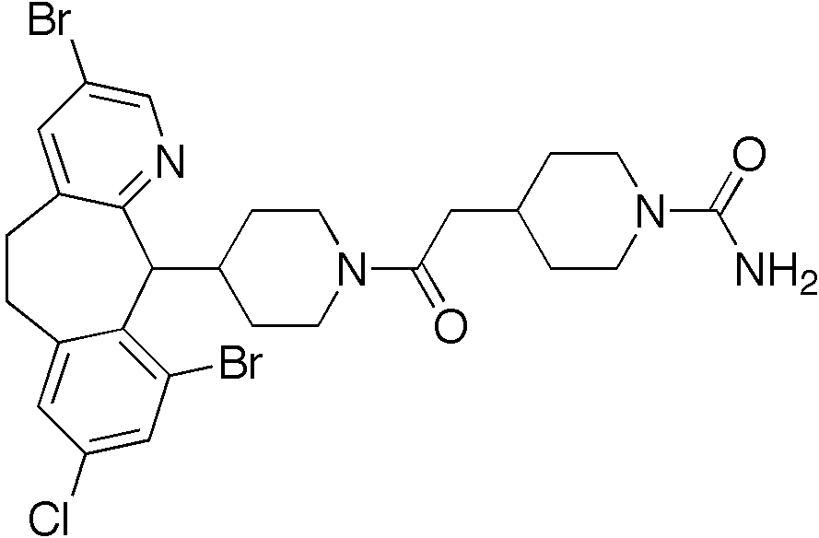
Lonafarnib in Cancer-Tumor Treatment
FAILED!
Lung Cancer (Adjei et al.)
Myelodysplastic Syndrome (Feldman et al.)
Chronic Myelomonocytic-Leukemia (Feldman et al.)
Urethelial Cancer (Winquist et al.)
FAILED!
FAILED!
FAILED!
Lonafarnib used as Single Agents
High Grade Toxicities, Low anti-Tumor activity
Toxicity Index, Bioavailable, DLT, MTD

Slide 14
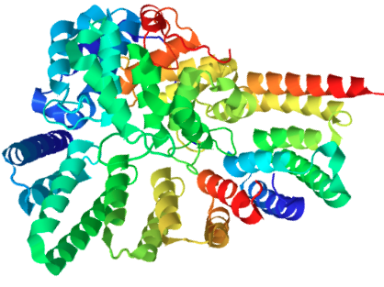
Jae’s Homemade Reason
Geranylgeranylation
adding 20C Isoprenoid.
Versatile Prenylation
Yield high count of hydrophobic proteins
Restore RAS activation, regardless of FTIs.

Slide 15
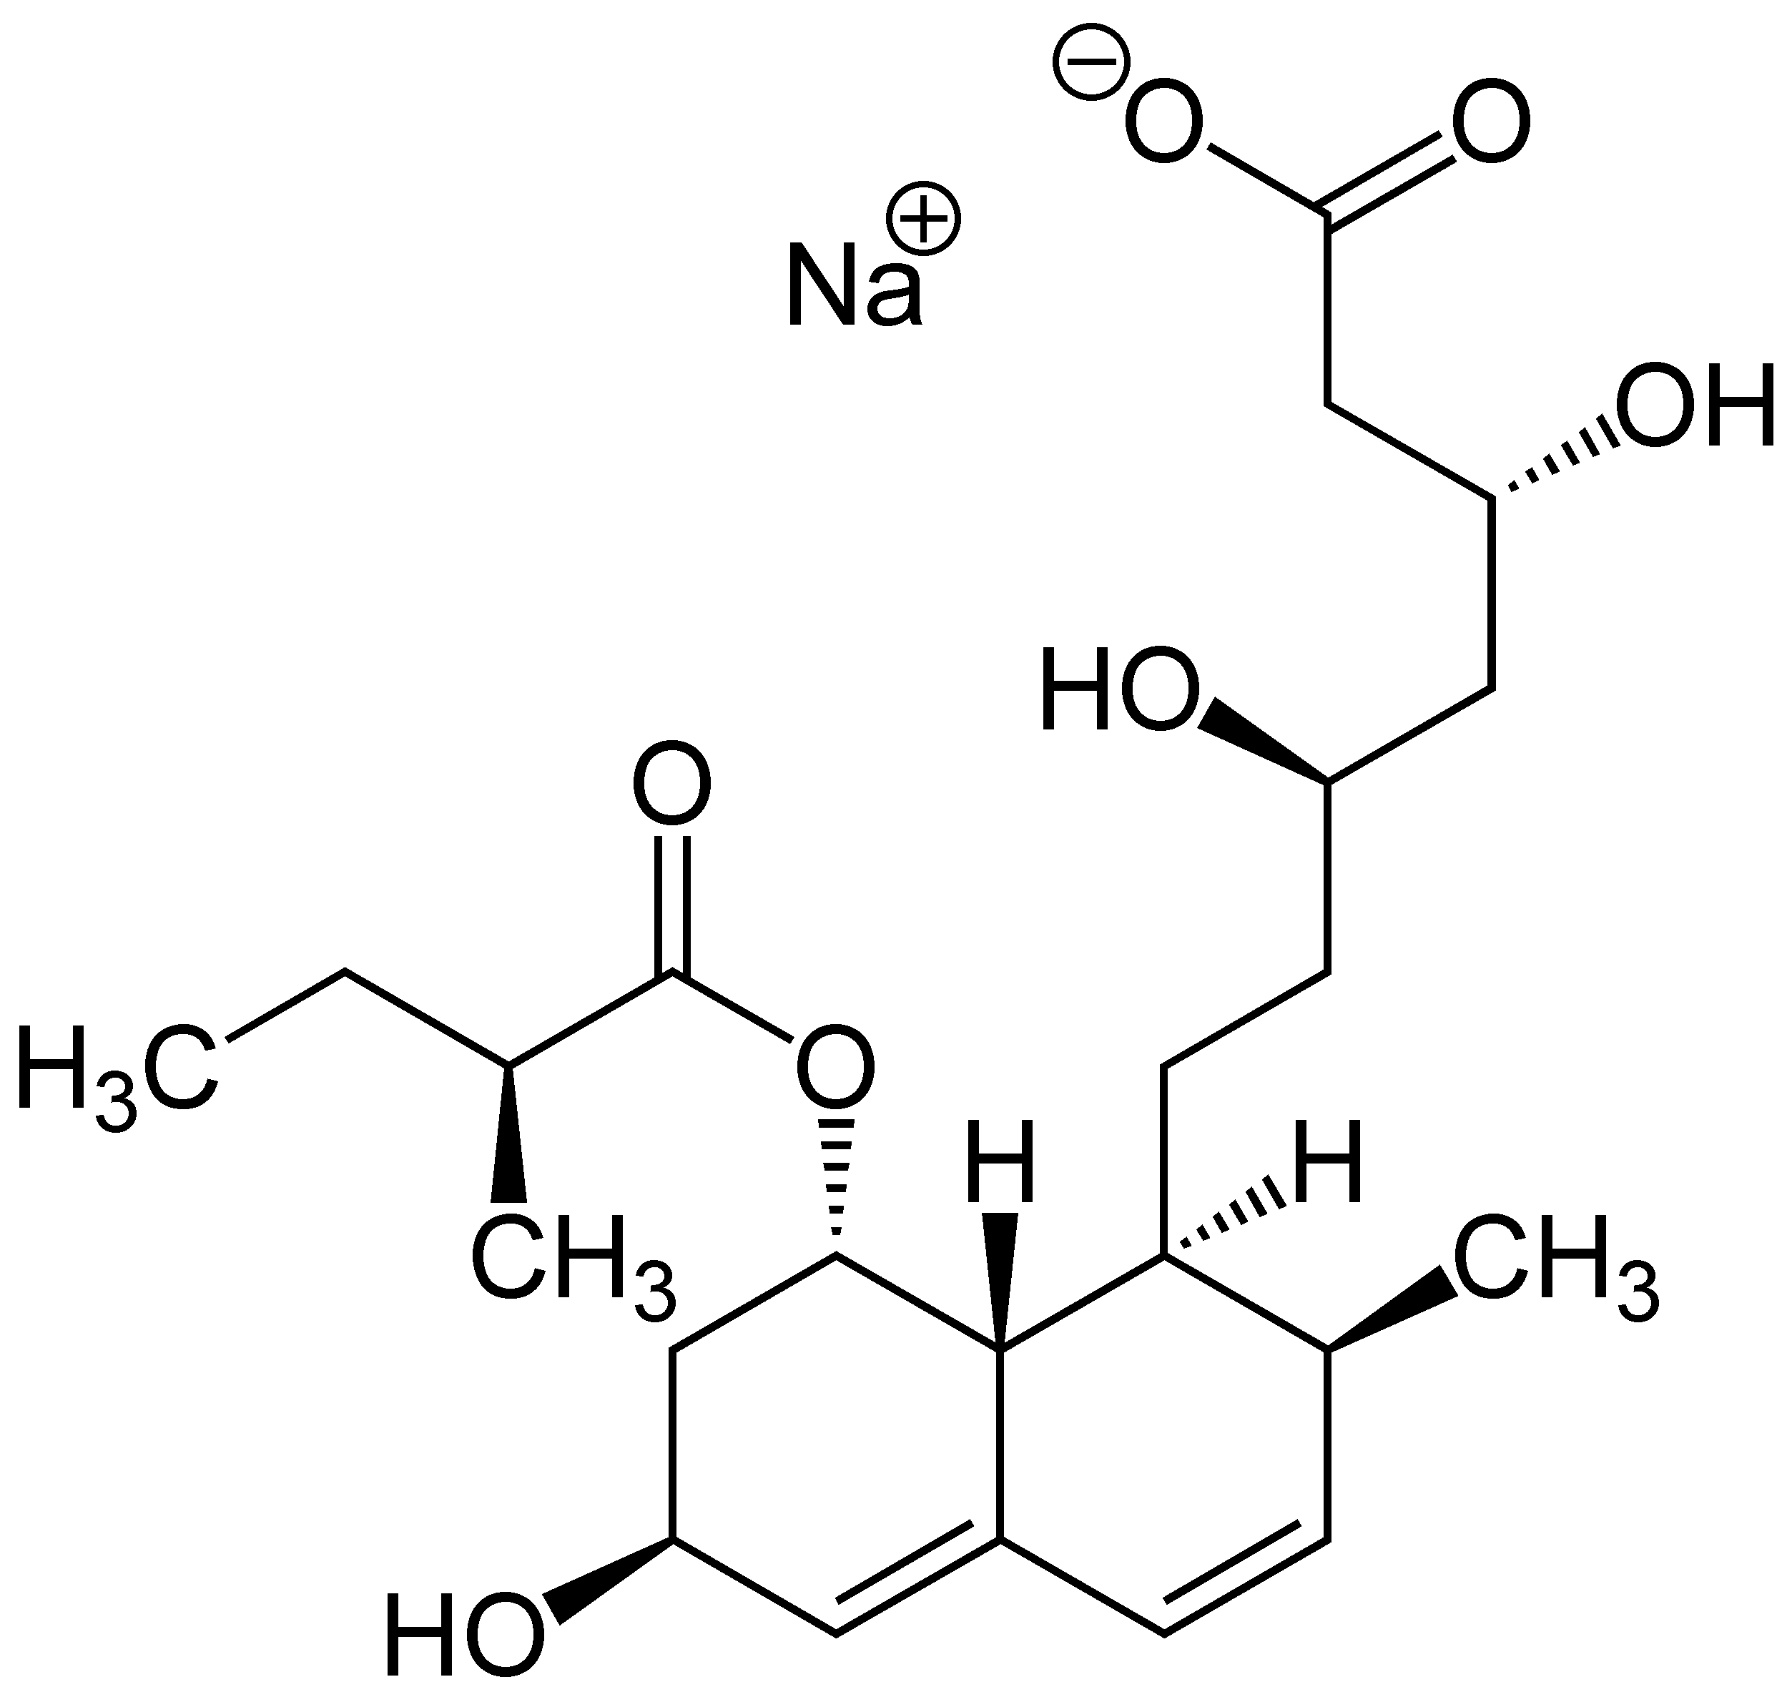
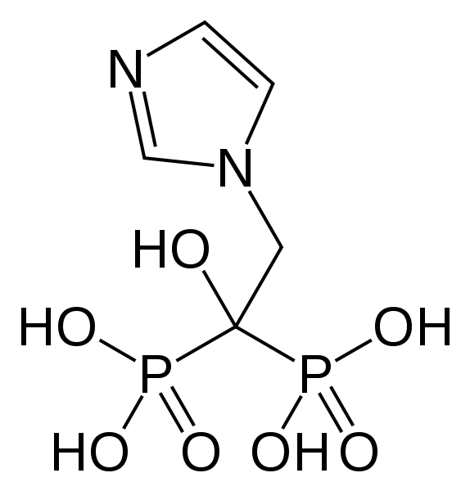
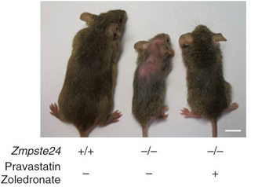
Transition to HGPS: Clinical Trial
LMNA Gene (lamin-A)
Adjei et al. (prelamin-A biomarker)
Leslie B. Gerdon PRF
Addition to existing HGPS therapy:
Pravastatin (Statin)
Zoledronic Acid (Biphosphonate)
+ Lonafarnib (FTIs)
3rd Clinical Trial

Slide 16
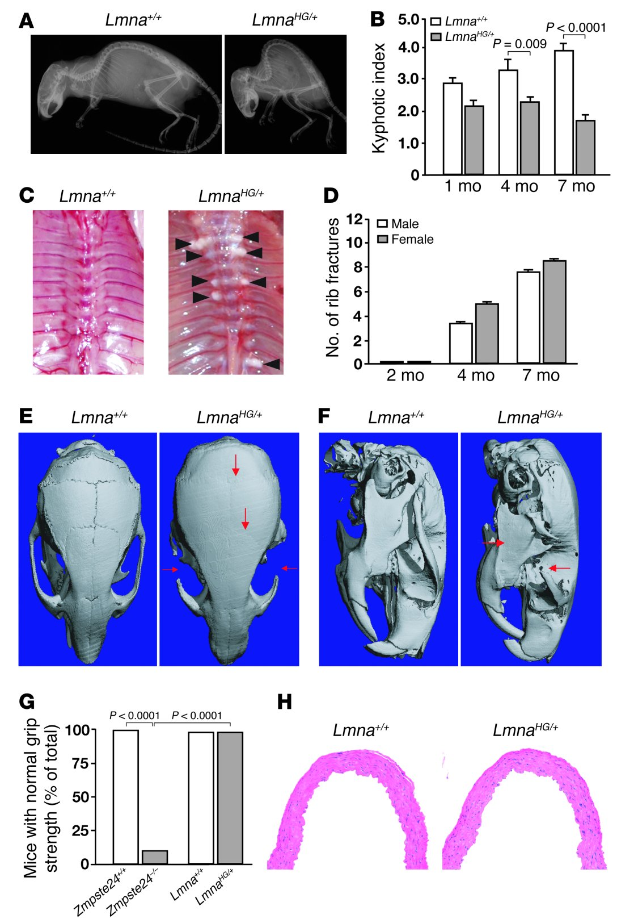
Disease Phenotype Mice Progeria
Spine Curvature Index
Osteolytic Lesions

Slide 17
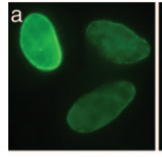
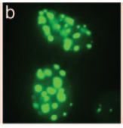
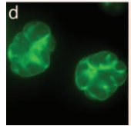
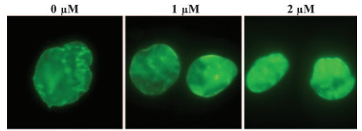
Preclinical Phase: Cell Assay
WT
WT-SSIM
HGPS
SCH66336+

Slide 18
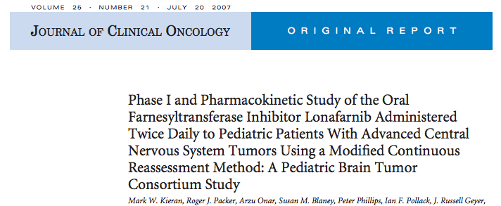
Phase I: Safety Evaluation of Lonafarnib
Weight Gain
Cardiovascular Health
Bone/Spine Structure
Clinical Trial:
Phase I: Safety of Lonafarnib in Pediatrics (>2y.o) Establish DLT MTD.
)

Slide 19
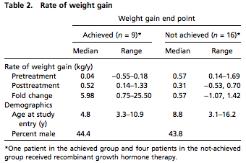
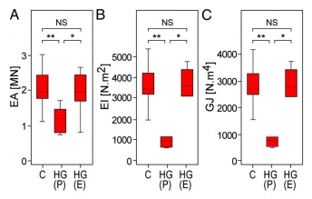
Phase II: Efficacy in Therapeutics
Tri-Drug Therapy
25 Patients (age 3-16)
So far, 50% increase annual Weight Gain.

Slide 20
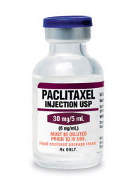
Future Prospective: Combinatorial Therapy
HGPS
SOLID TUMORS

Slide 21
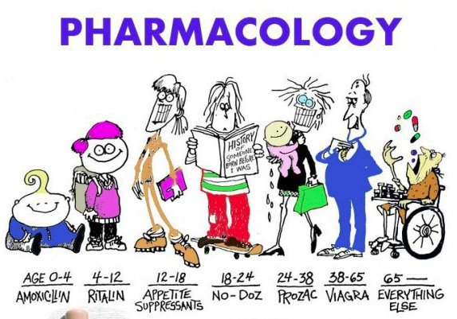
Questions?
WHERE DO YOU FIT IN?

