Slide 1
How to Fail AP Computer Science
yeah that's right we use monospace fonts because we're cool like that but we're too lazy to use a custom theme apparently
Presented by Andrew Zhou

Slide 2
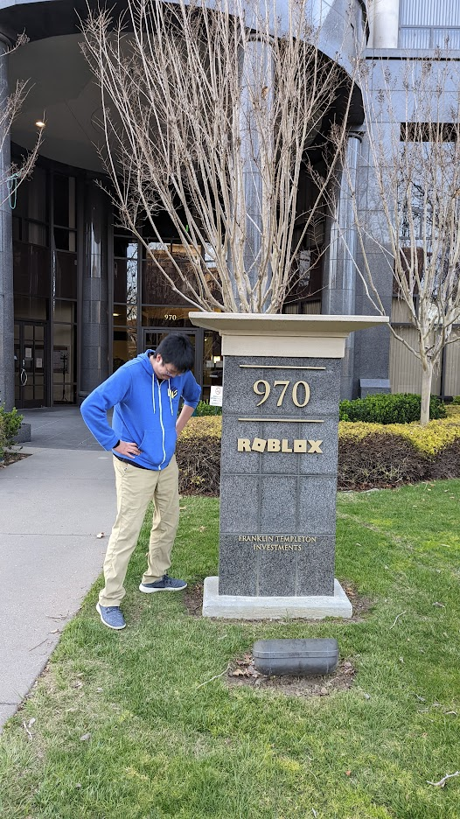
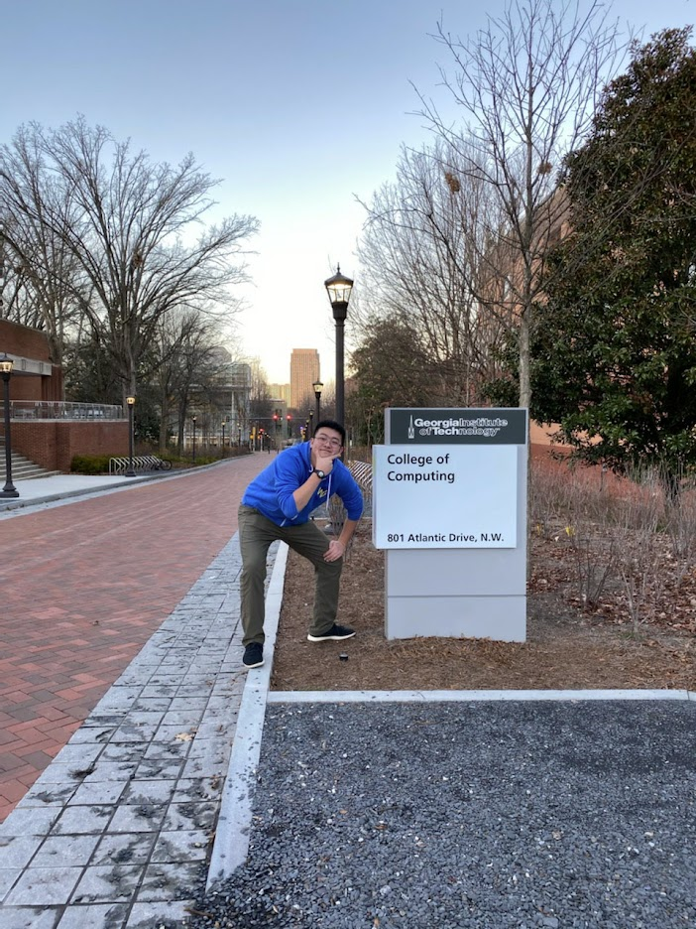
I Did Badly at AP Computer Science
I'm Andrew Zhou, and I didn't get a 5 on the AP CS exam in 2016.
Because of this permanent stain on my personal record, I could only aspirationally look as those smarter than me went to better universities and got better jobs.
I don't work at Roblox.
I never went to Georgia Tech.
I did badly at AP CS, and let me show you how you can too.

Slide 3
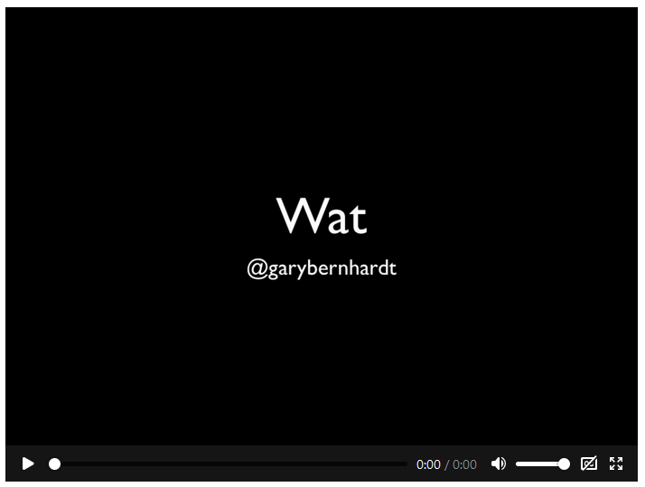
As Always, Plagiarize, Plagiarize, Plagiarize

Slide 4
Let's Start Programming…

Slide 5
What is AP Computer Science?
AP Computer Science tests students on basic programming knowledge in 10 areas:
Primitive Types
Using Objects
Boolean Expressions and If Statements
Iteration
Writing Classes
Array
ArrayList
2D Array
Inheritance
Recursion
Notes:
We may cover these during this lecture.

Slide 6
Types
A type describes what kind of thing a thing in programming is. There are many, but here are the major ones
Numbers - 5, 0.5, 0.3333333, 2147483648
Strings - "abcd", "hello world"
Booleans - True / False
Objects - {a: "value"}
Array - [1, 2, "hi"]
Notes:
2,147,483,648

Slide 7
Javascript
[] + []
[] + {}
{} + []
{} + {}
Notes:
[ ] + [ ] = " "
[ ] + { } = "[object Object]"
{ } + [ ] = 0
{ } + { } = NaN

Slide 8
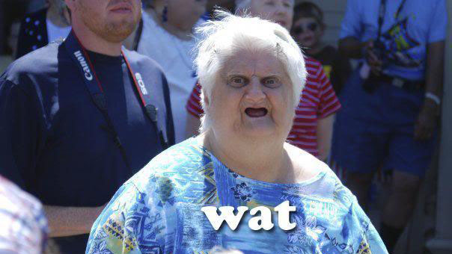

Slide 9
Python
sum([1,5])
sum("")
sum("", ())
sum("", [])
sum("", {})
sum("","")
Notes:
sum([1,5]) is 6
sum("") is 0
sum("", ()) is ()
sum("", []) is []
sum("", {}) is {}
sum("","") is ""

Slide 10
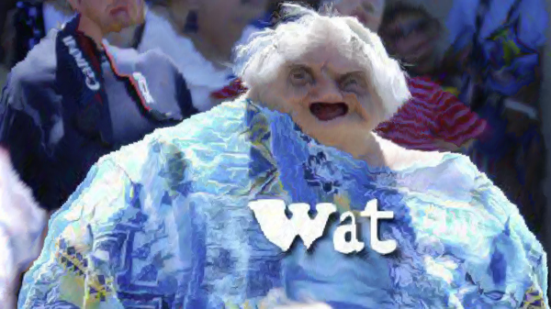

Slide 11
Boolean Expressions and If Statements
A boolean expression is one that returns a truth value. This can be true or false.
1 == 1 is true. The earth == flat is true.
Additionally, you can use ands and / or ors to add more logic
True and False == False
True or False == True
An if statement uses boolean expressions to control where the program goes.
Notes:
2,147,483,648

Slide 12
Python
(False == False) in [False]
False == (False in [False])
False == False in [False]
Notes:
(False == False) in [False] is False
False == (False in [False]) is False
False == False in [False] is True

Slide 13
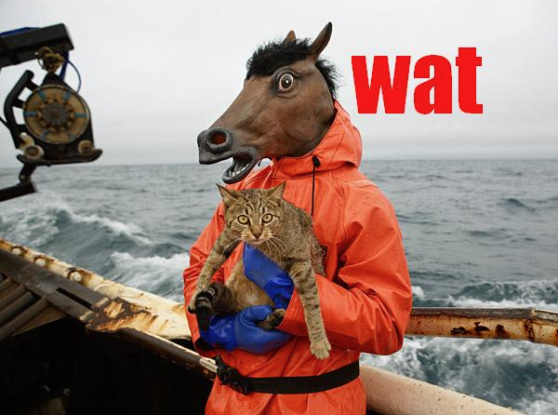

Slide 14
Ruby
not true && false
not true and false
Notes:
puts(not true && false) is true
puts(not true and false) is false

Slide 15
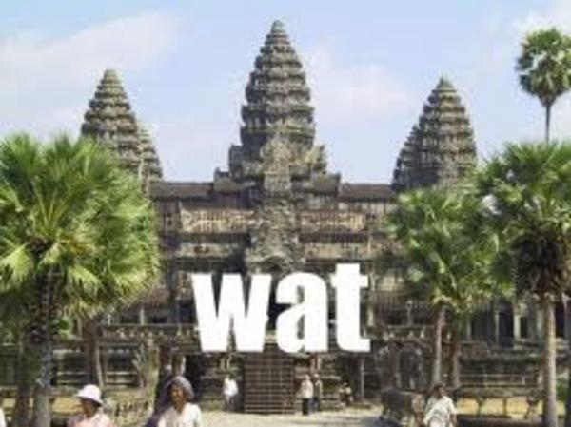

Slide 16
Python
all([True, True, True])
all([True, True, False])
all([])
all([[]])
all([[[]]])
all([[[[]]]])
Notes:
all([True, True, True]) is True
all([True, True, False]) is False
all([]) is True
all([[]]) is False
all([[[]]]) is True
all([[[[]]]]) is True

Slide 17
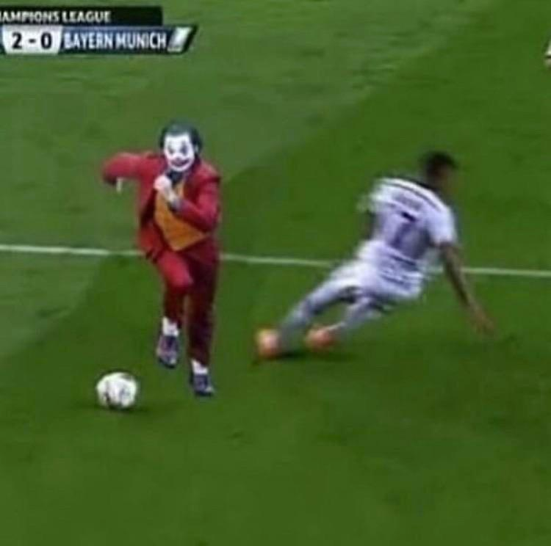

Slide 18
Powershell
if (36 > 42) { "true" } else { "false" }
if (36 < 42) { "true" } else { "false" }
cat 42
Notes:
Statement 1: false (the > operator is actually writing a file)
Statement 2: The '<' operator is reserved for future use
Powershell does have -lt, -gt operators for this

Slide 19
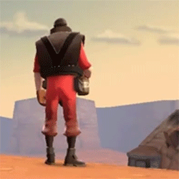

Slide 20
Arrays
An array is a data structure that contains other things inside it.
These arrays can be indexed, meaning I can say where in the array I want something from, like this: "hello"[1] = "e"
Apart from indexing, arrays can also be modified, added, etc.
They are useful for storing data, and implement many other data structures.
You can also have arrays inside arrays. These are known as multi-dimensional arrays. They also suck.
Notes:
2,147,483,648

Slide 21
Python
x = float("nan")
y = float("nan")
x == x
[x] == [x]
[x] == [y]
Notes:
>>> x = float("nan")
>>> y = float("nan")
>>> x == x
False
>>> [x] == [x]
True
>>> [x] == [y]
False

Slide 22
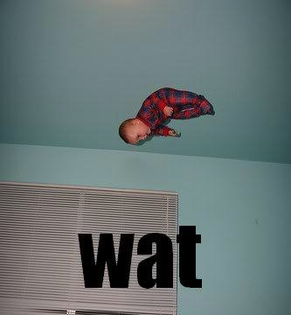

Slide 23
Python
[4][0]
[4][0.0]
{0:4}[0]
{0:4}[0.0]
Notes:
>>> [4][0]
4
>>> [4][0.0]
Traceback (most recent call last):
File "<stdin>", line 1, in <module>
TypeError: list indices must be integers, not float
>>> {0:4}[0]
4
>>> {0:4}[0.0]
4

Slide 24
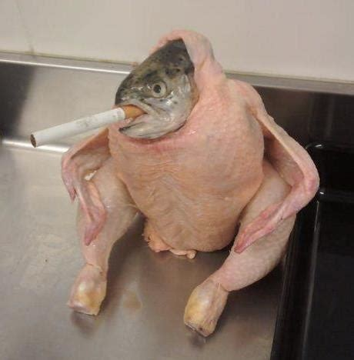

Slide 25
Javascript
Array(16)
Array(16).join("wat")
Array(16).join("wat" + 1)
Array(16).join("wat" - 1)
Array(16).join("wat" - 1) + " Batman!"

Slide 26
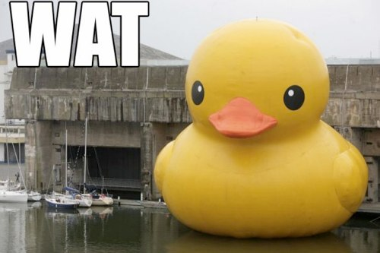

Slide 27
Javascript
console.log((![]+[])[+[]]+([][[]]+[])[+[]]+([][[]]+[])[+!![]]);
Notes:
console.log((![]+[])[+[]]+([][[]]+[])[+[]]+([][[]]+[])[+!![]]);
Evaluates to "fun"

Slide 28
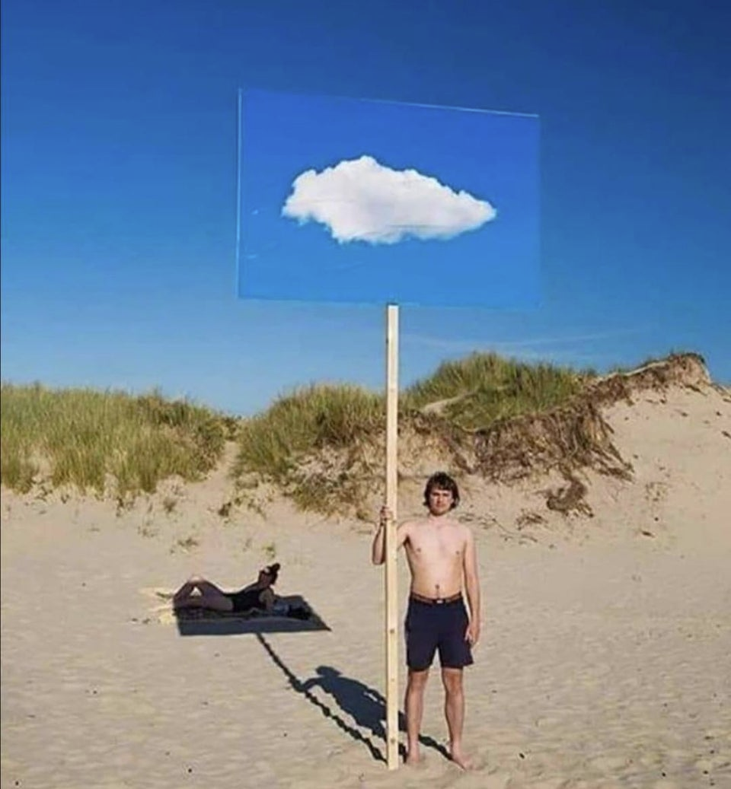

Slide 29
Javascript
[1,2,3] + [4,5,6]
Notes:
[1,2,3] + [4,5,6] is [1,2,34,5,6]

Slide 30
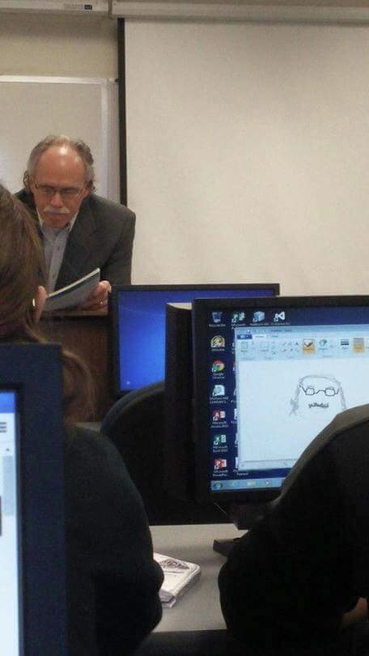
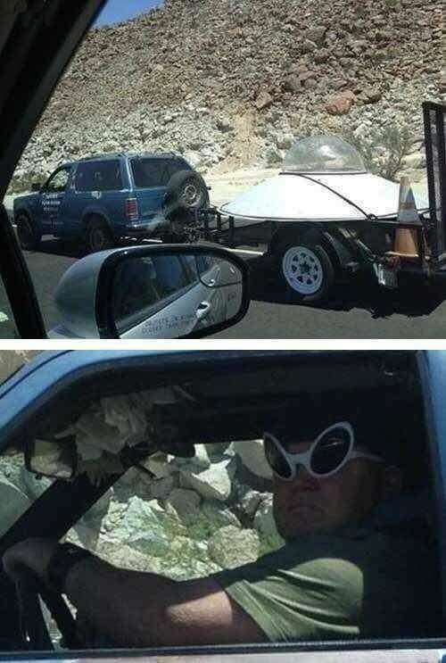
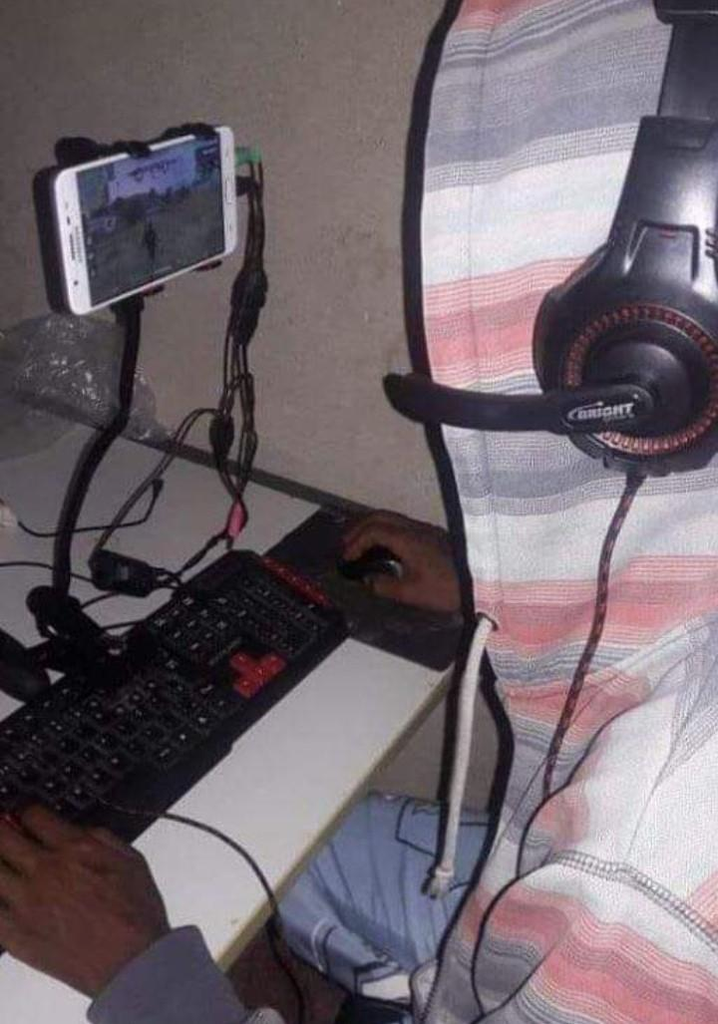

Slide 31
Functions
Functions are block of codes that perform a task.
They can be called and reused multiple times.
Think of functions like you do mathematical ones - if I put a value into sin(90º), I'll get 1 in return. There's an input, and sometimes an output
When called, the program pauses execution of the main program to then execute the function, and then the results of those function are returned to the main program if that function had a statement to return a value.
Notes:
2,147,483,648

Slide 32
Javascript
function example() {};
var example = function() {};
example = function example() {};

Slide 33
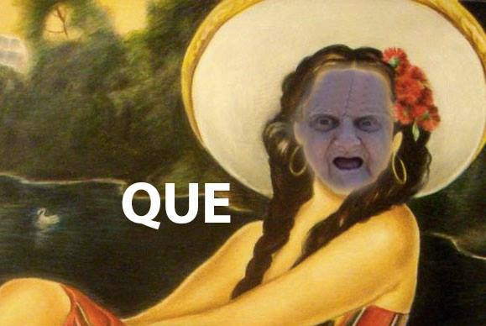

Slide 34
Javascript
function hello() {
console.log('hello');
world();
function world() {
console.log('World');
}
};
hello();
Notes:
The following code prints
hello
world

Slide 35
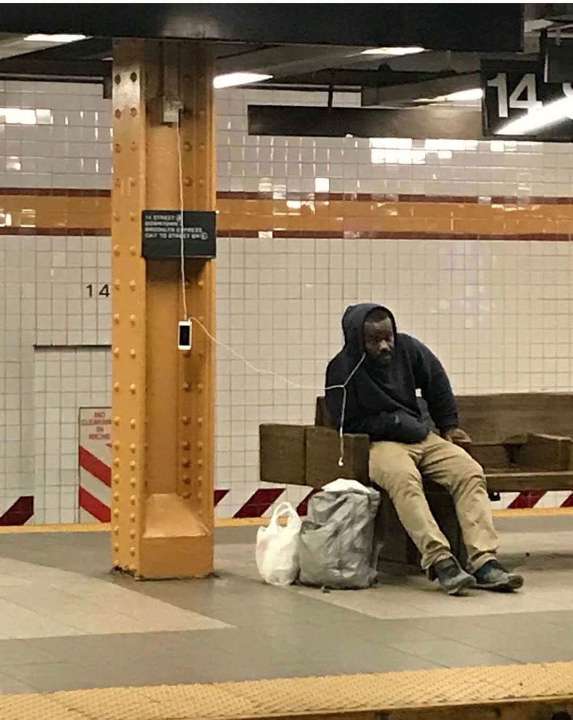

Slide 36
And the rest…

Slide 37
C++
int main(){<:]()<%[](){[:>()<%}();}();}();}
This compiles!
Notes:
THIS COMPILES.

Slide 38
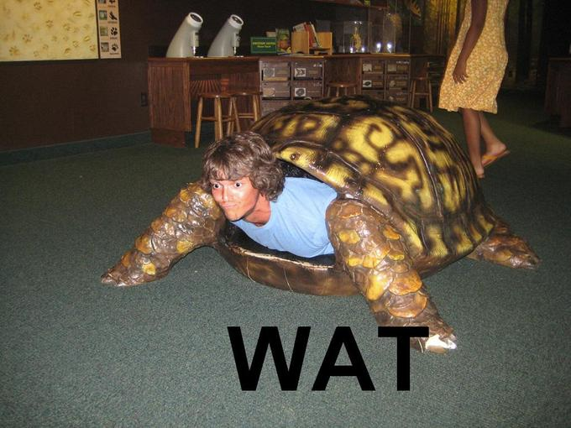

Slide 39
C++
int p
p.~int();
int main() {
using int_ = int;
int_ newInt;
newInt.~int_();
}
Notes:
Top won't compile
The bottom will

Slide 40
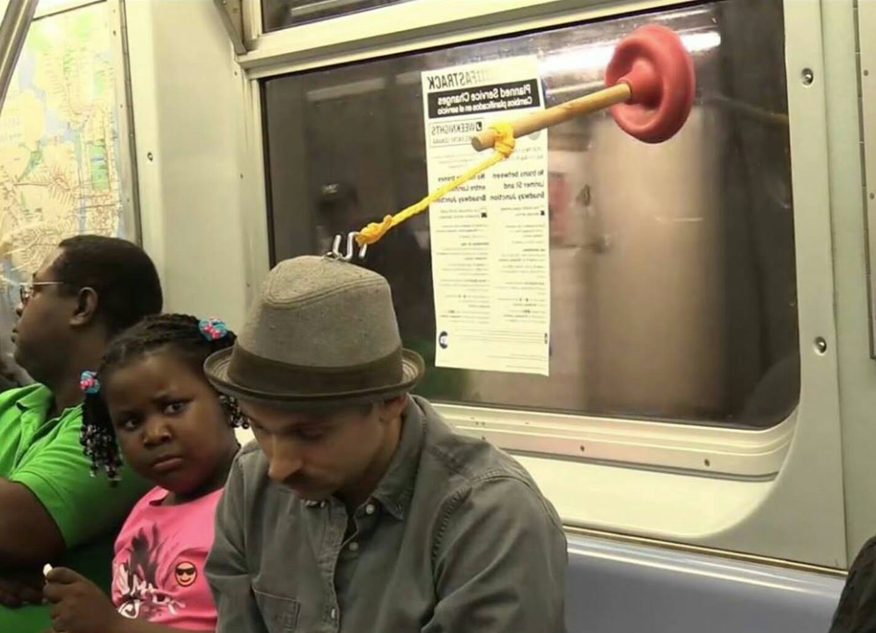

Slide 41
Ok, but really…

Slide 42
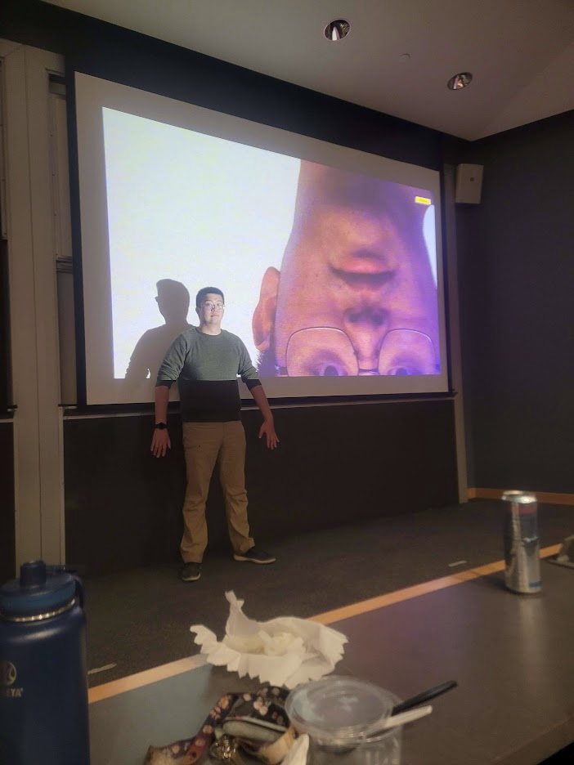
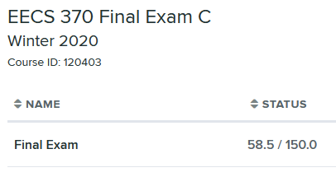
I did actually get a degree in Computer Science, and I now have a real software development job.
I did also get a 4 on the AP CS exam.
Fun fact, I also got Cs on both my Data Structures and Algorithms course, and still graduated!
College is weird like that!
In fact, college is so weird that I once got a 39% on a final exam and still passed the course!
And no, that wasn't a joke.

Slide 43
You may do badly on AP Computer Science, and that's fine.
Computer Science - or any academic field for that matter, don't end on the AP exams.
Everything will be fine.
The experiences you have and the skills you possess are what really matter.
Got any questions? All I have to offer are experience, stories, advice, and hot takes.

