Slide 1
X6493
Examining cultural paradigms through audiovisual encoded information over a high-speed routed network configured for continuous data delivery
MIT ESP Splash! 2012
Frank Chung, Nathan Braginsky

Slide 2
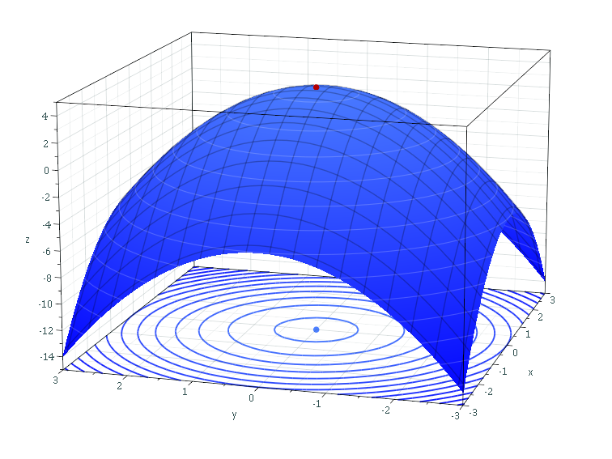
Class logistics
As with any Splash class, feel free to leave at any time
Just do so politely and quietly
To optimize the fun, we will ask for participation in terms of specimen selection
Please inform us of any food
allergies

Slide 3
The Count Censored
Neil Cicierega

Slide 4
In Soviet Russia...

Slide 5
Do you speak English?
BBC

Slide 6
Homeopathic A&E

Slide 7
The new Fuhrer

Slide 8
The Kiss

Slide 10
Cleveland...

Slide 11
Participation
What other videos would you like to share?

Slide 18
