Slide 1
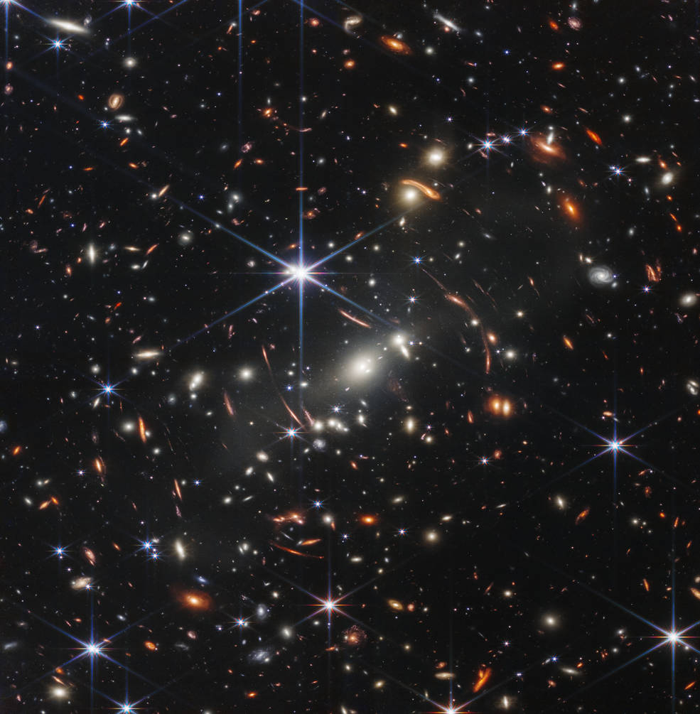
Exoplanets
Hannah Didehbani

Slide 2
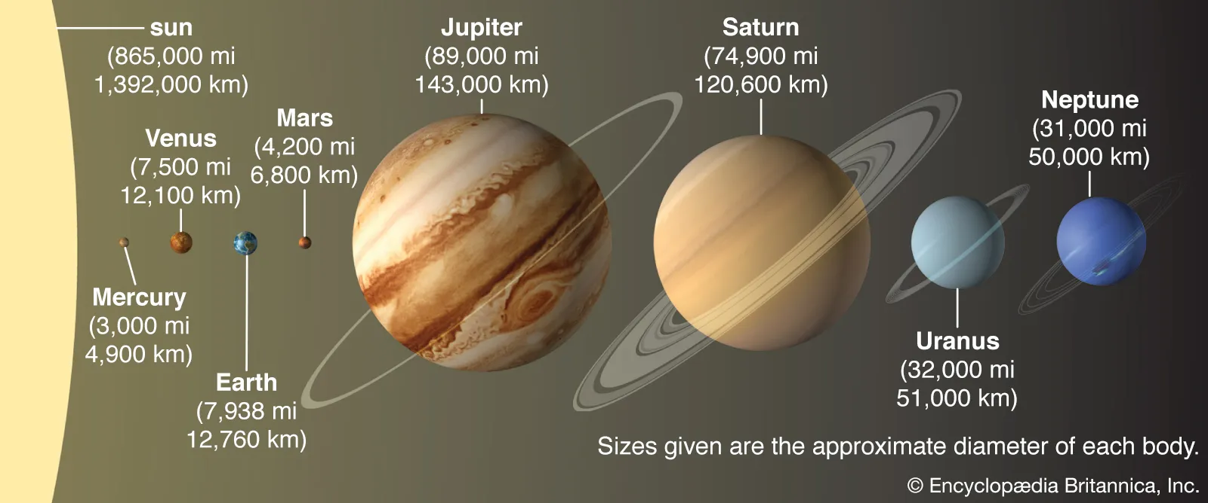
Our Solar System

Slide 3
Exoplanets are planets outside our solar system

Slide 4
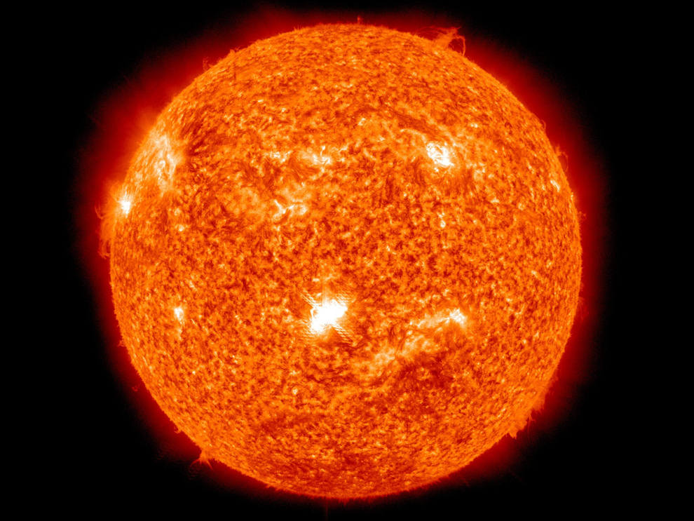
The Solar System has 1 star

Slide 5
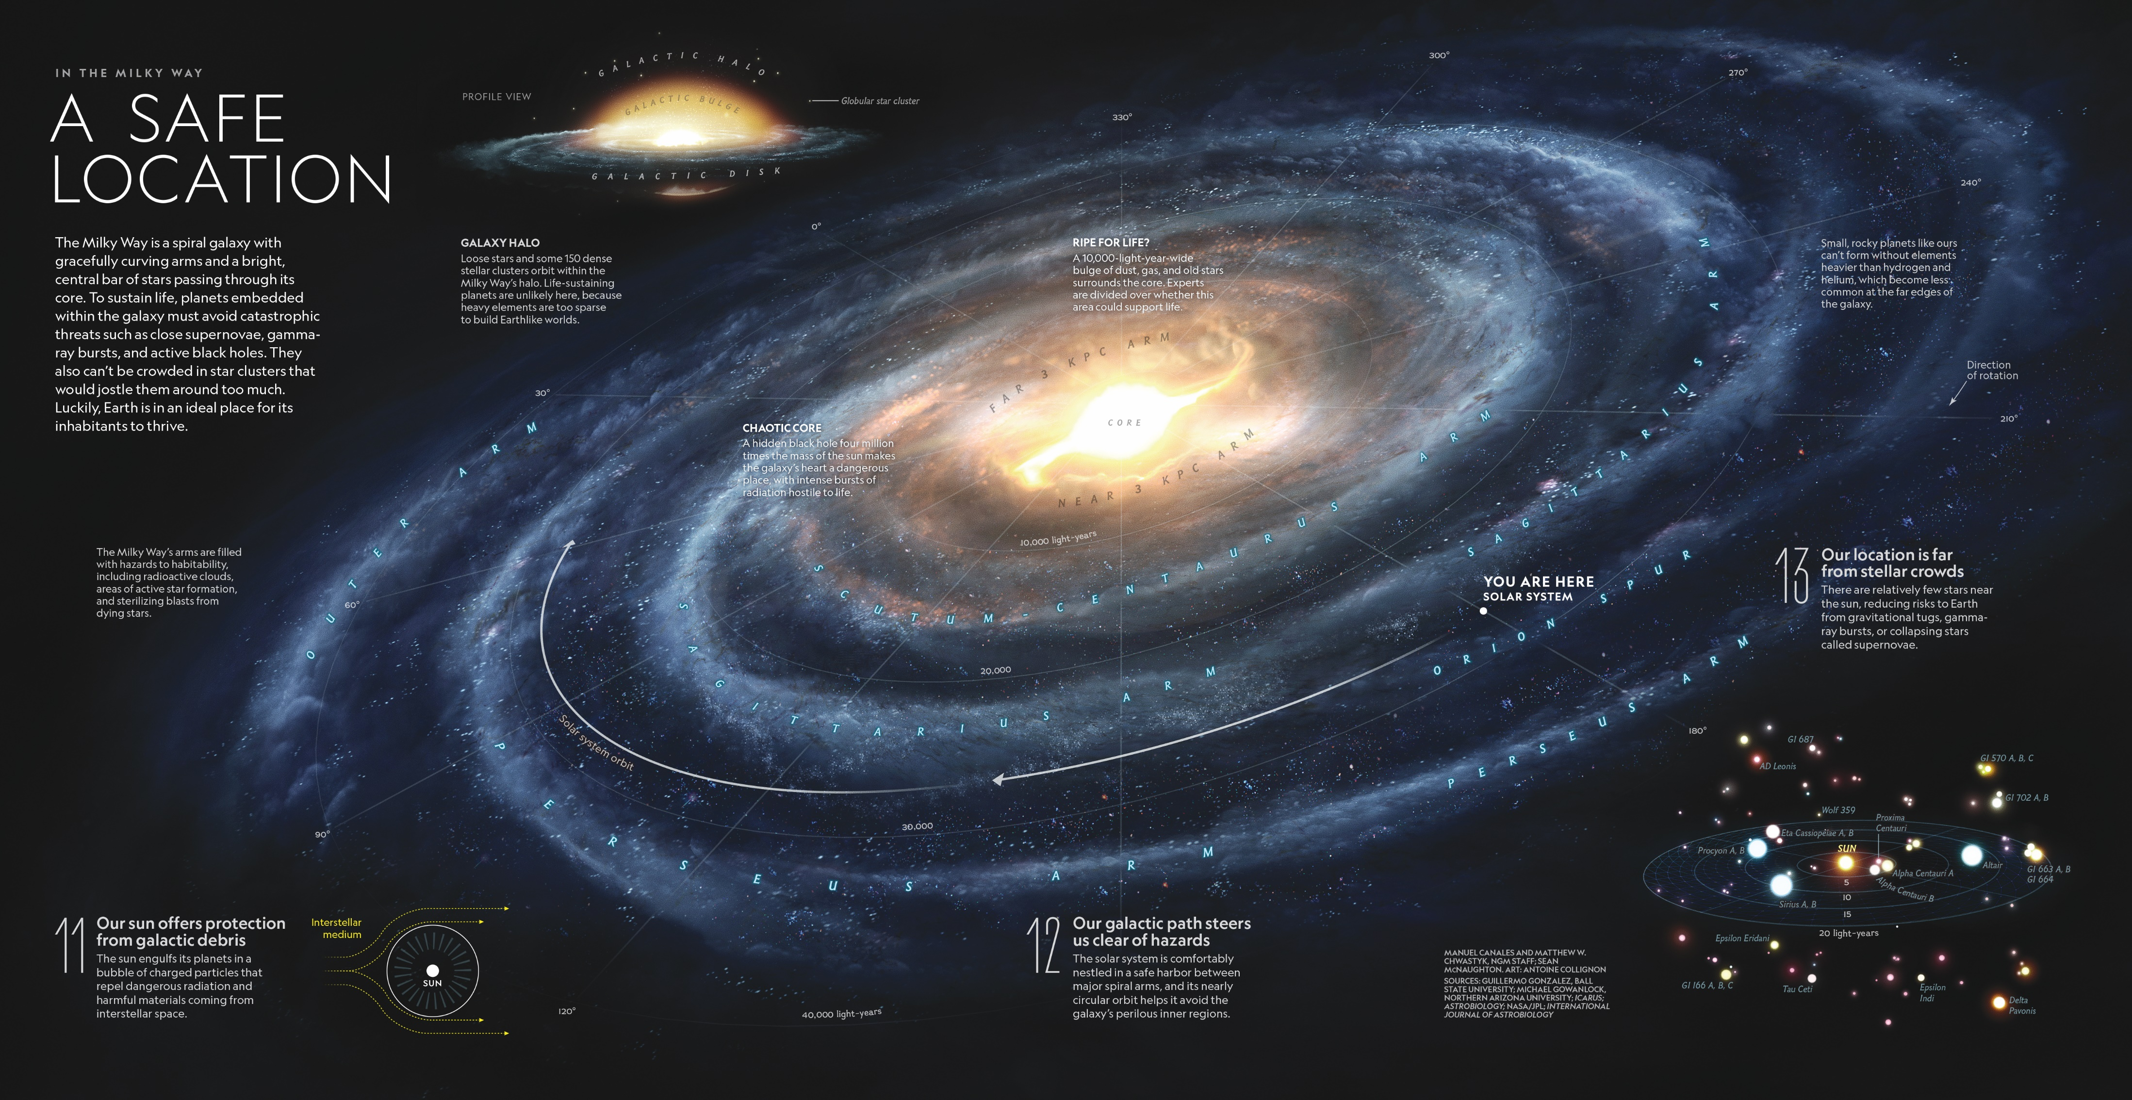
The Milky Way Galaxy has 10¹¹ stars

Slide 6
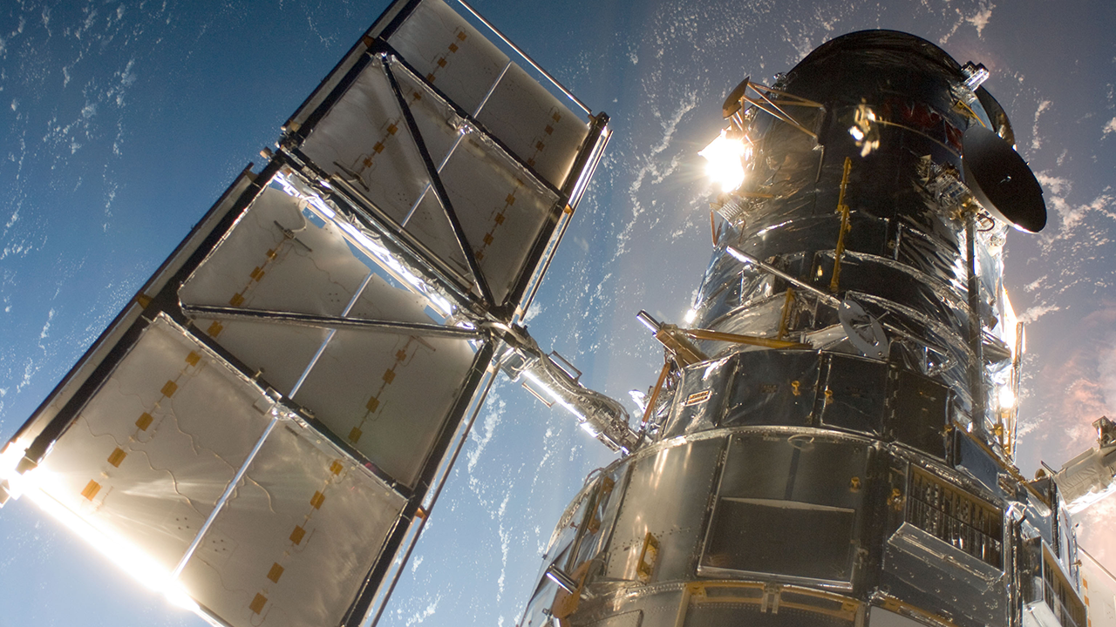
The Hubble Space Telescope estimates 10¹¹ galaxies in the universe – that’s a lot of stars!

Slide 7
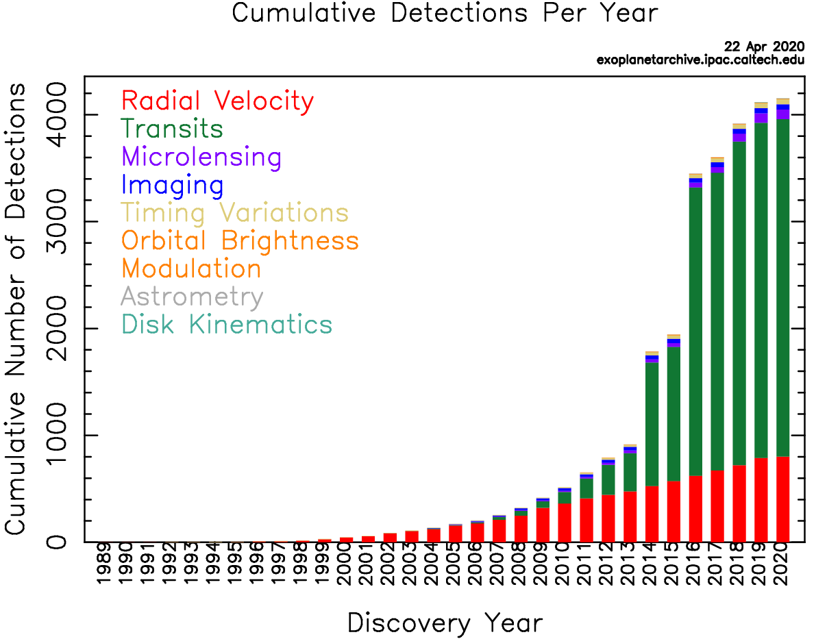
Exoplanet Discoveries Over Time
Most exoplanets we know of were detected indirectly
Only recently did direct imaging of exoplanets become possible

Slide 8
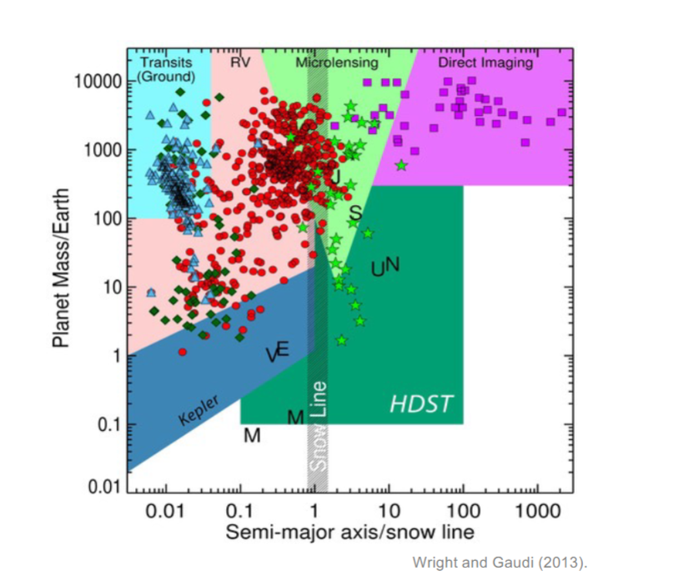
Different Techniques are Biased Towards Finding Certain Planet Sizes

Slide 9
We will focus on Transits and Radial Velocity

Slide 10
Transit Measurements Depend on the Flux of Starlight at the Earth’s Surface
Flux is the word we use to describe the amount of light we receive from a star at the Earth’s surface
Earth

Slide 11
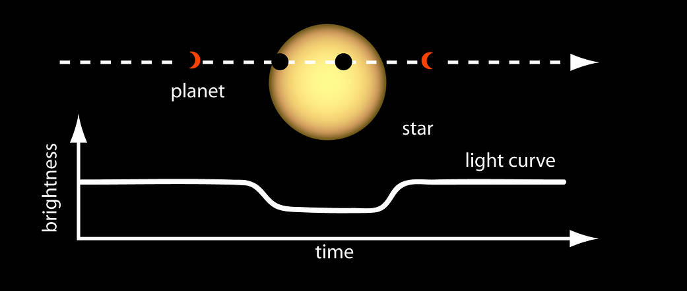
Transits
Transits are when a planet passes in front of its host star in our line of sight
We can detect the light from the star, so we can detect when the planet passes in front

Slide 12
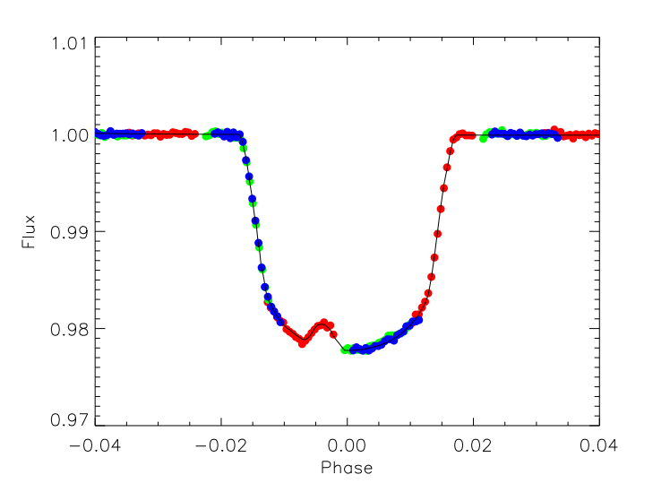
Tres-1
Rabus et al. 2008

Slide 13
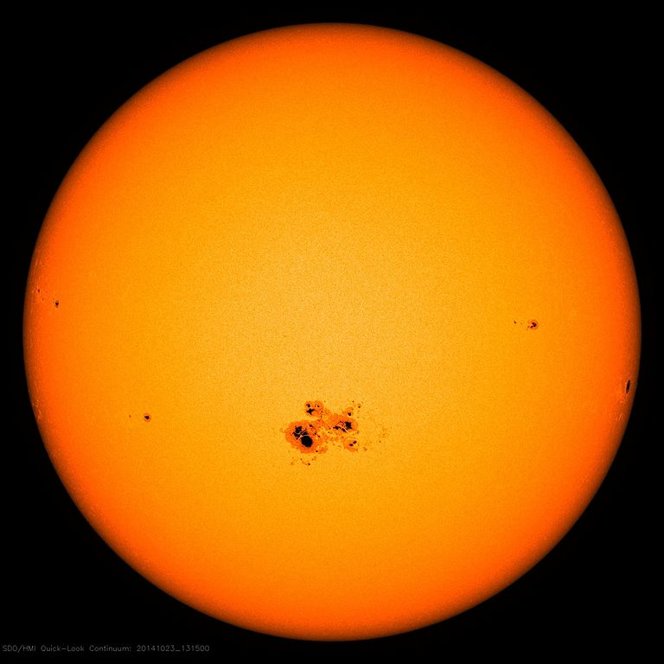
Tres-1 Star Spot
A star spot is darker than the rest of the star

Slide 14
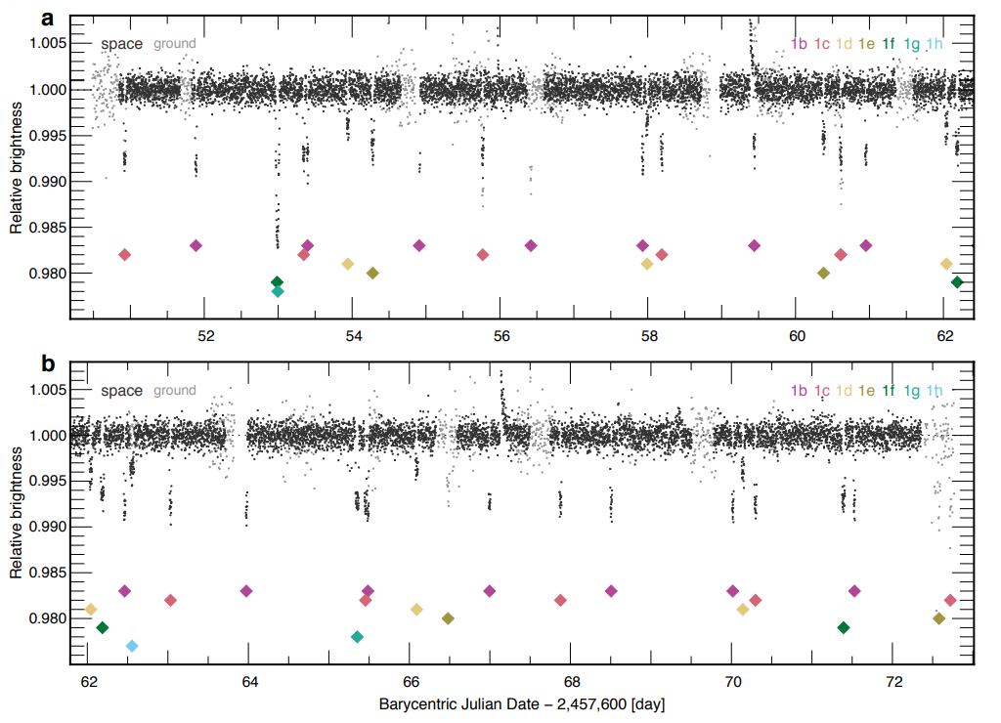
Trappist - 1
Gillon et al. 2017

Slide 15
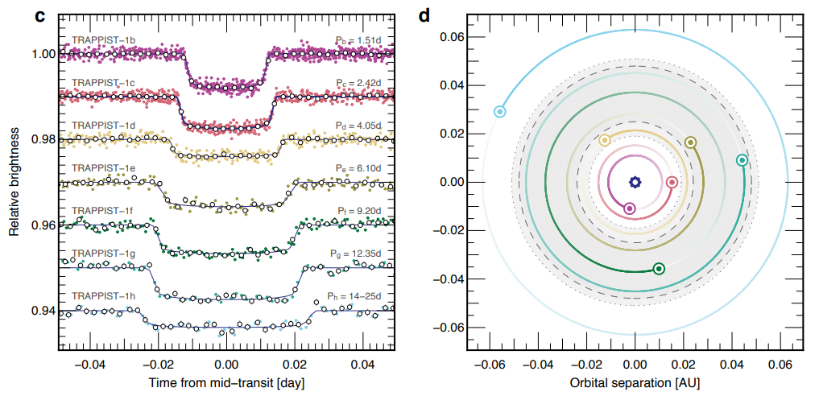
Trappist - 1
Gillon et al. 2017

Slide 16
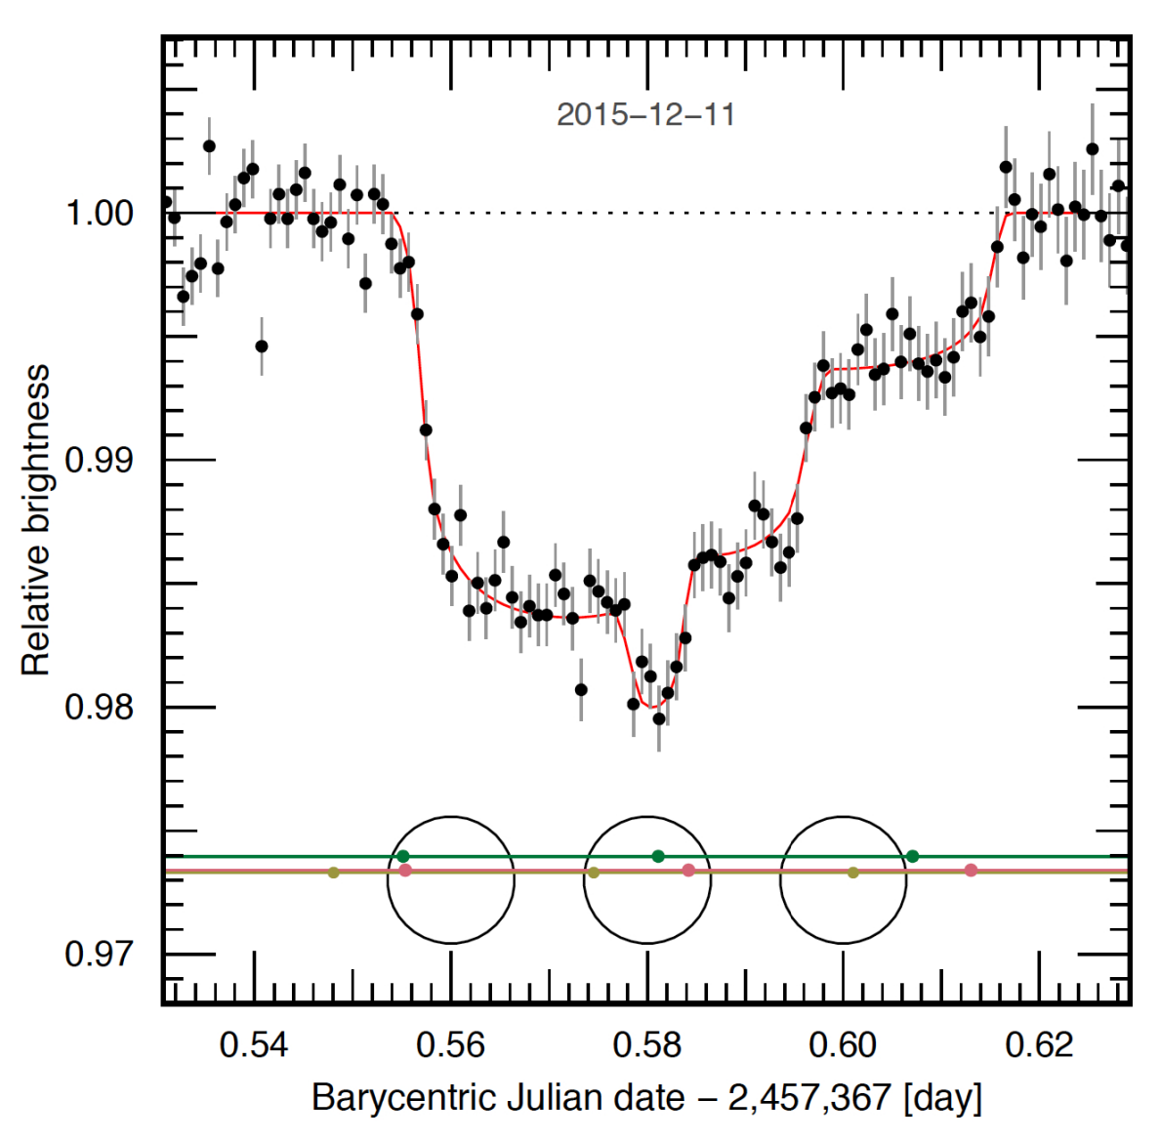
Trappist – 1: Multiple Planets in a Single Transit Curve
Gillon et al. 2017

Slide 17
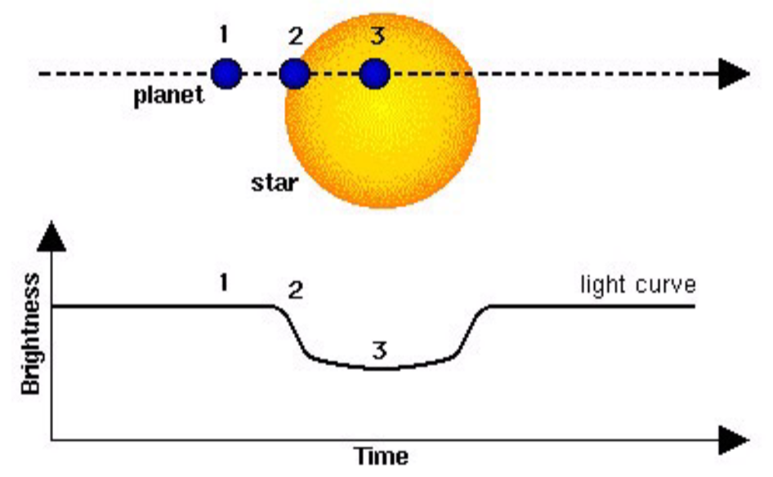
Learning about a Planet from a Transit Curve
Measurable
=
Unknown

Slide 18
Radial Velocity

Slide 19
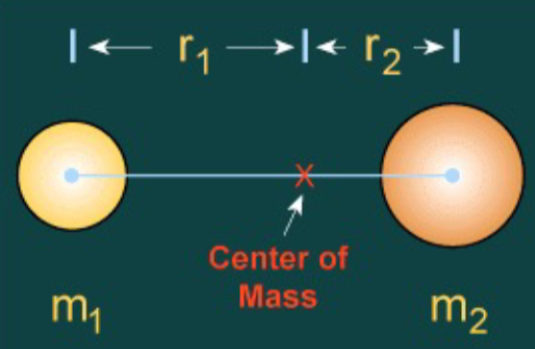
The Planet and Star Orbit the Center of Mass
The radius of the planet is much less than the radius of the star, so the center of mass is very close to the star, sometimes in the star

Slide 20
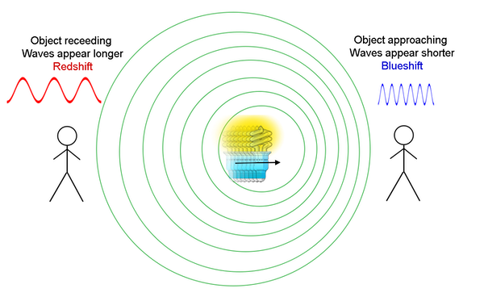
Doppler Shift

Slide 21
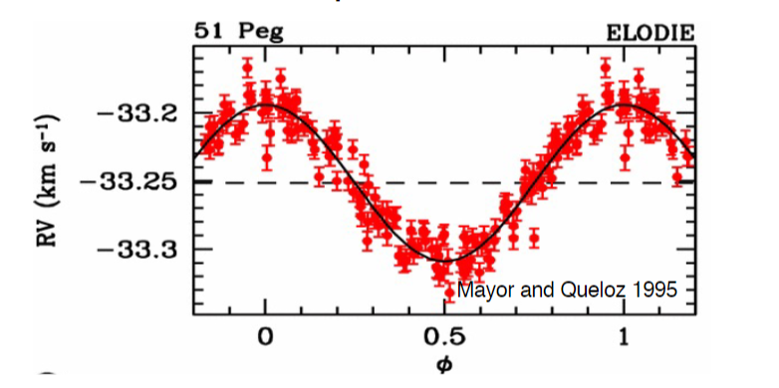
51 Peg
This star moves about 10m/s

Slide 22
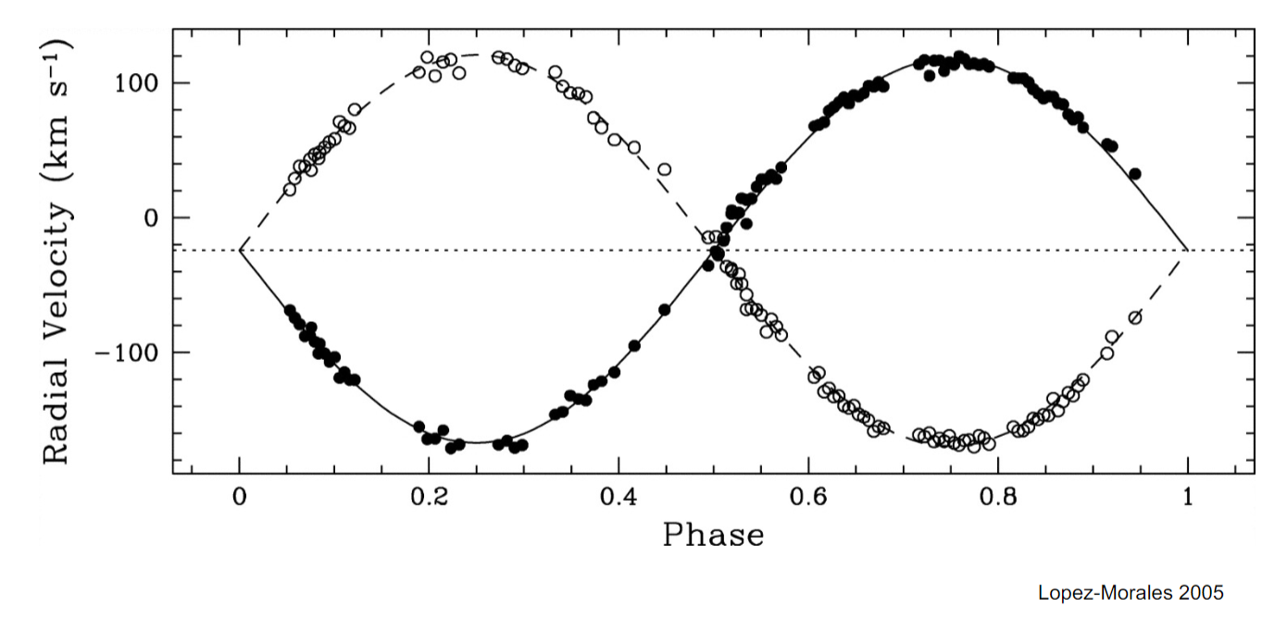
A strange y-axis

Slide 23
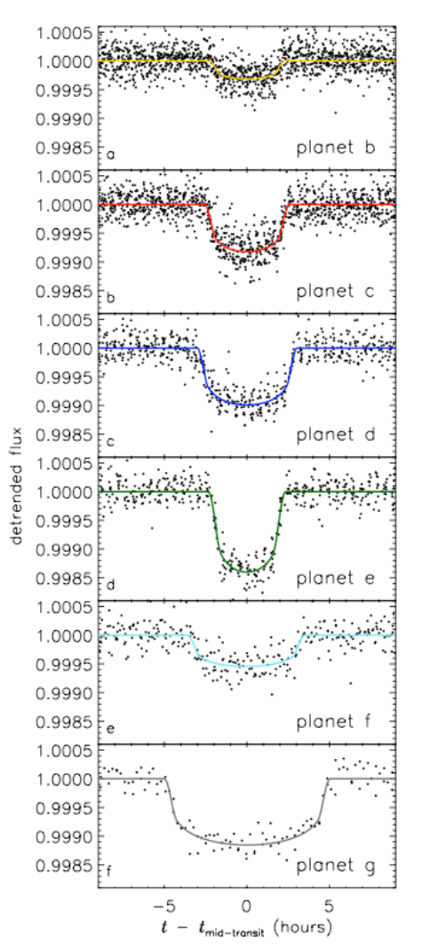
Which planet has the largest radius?

Slide 24
What is the drop in brightness from the star due to the planet?
a) 0.98
b) 0.02
c) 0.001
d) 0.99

Slide 25
Citations
https://exoplanets.nasa.gov/faq/31/whats-a-transit/ (Exoplanet Discoveries Over Time)
https://education.nationalgeographic.org/resource/safe-location (The Milky Way has 10¹¹ stars)
https://education.nationalgeographic.org/resource/sun (The Solar System has 1 Star)
https://www.space.com/25303-how-many-galaxies-are-in-the-universe.html (The Hubble Space Telescope)
https://hubblesite.org/contents/media/images/2021/035/01F8AHYJK6SPN9KT4JETB8XK1X?Topic=103-exoplanets&Topic=109-the-telescope (The Hubble Space Telescope)
https://www.nasa.gov/mission_pages/kepler/multimedia/images/transit-light-curve.html (Transits)
https://arxiv.org/ftp/arxiv/papers/1703/1703.01424.pdf ( Trappist -1)
https://spaceplace.nasa.gov/galaxy/en/ (title slide)
https://arxiv.org/pdf/0812.1799.pdf (Tres-1)
https://astronomy.com/news/2018/01/counting-starspots (Tres-1 Star Spot)

