Slide 1
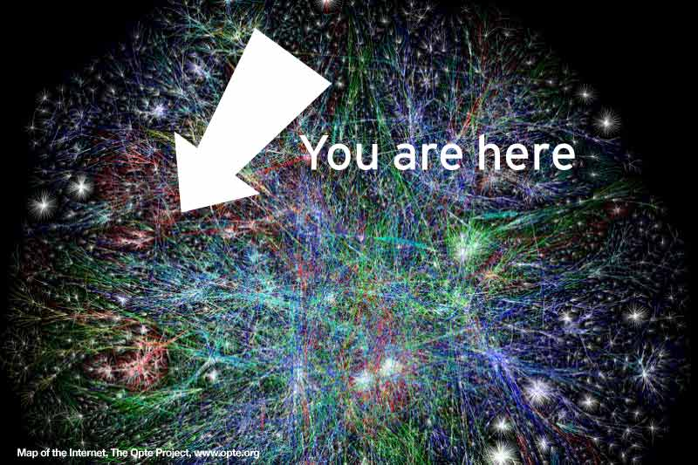
What the Heck is the Internet?
SPLASH 2012
Change Between Static and Animated You can change between static and animated layouts by clicking on the Layout tab in the HOME menu on the ribbon.
Notes:
Alternate cover page

Slide 2
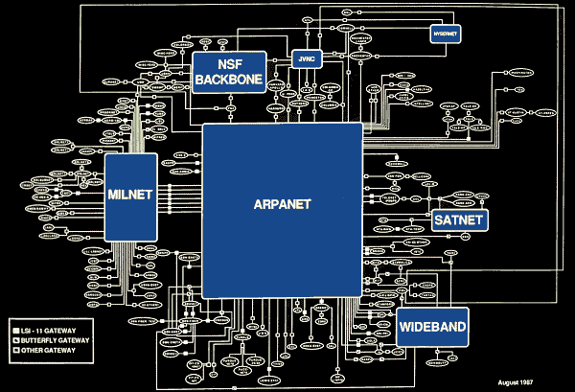
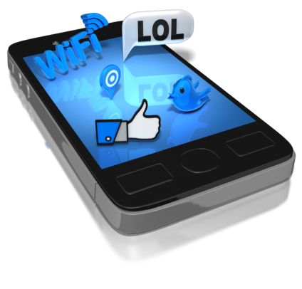
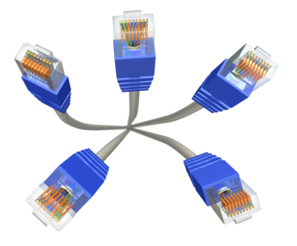
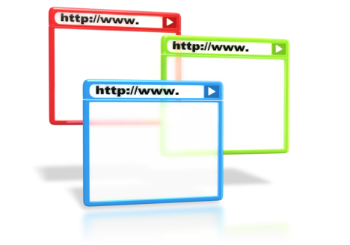
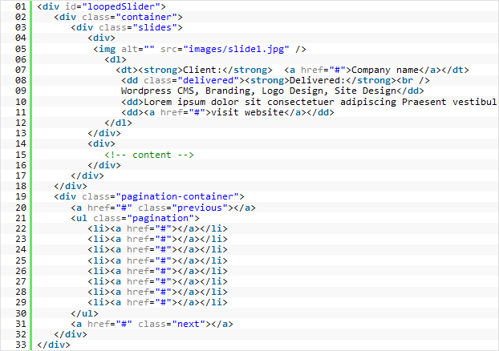
Course Agenda
History of the Internet & Internet Culture
What the Internet is Made Up Of (Hardware)
Programming the Internet (Software)

Slide 3
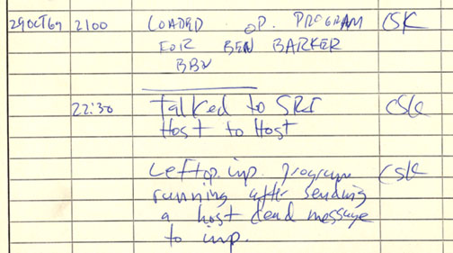
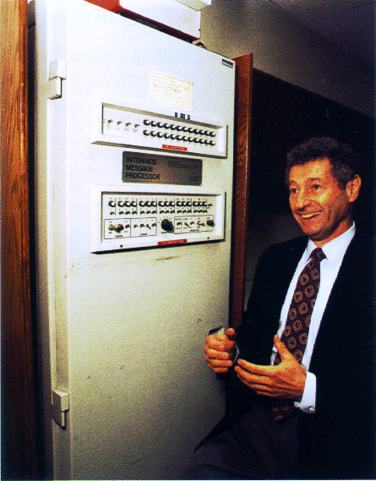
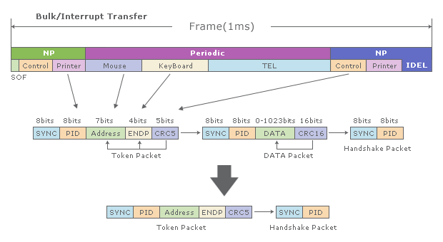
History of the Internet
First ARPANET message ever sent: 10:30 pm, 29 October 1969.
Leonard Kleinrock and his Interface Messaging Processor (ICM). ICMs were computers that served as the first interconnections between the Internet.
Packet switching gave rise to advanced technologies during the birth of the Internet
Notes:
5 minutes

Slide 4
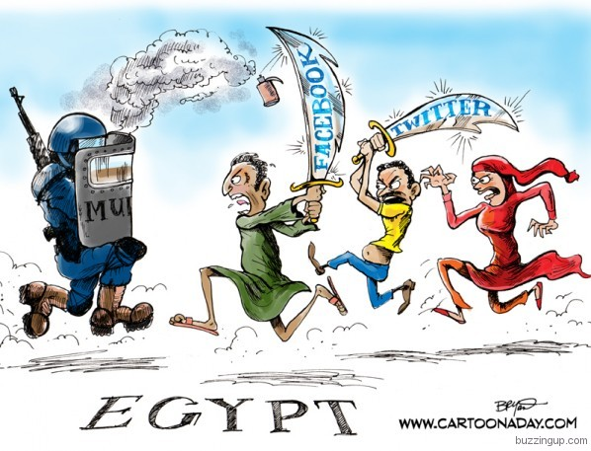
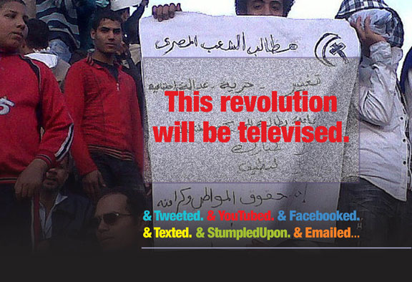
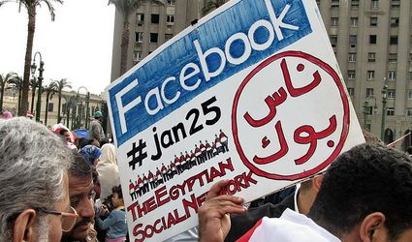
Internet Culture & It’s Impact
Change Between Static and Animated You can change between static and animated layouts by clicking on the Layout tab in the HOME menu on the ribbon.
Notes:
Censorship: SOPA/ACTA
Arab Uprising – Egyptian uprising
Cultural
-FB has changed what it means to be a friend

Slide 5
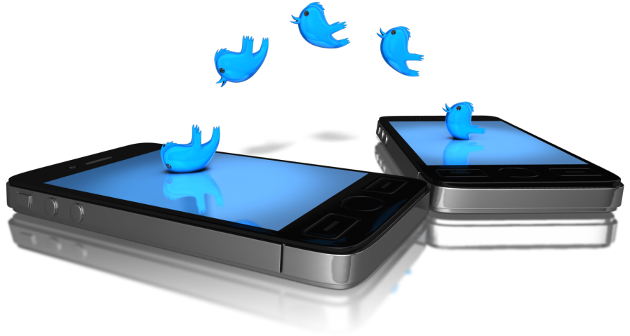
Internet Culture & It’s Impact
Change Between Static and Animated You can change between static and animated layouts by clicking on the Layout tab in the HOME menu on the ribbon.
Notes:
Censorship: SOPA/ACTA
Arab Uprising – Egyptian uprising
Cultural
-FB has changed what it means to be a friend

Slide 6
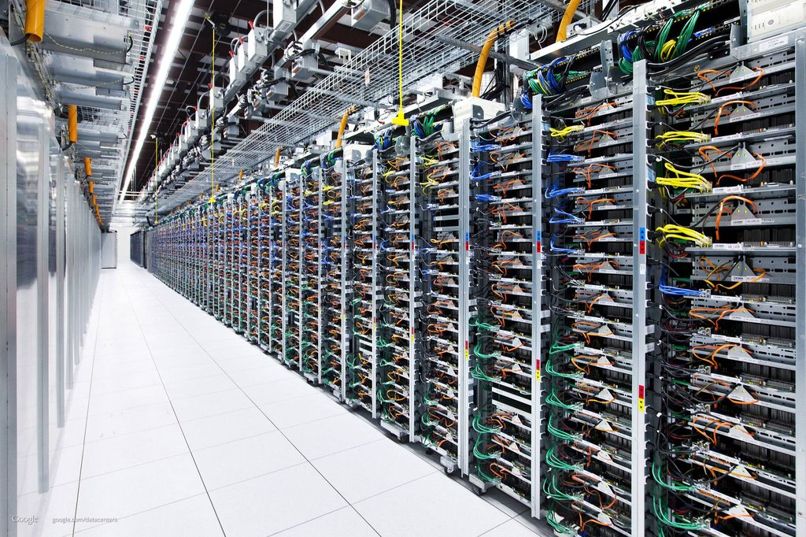
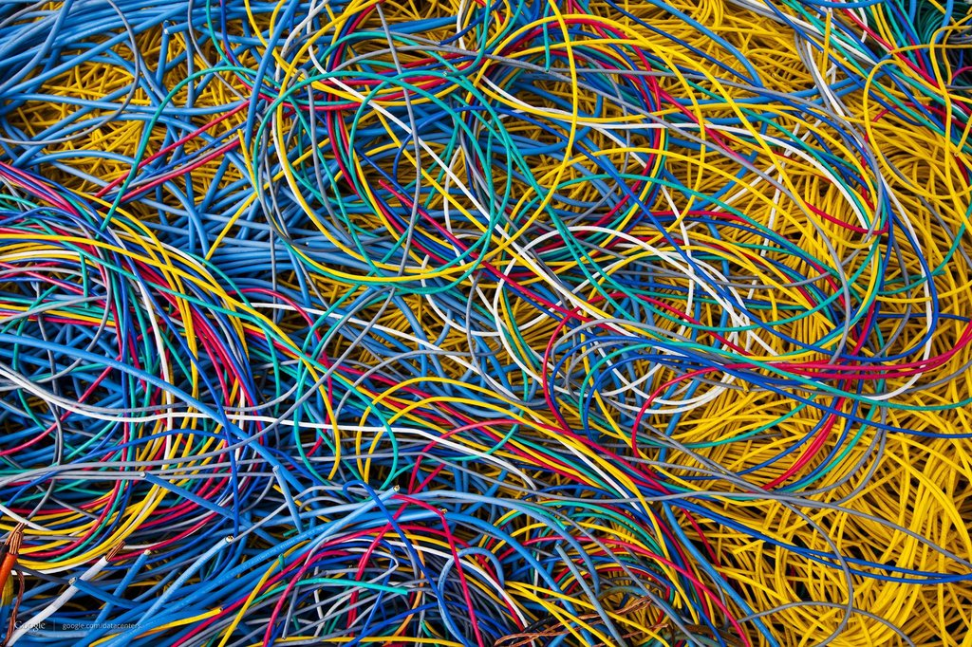
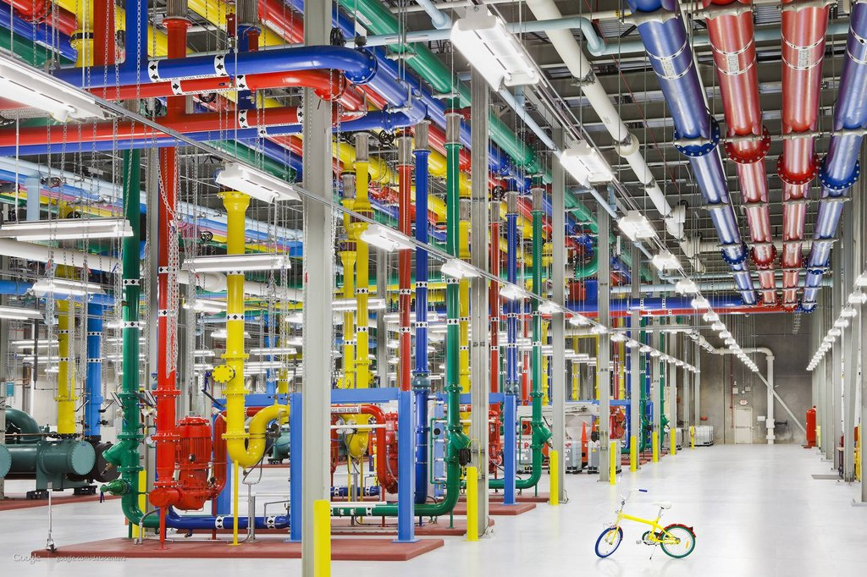
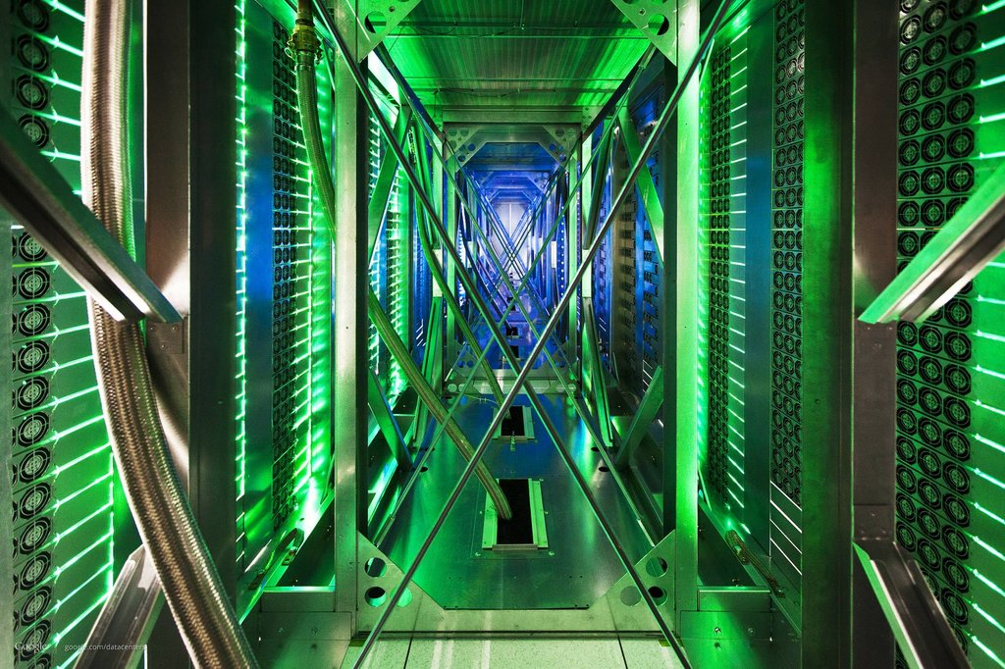
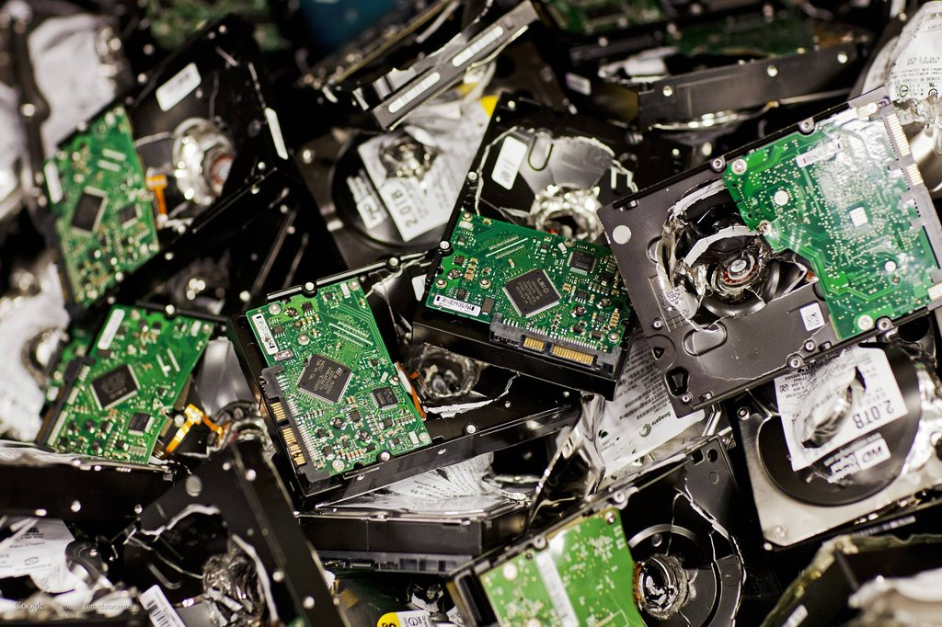
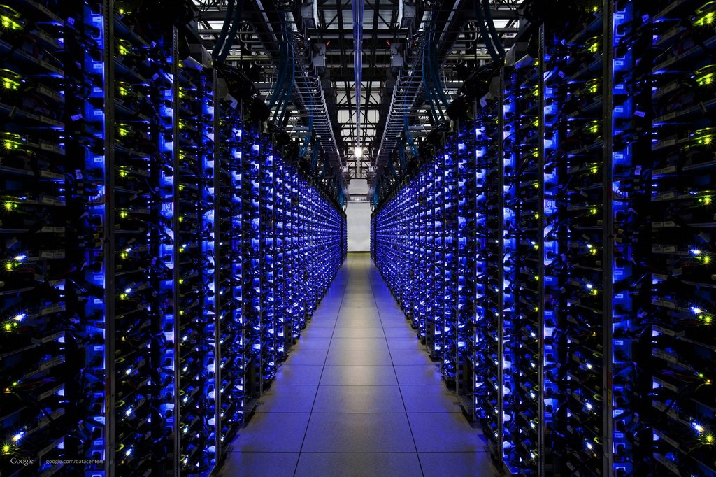
Where the Internet Lives
Notes:
Censorship: SOPA/ACTA
Arab Uprising – Egyptian uprising
Cultural
-FB has changed what it means to be a friend

Slide 7
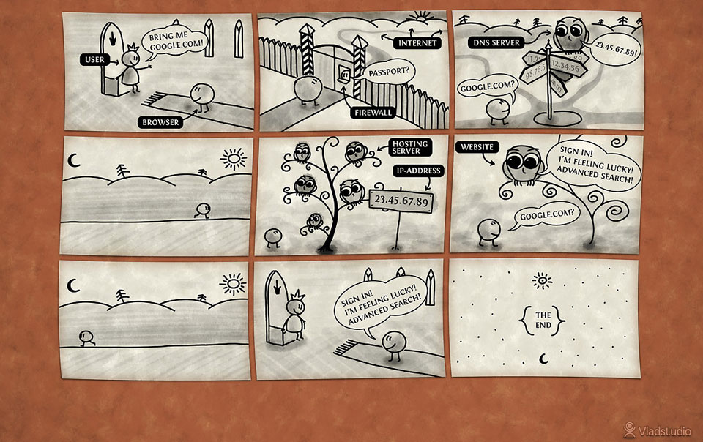
What the Internet is Made Up Of (Hardware)
Change Between Static and Animated You can change between static and animated layouts by clicking on the Layout tab in the HOME menu on the ribbon.

Slide 8
Programming the Web (Software)
Change Between Static and Animated You can change between static and animated layouts by clicking on the Layout tab in the HOME menu on the ribbon.

Slide 9
A Final Note

Slide 10
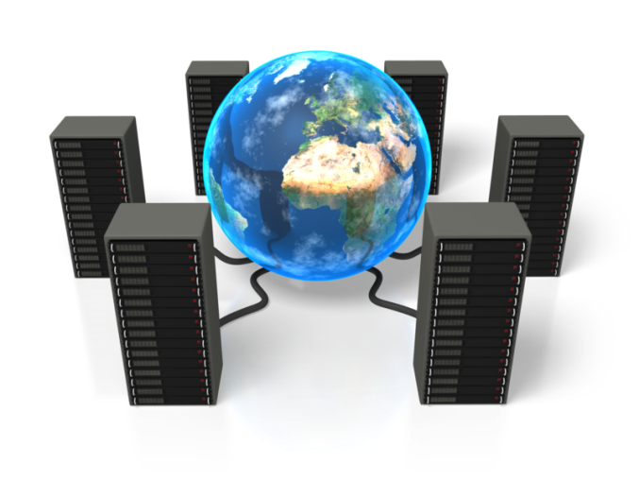
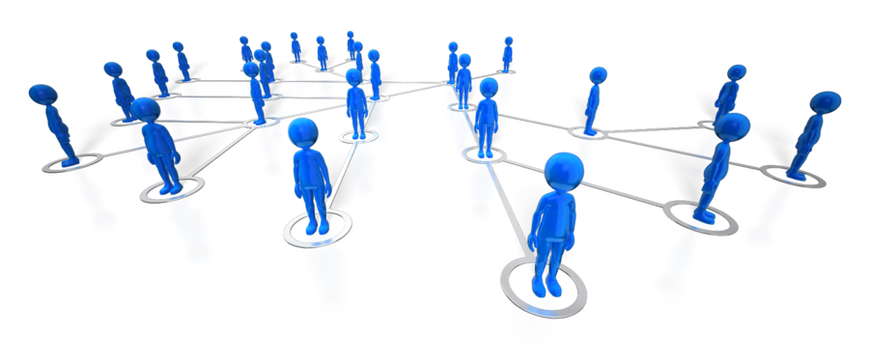
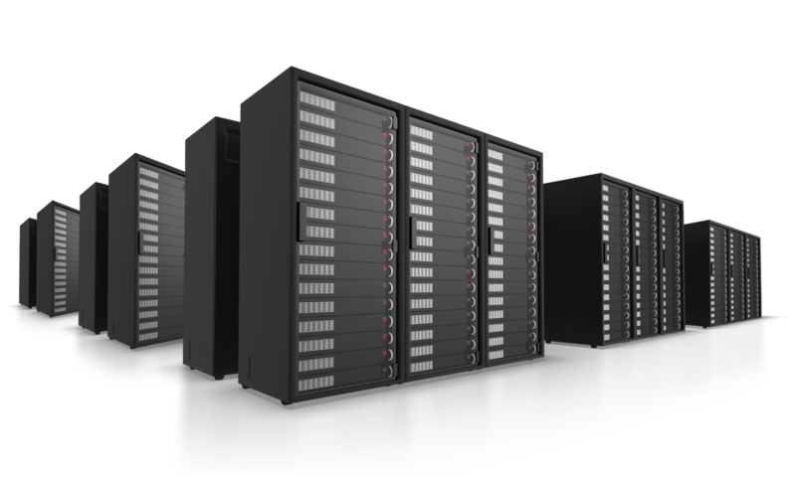
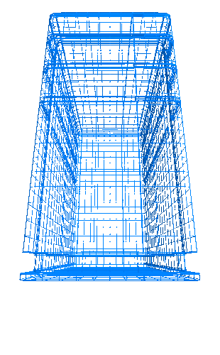
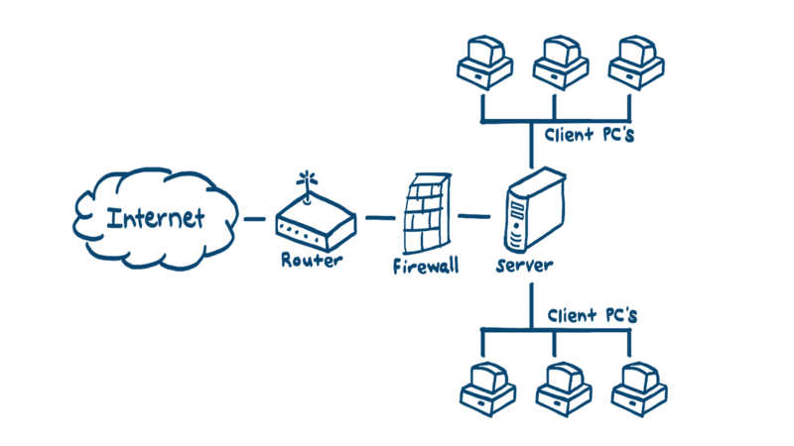
Useful Clipart and Images

