Slide 1
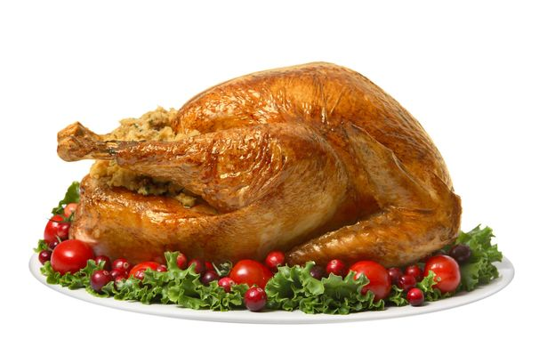
M13306: Introduction to diffusion and random walk: Thanksgiving special
Joey Gu, Pedro de Souza
What do you think the answer is? Use your intuition!
Suppose it takes 3 hours to cook a small turkey. How long would it take to cook a turkey that is 50% bigger in size?
< 4.5 hours
≈ 4.5 hours
(50% more time)
> 4.5 hours
Cooking time:
3 hours
Cooking time:
? hours

Slide 3




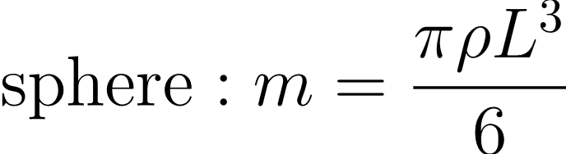

Mass scales as length cubed

Slide 4



Turkey roasting data
m (lbs) | L (some unit) | t (hours)
7 | 1.91 | 2.75
10 | 2.15 | 3.5
14 | 2.41 | 4.5
18 | 2.62 | 5.25
22 | 2.80 | 5.75
L | t
1.9 | 2.8
2.2 | 3.5
2.4 | 4.5
2.6 | 5.3
2.8 | 5.8
L² | t
3.7 | 2.8
4.6 | 3.5
5.8 | 4.5
6.9 | 5.3
7.9 | 5.8
How does cooking time scale with length?
Two hypotheses:
We can plot the data!

Slide 5
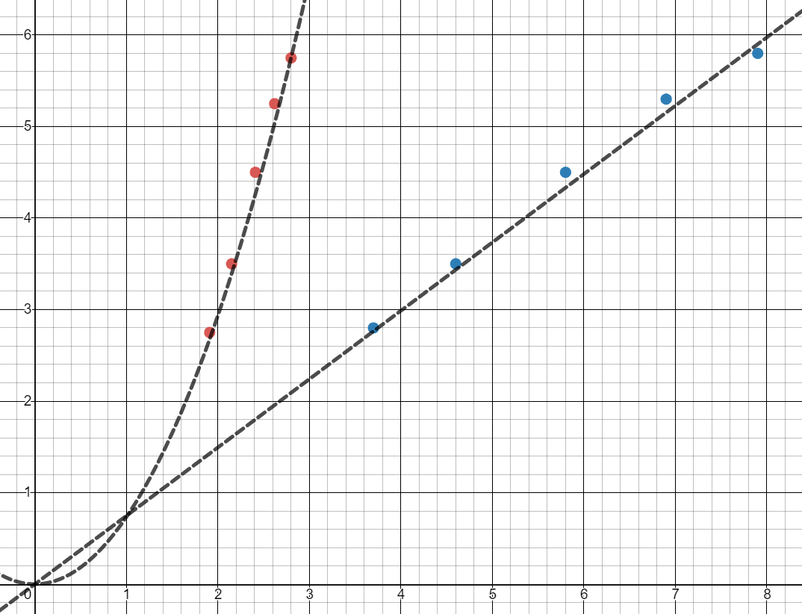
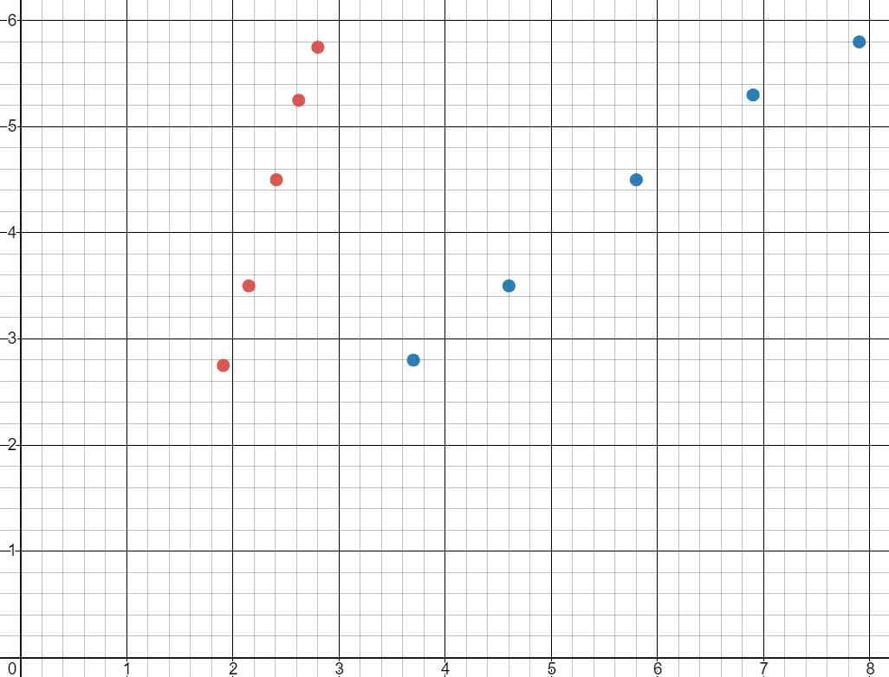


Conclusion:
cooking time scales as

Slide 6
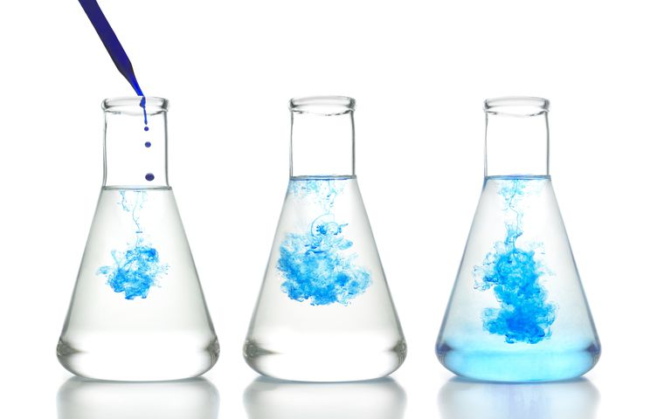
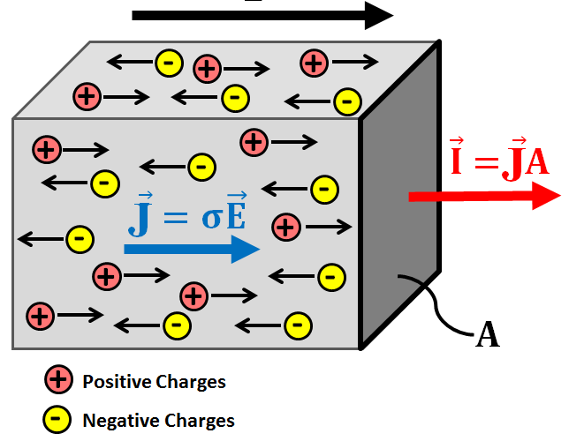
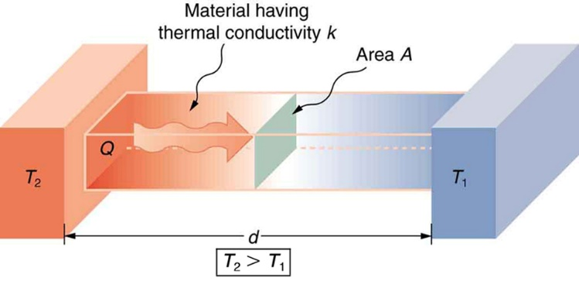
Diffusion: spreading from regions of high concentration to regions of low concentration
(movie removed due to size constraint)
Chemical species
Heat conduction
Electrical conduction

Slide 7
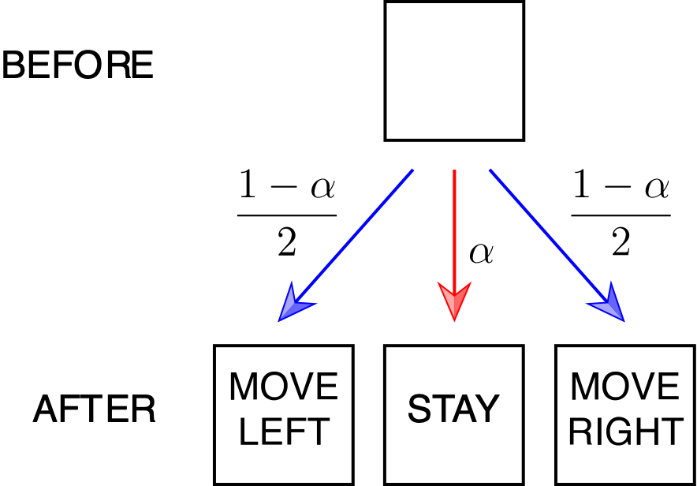
Random walk

Slide 8
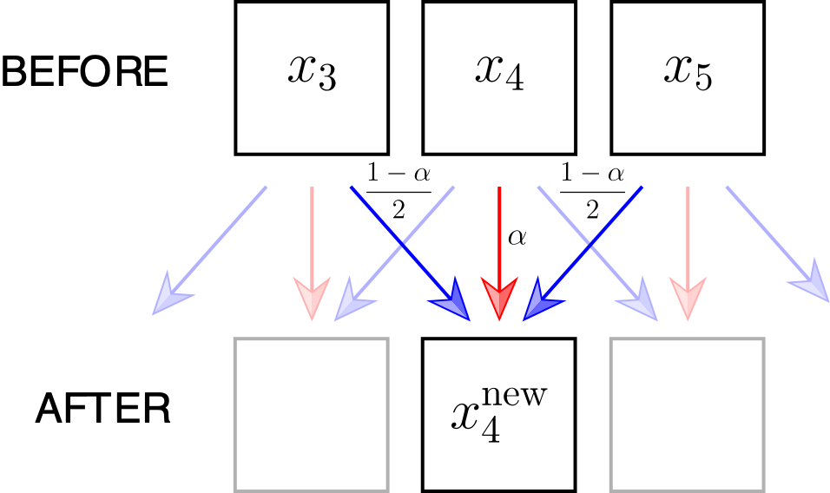
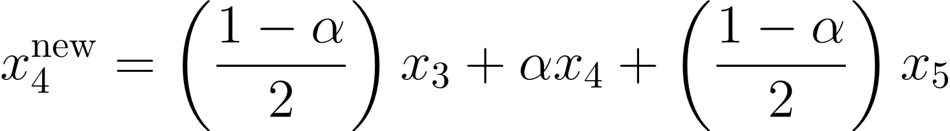
Random walk
Let’s try this out in an Excel spreadsheet!

Slide 9

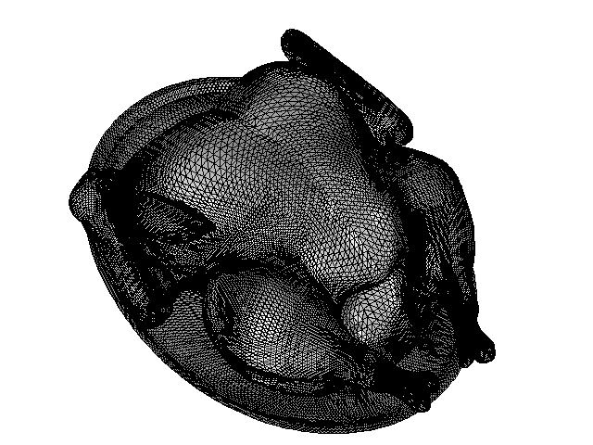



Example 1: Simulations of different sized turkeys
How long will it take for each turkey to reach the designated temperature of ?
Small
Medium
Large

Slide 10
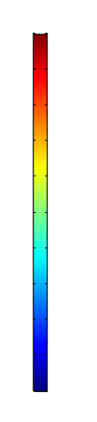



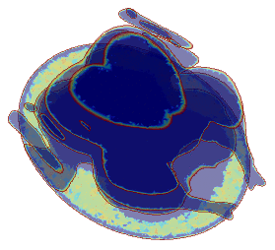
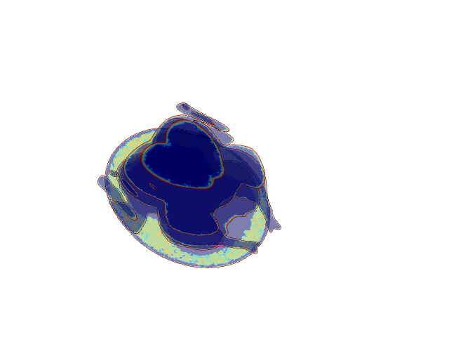
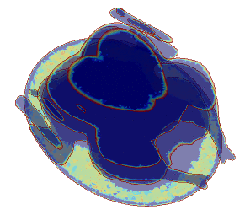

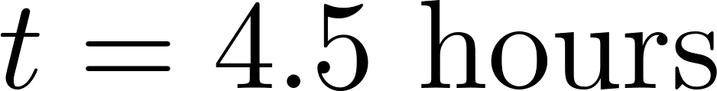
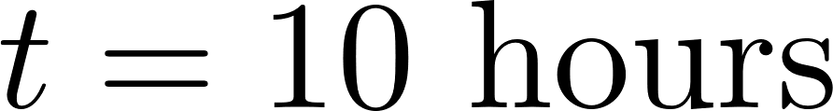
Example 1: Simulations of different sized turkeys
Small
Medium
Large

Slide 11
Example 1: Simulations of different sized turkeys

Slide 12
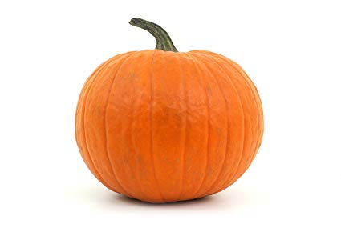
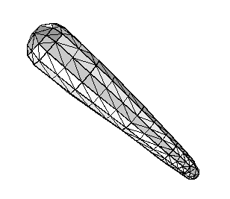
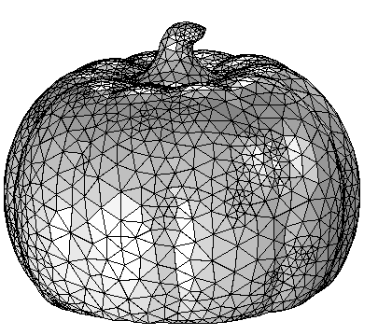
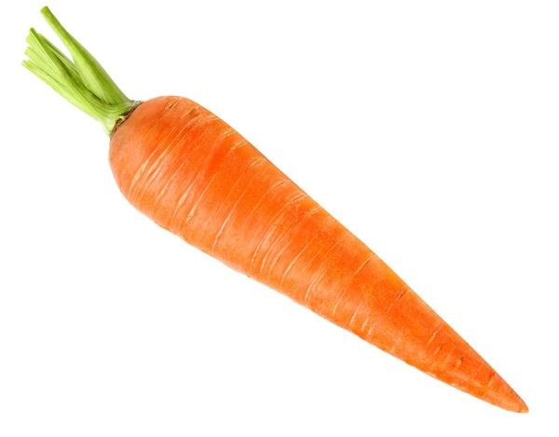
Example 2: Pumpkin versus Carrot
Pumpkin
Carrot
If we have a pumpkin and a carrot of the same mass, which one would be quicker to cook?

Slide 13
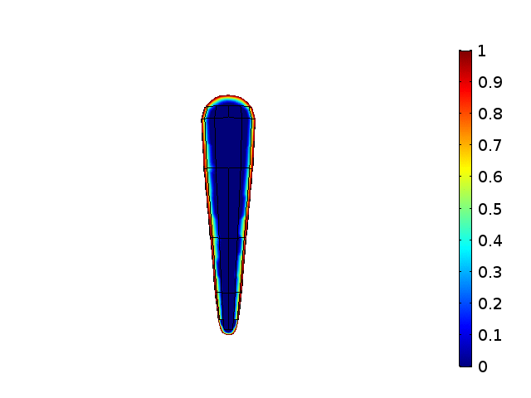
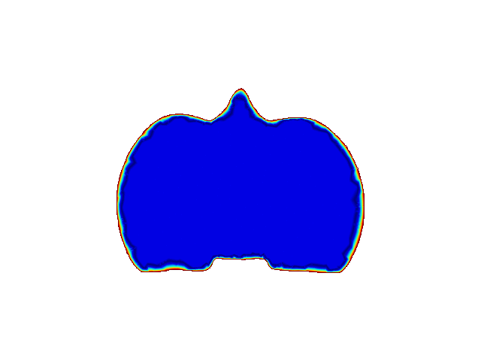




Example 2: Pumpkin versus Carrot
Time to Finish Cooking:
Food for thought: How can we define a characteristic length scale for diffusion of heat into a complicated vegetable shape?

Slide 14
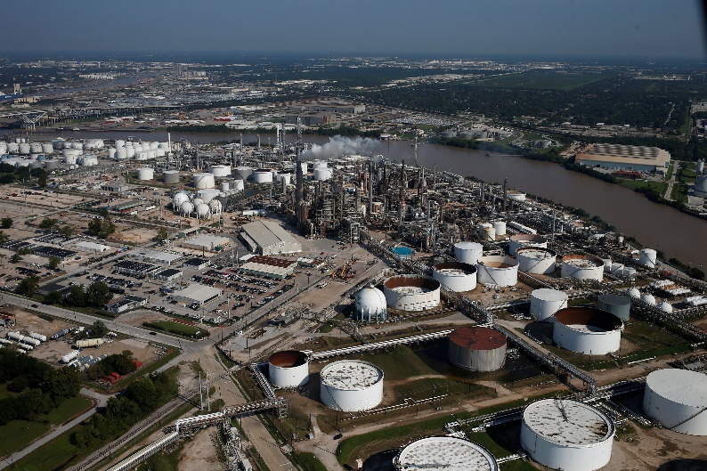
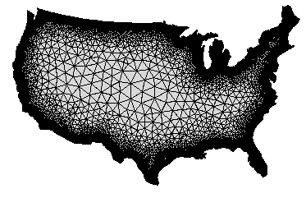
Example 3: Pollution from a chemical plant
A chemical plant in Houston is releasing a toxic chemical after an accident at the plant.
If the pollution is measured after 1 day in Denver, approximately how long will it take for the pollution to reach Boston?
BOSTON, ~1600 Miles
DENVER, ~800 Miles
HOUSTON

Slide 15
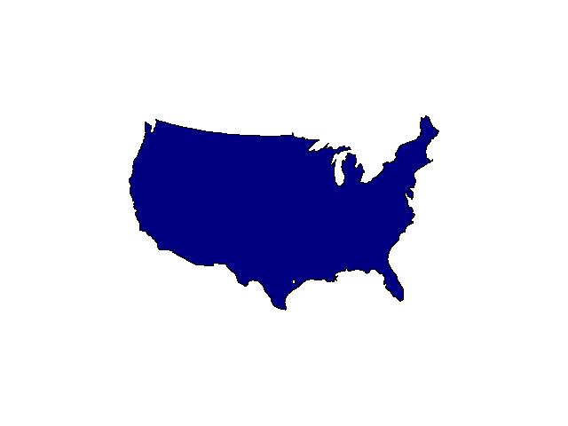
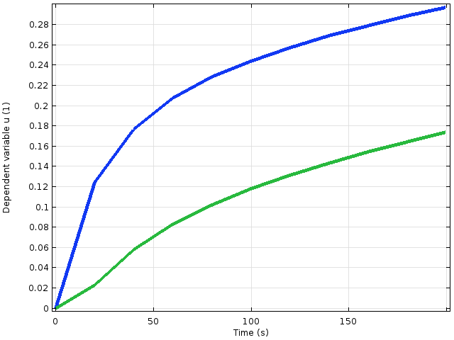



Example 3: Pollution from a chemical plant
Concentration of Pollutant
Concentration of Pollutant in Denver
Concentration of Pollutant in Boston
BOSTON
DENVER
Measureable Level
25 hrs
108 hrs
HOUSTON
Concentration of Pollutant

