Slide 1
Dreams, Dreaming and the Subconscious

Slide 2
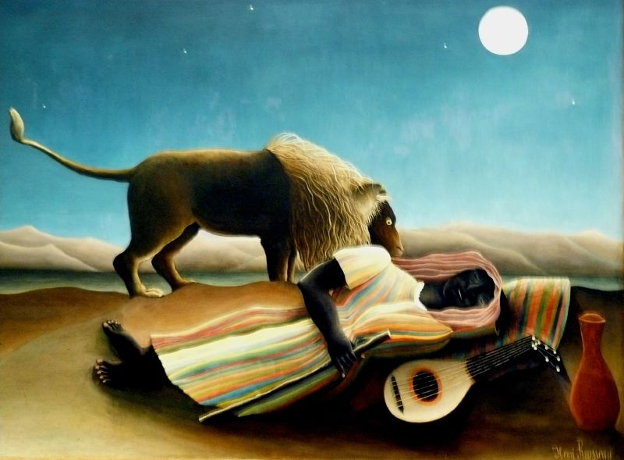

Slide 3
individuation
http://psychology.about.com/od/sensationandperception/ig/Optical-Illusions/spinning-dancer-illusion.htmgif

Slide 4
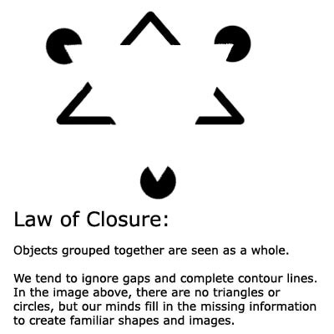
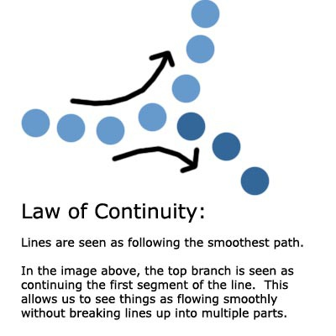
Confabulation: Psychology To fill in gaps in one's memory with fabrications that one believes to be facts.
Gestalt Laws of Perceptual Organization
Our brains often ignore contradictory information and fill in gaps in information.

Slide 5
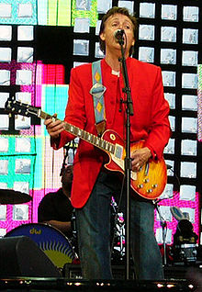
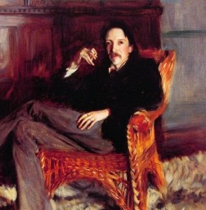

Slide 6
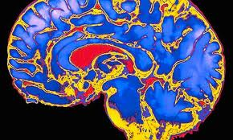
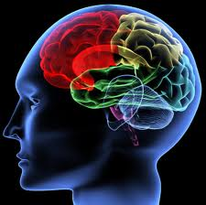
The brain is the “most extraordinary and complex creation in the universe.
Home to your mind and personality, your brain houses your cherished memories and future hopes.
It orchestrates the symphony of consciousness that gives you purpose and passion, motion and emotion.”
Franklin Institute
Notes:
http://www.quantumconsciousness.org/presentations/whatisconsciousness.html

Slide 7
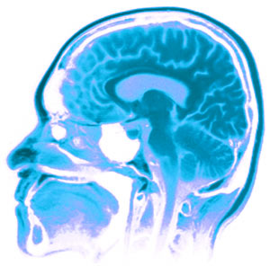
The Three Pound Universe
Franklin Institute, Center for Innovation in Science :
a thinking organ
learns and grows by interacting with the world
learns by perception and action.
Mental stimulation improves brain function
The human brain is able to continually adapt
Can rewire itself
-can grow new neurons.
-use it or lose it.

Slide 8
Minds, Brain, and Machine
Both:
Both use electrical pulses
Can communicate
Transmit information
Have memory that grows and can be expanded, supplemented
Adapt and learn
Evolve with time
Need Energy
Can be Damaged
Change and can be modified
Speak
What about thinking?

Slide 9
Coma means deep sleep-
but is it deep sleep?

Slide 11
If a tree falls in your dream, why does it make a sound?

Slide 12
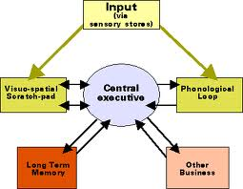
Memory
3 systems:
Short term
Long term
Sensory
Working Memory
Central Executive, Prefrontal lateral cortex (PFC)
Some of these memories are never in dreams- can you guess why??

Slide 13
Memory
3 systems:
Short term- active memory
7 things
7 seconds
Sensory- from senses
Long term- stored memory
Explicit (declarative)
Implicit (procedural)
Working Memory and the Central Executive
Some of these memories are never in dreams
can you guess why??
Long term memory
Declarative memory includes semantics

Slide 14
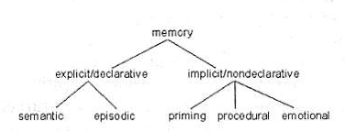
EXPLICIT MEMORY:
Episodic (long-term)
Specific
Autobiographical
Emotional
Includes flashbulb memory
Semantic (long term)
General knowledge
Not unique to individual

Slide 15
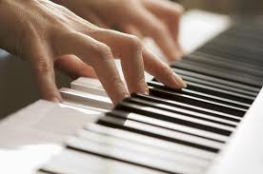
Long Term: IMPLICIT MEMORY
Procedural (long term)
Automatic sensorimotor behavior
(walking, playing a guitar, shooting baskets)
Emotional (love, fear)
Unconscious
Automatic
Muscle memory (how to hold a knife)
How deep and how vast is our mind? Is that what dreams are?
Clive Waring: http://www.youtube.com/watch?v=Vwigmktix2Y

Slide 16
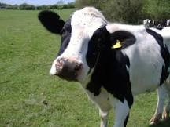
Dreams include memories
Episodic Memory
Memories which are actually perceived and known; Specific
Autobiographical
Emotional, such as love, fear
Includes flashbulb memory
Procedural memory
Procedural is the steps to doing something, or learning to do it
Procedural memory includes muscle memory (how to play piano)
Semantics
general knowledge, NOT unique to individual
symbols and meanings that the symbol emotes
long term memory and implicit
Perceptual memory
Conceptual memory
Abstract
Notes:
1. Episodic
Memories which are actually perceived and known;
For Ex: An actual memory of riding your bike to school
the day you almost got hit by a car. A distinct memory/event
2. Procedural memory
Procedural is the steps to doing something, or learning to do it; Learning How to ride a bike
3. Semantics
Semantics are long term memory;
it is the symbols and meanings that the symbol emotes (with a feeling), or connects in general to something, but not an actual specific experience or a specific thing.
Semantics are general knowledge
Dreams are filled with metaphors and semantics mixed in with episodic memory and learning
Think of everything we put into our brain, (some of it is your thoughts and some is not. Some is nonsense and some is not) and then think about what ends up in your dreams)

Slide 17
How experiences of your day are incorporated into dreams
Feelings that reflect the day manifest during dream sleep;
- not the actual actions or events
Stress and trauma effect your dream sleep
Remembering a dream is the same cognitive process as remembering
something when awake (klemm, 2011)

Slide 18
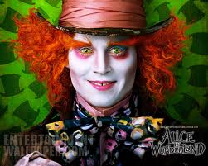
http://www.youtube.com/watch?v=KSKIkXvqruI&list=UUbDdmTlTwoCUx2p7nScbUCw&index=4&feature=plcp

Slide 19
Why Sleep?
Necessary for survival
Sleep deprivation
- effects immune system
- slows our reaction times during the day
- reduces ability to concentrate
- more difficult to execute math problems
- impairs memory and physical abilities
If it lasts for long periods:
-leads to hallucinations
- mood swings

Slide 20
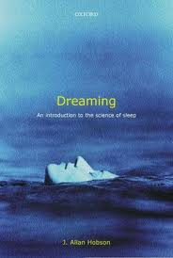
The Neuroscience of Dreams according to Hobson
Dr. J. Allan Hobson: Activation-Synthesis Hypothesis
Dreams are a neurochemical change in the brain and
Erratic electric pulses from the brain stem
are cholinergic
made of internally-generated visual imagery rather than taking in information from the senses
Random, no hidden meaning
Disputes Freudian dream theory
Supports Jungian theory
This Rift still exists in dream science today
Notes:
But what Hobson is really known for is sticking it to Freudian theory. In his break-out 1977 paper, Hobson and co-author McCarley declared victory over Freud (and the entire psychoanalytic community) by reporting their discovery that dreams in the REM state form by grace of neurochemical changes in the brain. As Kelly Bulkeley notes (1994), Hobson presented his work as a polemic against Freud, whose influence he accused of preventing scientific progress in the study of dreams. His central beef with Freudian theory is the notion that dreams are full of hidden messages by design. On the other hand, Hobson agrees with Jungian dream theory that dreams reveal more than they conceal, and can be quite transparent in significance
http://dreamstudies.org/2010/01/07/neuroscience-of-dreams/
One problem with Hobson’s original activation-synthesis model was that the theory presumes that all dreams occur in the REM state. However, two neuroscientists, James Foulkes and John Antrobus, have independently shown that long narrative dreams with bizarre elements can happen in non REM states too (see Rock 2004). Neuro-psychologist Mark Solms (1997) has also convincingly reframed the role of REM as an “alarm clock” for the mind to start dreaming, not as the prime creator. All of these researchers suggest that biochemical activation is not the sole genesis of a dream’s structure.

Slide 21
Allan Hobson Activation synthesis
Chaotic, spontaneous firings of neurons
There can be configurations/combinations that inspire great ideas
No hidden meaning
Meaningless, but as humans we want to give them meaning
The Limbic System
emotions are as important in dream genesis/structure
as brainstem activation
Lucidity
During lucidity the lateral prefrontal cortex becomes activated
The dream state and sleeping are two separate dissociable states of the brain process
cognitive thought is another state
Harry Potter- The Ridikulous Spell
http://www.youtube.com/watch?v=Ps3cJksVMXw

Slide 22
Dreams are a Cognitive Process
MRI of Brain on Avatar
http://www.youtube.com/watch?v=KSKIkXvqruI&list=UUbDdmTlTwoCUx2p7nScbUCw&index=4&feature=plcp

Slide 23
Henri Rousseau, The Dream Rousseau never went to Africa, but at the time, travel books were very popular and widely read, not unlike we watch tv today as entertainment.

Slide 25
Why are dreams weird?
Notes:
Hobson argues that dreams are clumsy narratives stitched together by the forebrain to make sense of the activation of biochemical changes and erratic electric pulses originating in the brainstem. This is Hobson’s theory of dream formation in a nutshell, which he has updated many times over the last 30 years, and is still referred to as the activation-synthesis hypothesis of dream formation.
The theory sheds light on several aspects of dreaming cognition. Most importantly, Hobson’s discovery of the role of neurotransmitters in dreaming has stimulated robust research into the biochemistry of consciousness and revolutionized the way that mental illness is conceptualized in psychiatry. REM dreaming is characterized by low serotonin levels and high acetylcholine levels, which may explain why dreams are so hard to remember: they are never encoded in short-term memory in the first place. When we wake up, serotonin floods the brain and our dream experiences from just a moment before are carried away by the ti
Hobson’s theory also offers a partial solution to why dreams are so wacky. In waking life, the brain performs reality checks and strings together logical stories to keep up with our thoughts, emotions and movements as we interact with the world. But in dreams, this ability is zapped when the serotonin valve is turned off, bringing about a state of consciousness ruled by strong emotions and uncanny sensations. It’s a chaotic place to be sentient, but the mind is so motivated to construct meaning that bizarre narratives are hastily thrown together so we can make order out of the mess. It’s a patch-job, at best, says Hobson.

Slide 26
changes while we sleep
NREM stages
Body temperature drops, body relaxes
Metabolism drops, blood pressure drops
Immune systems kick in, growth hormones
Electro-chemical
serotonin, epinephrine and melatonin
REM
Pons activates the switch
Intense brain activity
Rapid breathing, Increase blood pressure and heart rate
REM paralysis
PFLC shuts off
No working memory
No serotonin and no noradrenalin
Activation synthesis

Slide 27
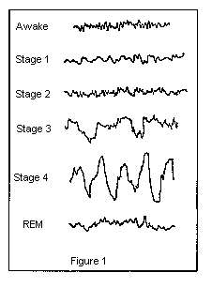
Sleep
neurotransmitters control whether we are asleep or awake
Serotonin
Norepinephrine
Adenosine
while we’re awake, they build up and cause drowsiness, & break down when we sleep
Melatonin
Notes:
Nerve-signaling chemicals called neurotransmitters control whether we are asleep or awake by acting on different groups of nerve cells, or neurons, in the brain. Neurons in the brainstem, which connects the brain with the spinal cord, produce neurotransmitters such as serotonin and norepinephrine that keep some parts of the brain active while we are awake. Other neurons at the base of the brain begin signaling when we fall asleep. These neurons appear to "switch off" the signals that keep us awake. Research also suggests that a chemical called adenosine builds up in our blood while we are awake and causes drowsiness. This chemical gradually breaks down while we sleep.

Slide 28
Chemicals and Sleep
neurotransmitters carry information between synapses
also control whether we are asleep or conscious
Serotonin- our “happy hormone”
Norepinephrine- our “reward system”
Melatonin- cicada rhythm
Adenosine
while we’re awake, it builds up & causes drowsiness
breaks down as we sleep
Notes:
Nerve-signaling chemicals called neurotransmitters control whether we are asleep or awake by acting on different groups of nerve cells, or neurons, in the brain. Neurons in the brainstem, which connects the brain with the spinal cord, produce neurotransmitters such as serotonin and norepinephrine that keep some parts of the brain active while we are awake. Other neurons at the base of the brain begin signaling when we fall asleep. These neurons appear to "switch off" the signals that keep us awake. Research also suggests that a chemical called adenosine builds up in our blood while we are awake and causes drowsiness. This chemical gradually breaks down while we sleep.

Slide 29
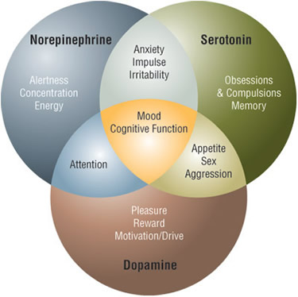
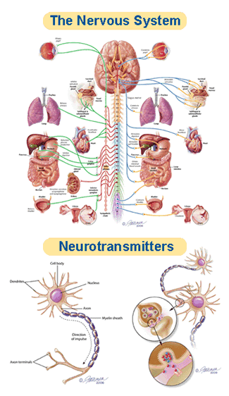
The Chemicals of Sleep… or not
Notes:
REM dreaming is characterized by low serotonin levels and high acetylcholine levels,(a neurotransmitter to the periphery and CN (central nervous system) norepinephrine
which may explain why dreams are so hard to remember: they are never encoded in short-term memory in the first place. When we wake up, serotonin floods the brain and our dream experiences from just a moment before are carried away by the tide.

Slide 30
Stages of sleep: Non-REM
N1 - hypnic myoclonia
(similar to when we jump when startled)
N2-
N3- Deep sleep- slow delta waves start
growth hormones
N4 Deepest Sleep
Delta-waves
Difficult to wake
Bed-wetting
Night terrors
Sleep walking
Growth hormones for children & young adults
Immune System kicks in
Repairs damages (inc. those caused by stress)
Beauty sleep
Consolidate memory
Encode memory (improves learning ability)
Sleep amnesia- we don’t remember phone calls, alarms, etc.
Dream science experts believe most dreams are during REM sleep
Notes:
One cycle is about 90 minutes:
N1 Our eyes move very slowly and muscle activity slows. People awakened from stage 1 sleep often remember fragmented visual images. Many also experience sudden muscle contractions called hypnic myoclonia, often preceded by a sensation of starting to fall. These sudden movements are similar to the "jump" we make when startled.
REM: The first REM sleep period usually occurs about 70 to 90 minutes after we fall asleep. A complete sleep cycle takes 90 to 110 minutes on average. The first sleep cycles each night contain relatively short REM periods and long periods of deep sleep. As the night progresses, REM sleep periods increase in length while deep sleep decreases. By morning, people spend nearly all their sleep time in stages 1, 2, and REM.
Amnesia: People awakened after sleeping more than a few minutes are usually unable to recall the last few minutes before they fell asleep. This sleep-related form of amnesia is the reason people often forget telephone calls or conversations they've had in the middle of the night. It also explains why we often do not remember our alarms ringing in the morning if we go right back to sleep after turning them off.
Catching up on REM: People lose some of the ability to regulate their body temperature during REM, so abnormally hot or cold temperatures in the environment can disrupt this stage of sleep. If our REM sleep is disrupted one night, our bodies don't follow the normal sleep cycle progression the next time we doze off. Instead, we often slip directly into REM sleep and go through extended periods of REM until we "catch up" on this stage of sleep. What Does Sleep Do For Us?
Although scientists are still trying to learn exactly why people need sleep, animal studies show that sleep is necessary for survival. For example, while rats normally live for two to three years, those deprived of REM sleep survive only about 5 weeks on average, and rats deprived of all sleep stages live only about 3 weeks. Sleep-deprived rats also develop abnormally low body temperatures and sores on their tail and paws. The sores may develop because the rats' immune systems become impaired. Some studies suggest that sleep deprivation affects the immune system in detrimental ways.
Sleep appears necessary for our nervous systems to work properly. Too little sleep leaves us drowsy and unable to concentrate the next day. It also leads to impaired memory and physical performance and reduced ability to carry out math calculations. If sleep deprivation continues, hallucinations and mood swings may develop. Some experts believe sleep gives neurons used while we are awake a chance to shut down and repair themselves. Without sleep, neurons may become so depleted in energy or so polluted with byproducts of normal cellular activities that they begin to malfunction. Sleep also may give the brain a chance to exercise important neuronal connections that might otherwise deteriorate from lack of activity.
Deep sleep coincides with the release of growth hormone in children and young adults. Many of the body's cells also show increased production and reduced breakdown of proteins during deep sleep. Since proteins are the building blocks needed for cell growth and for repair of damage from factors like stress and ultraviolet rays, deep sleep may truly be "beauty sleep." Activity in parts of the brain that control emotions, decision-making processes, and social interactions is drastically reduced during deep sleep, suggesting that this type of sleep may help people maintain optimal emotional and social functioning while they are awake. A study in rats also showed that certain nerve-signaling patterns which the rats generated during the day were repeated during deep sleep. This pattern repetition may help encode memories and improve learning.

Slide 31
Stages of sleep: REM
Necessary to survive
Necessary for brain development (even for infants)
REM Complex brain activity with delta waves
As active when we’re awake
Rapid and irregular breathing
Blood pressure rises
Body paralysis
Across species, females have more delta waves
Sleep starts because
the Pons sends signals Thalamus Cerebral cortex
During REM Sleep
the cortex tries to interpret the random signals from the pons
Notes:
One cycle is about 90 minutes:
N1 Our eyes move very slowly and muscle activity slows. People awakened from stage 1 sleep often remember fragmented visual images. Many also experience sudden muscle contractions called hypnic myoclonia, often preceded by a sensation of starting to fall. These sudden movements are similar to the "jump" we make when startled.
REM: The first REM sleep period usually occurs about 70 to 90 minutes after we fall asleep. A complete sleep cycle takes 90 to 110 minutes on average. The first sleep cycles each night contain relatively short REM periods and long periods of deep sleep. As the night progresses, REM sleep periods increase in length while deep sleep decreases. By morning, people spend nearly all their sleep time in stages 1, 2, and REM.
Amnesia: People awakened after sleeping more than a few minutes are usually unable to recall the last few minutes before they fell asleep. This sleep-related form of amnesia is the reason people often forget telephone calls or conversations they've had in the middle of the night. It also explains why we often do not remember our alarms ringing in the morning if we go right back to sleep after turning them off.
Catching up on REM: People lose some of the ability to regulate their body temperature during REM, so abnormally hot or cold temperatures in the environment can disrupt this stage of sleep. If our REM sleep is disrupted one night, our bodies don't follow the normal sleep cycle progression the next time we doze off. Instead, we often slip directly into REM sleep and go through extended periods of REM until we "catch up" on this stage of sleep.

Slide 32
REM SLEEP (Stages of sleep, continued)
REM Complex brain activity with delta waves
As active when we’re awake
Rapid and irregular breathing
Blood pressure rises
Body paralysis
No one knows why but the Pons shuts of the
PFC & Central Executive
During REM Sleep
the cortex tries to interpret the random signals from the Pons
the Limbic System remains active (the emotion center of our brain)
REM SLEEP
Necessary to survive
Necessary for brain development (even for infants)
REM Sleep is when we dream
Notes:
One cycle is about 90 minutes:
N1 Our eyes move very slowly and muscle activity slows. People awakened from stage 1 sleep often remember fragmented visual images. Many also experience sudden muscle contractions called hypnic myoclonia, often preceded by a sensation of starting to fall. These sudden movements are similar to the "jump" we make when startled.
REM: The first REM sleep period usually occurs about 70 to 90 minutes after we fall asleep. A complete sleep cycle takes 90 to 110 minutes on average. The first sleep cycles each night contain relatively short REM periods and long periods of deep sleep. As the night progresses, REM sleep periods increase in length while deep sleep decreases. By morning, people spend nearly all their sleep time in stages 1, 2, and REM.
Amnesia: People awakened after sleeping more than a few minutes are usually unable to recall the last few minutes before they fell asleep. This sleep-related form of amnesia is the reason people often forget telephone calls or conversations they've had in the middle of the night. It also explains why we often do not remember our alarms ringing in the morning if we go right back to sleep after turning them off.
Catching up on REM: People lose some of the ability to regulate their body temperature during REM, so abnormally hot or cold temperatures in the environment can disrupt this stage of sleep. If our REM sleep is disrupted one night, our bodies don't follow the normal sleep cycle progression the next time we doze off. Instead, we often slip directly into REM sleep and go through extended periods of REM until we "catch up" on this stage of sleep.

Slide 33
What IS activated during REM ?
Melatonin, cicada rhythm
Interpreting imagery
Limbic system: emotion center- pleasure center
Long-term memory consolidation & retrieval
Hippocampus:
spatial memory
Moves short term memory to long term memory
Amygdala
activates emotional learning,
fear conditioning
Anterior Cingulata
Mediates
Attention
Motivation
Lucid dreaming

Slide 34
REM: what is Not activated
Prefrontal lateral cortex
Central Executive
Organization
Planning
Tasks
Thinking
reasoning
Vision
No serotonin, noradrenalin/epinephrine
No social filter
Words and language

Slide 35
What is activated during REM sleep?
Melatonin, cicada rhythm
Interpreting imagery
Limbic system: emotion center- pleasure center
Long-term memory consolidation & retrieval
Hippocampus:
spatial memory
Moves working memory to long term memory
Amygdala
activates emotional learning
fear conditioning
Anterior Cingulate
Mediates
Attention
Motivation
Lucid dreaming

Slide 36
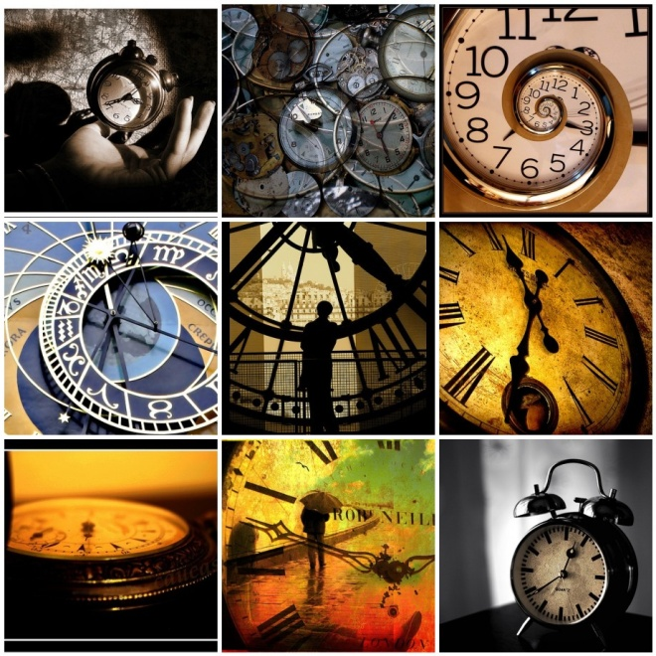
Neurological Influence on Dreams
1) Dreams Originate from Within
2) You are Conscious in Dreams
3) Time and Linear Logic Have Little Meaning
4) Your Will is Absent or Diminished
5) Appear irrational- but only to the waking mind
6). Emotions Dominate Dream Imagery

Slide 37
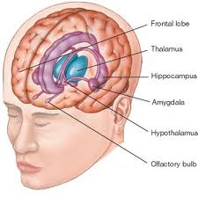
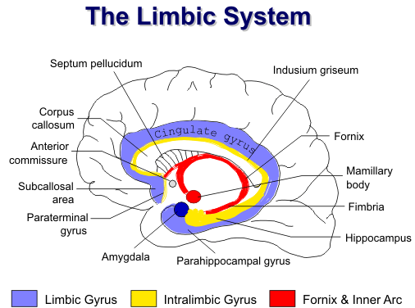
thalamus
Notes:
Phylogenetically, the limbic system is one of the more primitive parts of the brain. It has a central role in memory, learning, emotion, neuroendocrine function, and autonomic activities. Clinical conditions involving the limbic system include epilepsy, congenital syndromes, dementias, and various psychiatric disorders

Slide 38
Where the wild things are
http://www.traileraddict.com/trailer/where-the-wild-things-are/feature-trailer

Slide 39
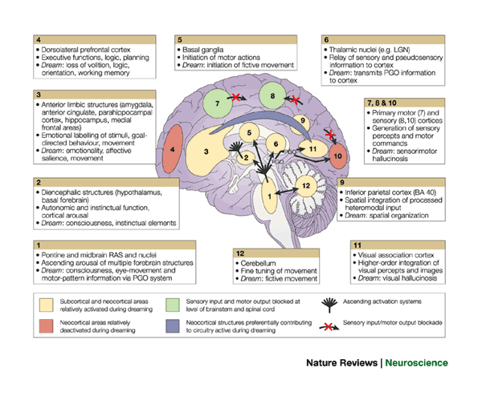
Notes:
From Hobson:
Regions 1 and 2, ascending arousal systems; 3, subcortical and cortical limbic and paralimbic structures; 4, dorsolateral prefrontal executive association cortex; 5, motor initiation and control centres; 6, thalamocortical relay centres and thalamic subcortical circuitry; 7, primary motor cortex; 8, primary sensory cortex; 9, inferior parietal lobe; 10, primary visual cortex; 11, visual association cortex; 12, cerebellum. BA, Brodmann area; LGN, lateral geniculate nucleus; PGO, ponto-geniculo-occipital; RAS, reticular activating system. Anatomical image adapted, with permission, from Ref. 129 © 1996 Appleton & Lange.

Slide 40
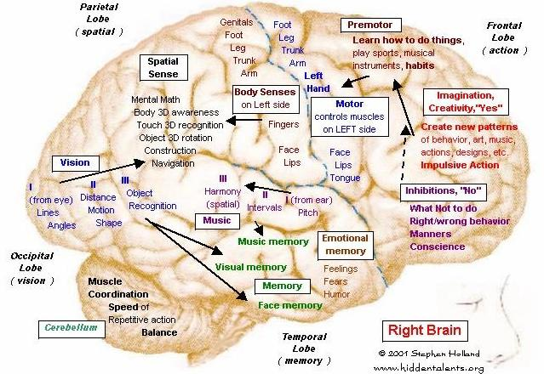

Slide 41
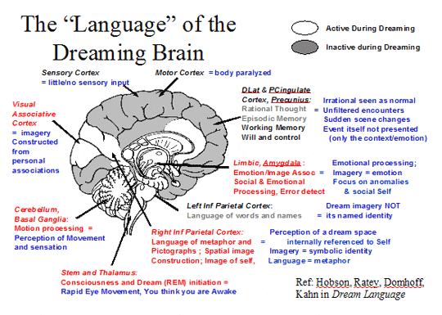
Notes:
The four stages of sleep during which the sleeper does not experience rapid eye movement (REM) sleep. They average sleep cycle lasts about 90 to 100 minutes. Non-REM dreams are more likely to consist of brief, fragmentary impressions that are less emotional and less likely to involve visual images than REM sleep dreams.
What exactly is the difference between REM & Non-REM Sleep?
REM Dreams and Non-REM dreams are very different from each other in a few major ways.
-Non-REM dreams consist of brief, fragmentary impressions.
-NREM less likely to involve visual images compared to REM sleep,
-more frequently forgotten.
Non-REM dreams are like thinking about something during the day for a brief period of time
Non-REM sleep lasts about four to six hours
REM dreams are comparable to thinking deeply about something.
REM sleep consists of about two hours a night while.

Slide 42
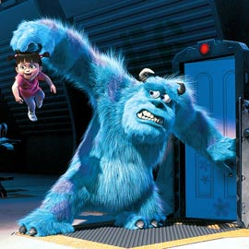
Dreams focus:
Dreams focus on self
Anomalies and Conflict
Can Project Appropriate Action
Dream Language:
Dreams are an inner language
language of metaphor
language of context
Are rarely ‘literal’

Slide 43
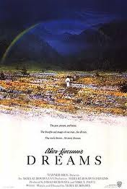
Man Searches for Meaning

Slide 44
Calvin Hall: Dreams are a cognitive process
The goal is not to understand the dream-
But to understand the dreamer
Analyzed thousands of dreams from diaries
Developed a quantitative coding system for content
Looked for patterns
Methodical, empirical
Believed meaningful predictions could be made about
dreamer’s behavior and lifestyle
Dreams provide a path to the unconscious areas of the mind,
and can be a map for the dreamer to anticipate difficulties and obstacles

Slide 45
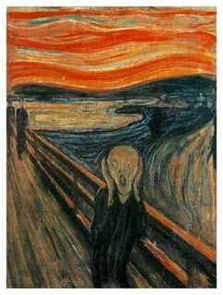
Calvin Hall: Dreams are a cognitive process
Concepts of Self
refer to the types or number of roles you play in your dreams
Concepts of other people are the roles other people play
in your dreams. Consider your feelings toward them and how
you interact with them
Concepts of the world represent the dream surrounding
and landscape. The adjectives you use to describe your
dreamscape is how you view the world.
Concepts of impulses, prohibitions and penalties
indicate your behavior and how it is ruled by impulses and
punishment.
Concepts of problems and conflicts symbolize your
struggles, issues and problems you are facing in your waking life.
Dream try to offer insight and resolution to your conflicts.

Slide 46
Calvin Hall:
One picture is worth a thousand words
A dream is a work of art
Metaphor isn’t necessarily a metaphor
It can be a pun or a slang
He didn’t think it was a disguise or a hidden expression
Dreams provide a path to the unconscious areas of the mind,
and can be a map for the dreamer to anticipate difficulties and obstacles

Slide 47
One picture is worth a thousand words
A dream is a work of art
Metaphor isn’t necessarily a metaphor
It can be a pun or a slang
He didn’t think it was a disguise
not hidden expression

Slide 48
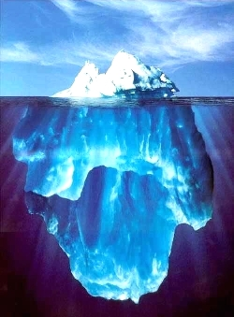
Alfred Adler Founder of Depth Psychology w/ Freud and Jung
Not Repressed
Dreams reflect the person’s desire to have control
over his own life
Dreams relate to your interests in life
Show ways to solve your problems
Dreams are an open pathway toward your true thoughts, emotions and actions
Developed the Theory of Inferiority Complex
Developed the idea that men search to find meaning in their life
Notes:
To solve problems, shed understanding
They are problem-solving devices. Dreams need to be brought to the conscious and interpreted so that better understanding can be shed on your problems. It is important to learn from your dreams and
He was the first to leave
-he supported feminism, a difference from Freud
-believed anyone could apply psychology to help themselves

Slide 49
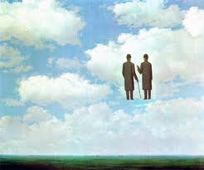
Fritz Perls
Trained in neuroscience
Founder of gestalt therapy
How can we NOT project ourselves into
every dream?
Holistic
Individuation:
symbols are unique/ not universal
only the dreamer can interpret the dream
Unfinished business
Dreams are a projection of parts of oneself
Every character and every thing represents an aspect of the dreamer
Early Research on Lucid Dreaming

Slide 50
Confabulation: Psychology To fill in gaps in one's memory with fabrications that one believes to be facts.
Gestalt Laws of Perceptual Organization
Our brains often ignore contradictory information and fill in gaps in information.

Slide 51
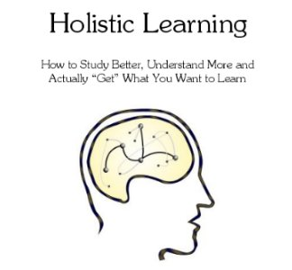
Gestalt Therapy
Open dialogue to understand the depth of who you are;
embrace it
Closure
an existential psychotherapy of self-responsibility
focuses upon the individual's experience in the present moment
Perls talking about being whole, a way of being the obvious, the now and awareness, to understand the life script http://www.youtube.com/watch?v=T3jYcDbcpUs&feature=related

Slide 52
Gestalt Psychology
A theory of mind
The whole is greater than the sum of the parts“
The brain is self-organizing,
The brain is holistic
Objects grouped together are seen as a whole.
We ignore gaps and fill them in.
In this design- there are no circles and triangles,
but our minds complete the missing information
to create the familiar shapes

Slide 53
The Gestalt Prayer
I do my thing
And you do your thing.
I am not in this world
To live up to your expectations
And you are not in this world
To live up to mine.
You are you and I am I.
And if by chance
We find each other, it’s beautiful,
If not, it can’t be helped.
Fritz Perls (1893-1970)
Gestalt Therapy pioneer

Slide 54
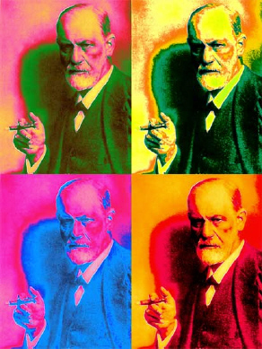
Sigmund Freud
ID:
Primal impulses
Unchecked urges
Wish fulfillment
Ego
Conscious
Rational / moral
Self-awareness
Superego
The censer of the ID
Enforces your moral code
Dreams:
Manifest Content
What dreams seem to be saying
Latent Content
What the dream is really trying to say
Notes:
To fit into society we hold back urges and repress our impulses
We release in disguise in our dreams
- dreams always have a manifest content
The manifest content is what the dream seems to be saying.
It is often bizarre and nonsensical.
The latent content is what the dream is really trying to say. Use “free association to interpret”
Using this technique, you start with one dream symbol and then follow with what automatically comes to your mind first. You continue in this manner and see where it leads.

Slide 55
Sigmund Freud: Unmasking the action
Four Elements of his dream theory
include:
1. Symbolization
Latent or repressed ideas
2. Condensed
Image/idea may appear condensed, or seem less important than they are
Many different ideas and concepts in one dream or one image
Use ‘word association’ to find meanings, and then the correct one
3. Displacement and Projection
Disguised motive or action played or acted out
4. Revision/Summary
In the last stage of the dream, bizarre events are reorganized to make sense
the last frame will attempt to summarize or revise to make the meaning more obvious

Slide 56
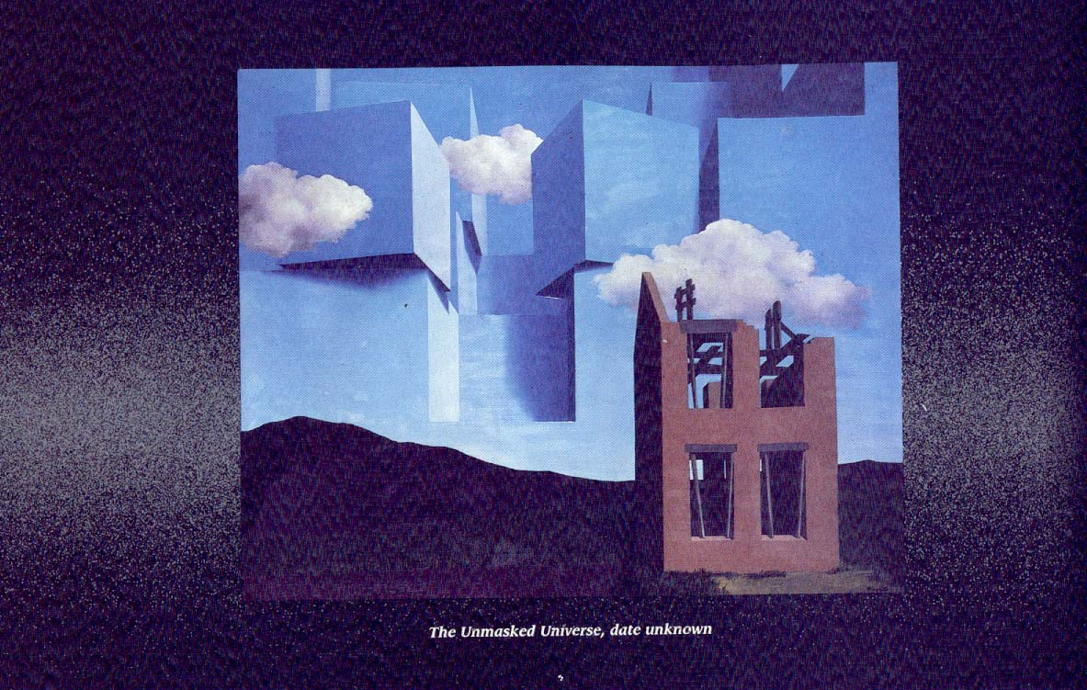
Are there people in your dream, who you do not know?
Are there people but they seem to be faceless?
Considering that Jung says a house in a dream represents the person and his personality, I think this painting is a good metaphor for the people in a dream who float past, but are faceless , strangers or undefined.
What do you think?
This house, if it were a person, has his mind open to higher thought- and under construction

Slide 57
Magritte: “Golconda”
Using Jungian depth psychology, this person is not restricted by the constraints of a body. He’s floating everywhere, and outside his house!

Slide 58
Magritte Castle in the Pyrenees
What would your depth psychology analysis of this painting/dream be?
His house has a huge rock solid foundation- and everything is floating or flying freely including the house.
Water is a universal metaphor for life.

Slide 59
Fritz Perls
Trained in neuroscience
Founder of gestalt therapy
Holistic
Individuation:
symbols are unique/ not universal
only the dreamer can interpret the dream
Unfinished business
Dreams are a projection of parts of oneself
Every character and every thing represents an aspect of the dreamer
How can we NOT project ourselves into every dream?
Early Research on Lucid Dreaming

Slide 60
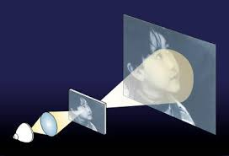
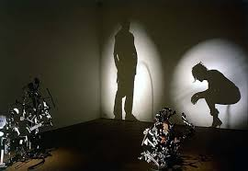
Projection
Looking at yourself in a dream

Slide 61
http://www.youtube.com/watch?v=WhQySxqSANU

Slide 62
PROJECTION
Fritz Perls:
How can we NOT project ourselves into every dream?
Freud: Projection is a defense mechanism – where a person unconsciously rejects his or her own unacceptable ideas and by applies them to other people
Magritte, Infinite gratitude

Slide 63
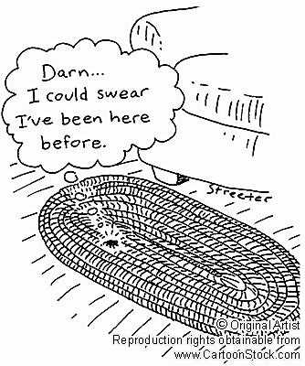
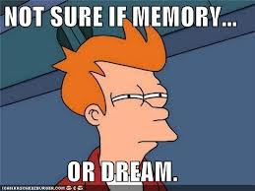
Deja Vu
Schema
Encoding
Flow/ astral plane

Slide 64
Schrodinger’s Cat
I’m a kitty
-a cat, a flask of poison, and a radioactive source are placed in a sealed box
-poison kills the cat.
-after a while, the cat is simultaneously alive and dead
when one sees the cat either alive or dead, not both alive and dead.
This poses the question of when exactly quantum superposition ends and reality collapses into one possibility or the other.
Jung’s Synchronicity:

Slide 65
superposition
Carl Jung – Synchronicity
Pauli-
Quantum Mechanics
I’m a kitty!
Schrodinger’s Cat

Slide 66
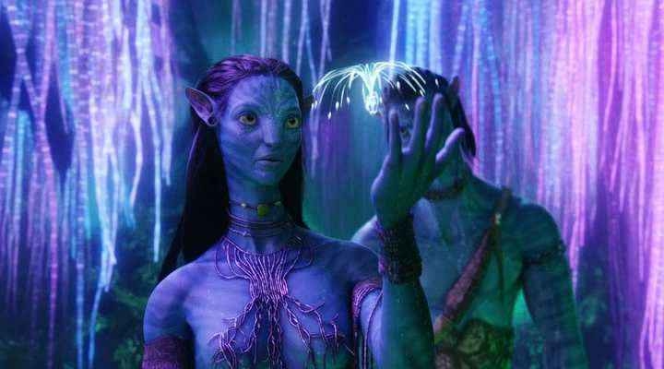
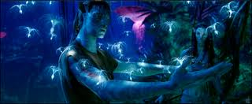
in Avatar, the Sacred Tree, The Tree of Souls, Tree of Voices
and the vast network of roots, which they connect to by using their braids, are their collective unconscious (which they treat divinely)
** Energy is borrowed and one day you have to give it back. (life & death)

Slide 67
Are you a dreamer?
Clip from Waking Life: http://www.youtube.com/watch?v=9yJE1iiO0qI

Slide 68
In 1932, Wolfgang Pauli was a world-renowned physicist and had already done the work that would win him the 1945 Nobel Prize. He was also in pain. His mother had poisoned herself after his father's involvement in an affair. Emerging from a brief marriage with a cabaret performer, Pauli drank heavily, quarreled frequently and sometimes publicly, and was disturbed by powerful dreams. He turned for help to C. G. Jung, setting a standing appointment for Mondays at noon. Thus bloomed an extraordinary intellectual conjunction not just between a physicist and a psychologist but between physics and psychology. Eighty letters, written over twenty-six years, record that friendship. This artful translation presents them in English for the first time. Though Jung never analyzed Pauli formally, he interpreted more than 400 of his dreams--work that bore fruit later in Psychology and Alchemy and The Analysis of Dreams. As their acquaintance developed, Jung and Pauli exchanged views on the content of their work and the ideas of the day. They discussed the nature of dreams and their relation to reality, finding surprising common ground between depth psychology and quantum physics. Their collaboration resulted in the combined publication of Jung's treatise on synchronicity and Pauli's essay on archetypal ideas influencing Kepler's writings in The Interpretation of Nature and the Psyche.
Carl Jung
The Pauli Principle & Quantum Physics
Link to Amazon: http://www.amazon.com/gp/product/images/0691012075/ref=dp_image_0?ie=UTF8&n=283155&s=books

Slide 69
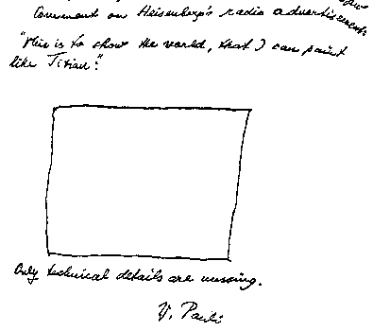
Pauli Effect, and the Pauli Principle
The Pauli effect refers to unexplained anecdotal failure of technical equipment in the presence of certain people
Interference with street lights
They said Pauli was an “intender” (could make things happen)
The Pauli Principle and Quantum Mechanics
Entanglement: http://www.youtube.com/watch?v=Jh8uZUzuRhk&playnext=1&list=PLEC03CF8A08EAD34F
Superposition, and observing: (6 minutes and awesome)
http://www.youtube.com/watch?v=DfPeprQ7oGc&feature=autoplay&list=PLEC03CF8A08EAD34F&index=20&playnext=2
How do you think this would relate to dreams, lucid dreams and visions ?
if you’re interested in reading more about Pauli
http://www.youtube.com/watch?v=TN9vqSHBEMs synchronicity, quantum & Pauli effect explained
http://www.library.ethz.ch/exhibit/pauli/effekt_pauli_e.html

Slide 70
I Have a Dream
Black Elk
Martin Luther King
Black Elk
http://www.youtube.com/watch?v=xbH6NY0GdgM

Slide 71
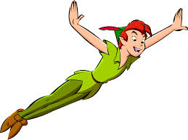
Fantasy Visions Hallucinations
Shutter Islandhttp://www.youtube.com/watch?v=V0eG0O9qNB4
http://www.youtube.com/watch?v=TongJJMgBeY

Slide 72
River of Dreams
Billy Joel river of dreams http://www.youtube.com/watch?v=hSq4B_zHqPM

Slide 73
Carl Jung’s
Spirit Guide
Dream Helper
Philemon
(from a dream)
Originally,
Jung drew
Philemon without wings.
When he added wings, like a kingfisher, a few days later he found a dead kingfisher in his garden. Jung viewed this as very synchronistic.

Slide 74
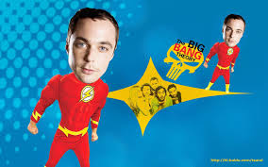
Schrodinger’s Cat Quantum Theory of Superposition
The Cat’s Alive http://www.youtube.com/watch?v=HCOE__N6v4o

Slide 75
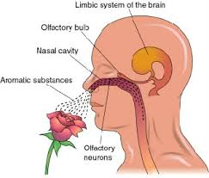
Visions
Eli Stone http://www.youtube.com/watch?v=08tPHCdha34&feature=related
First 45 minutes intro:
http://www.youtube.com/watch?v=79P4ip08PNw

Slide 76
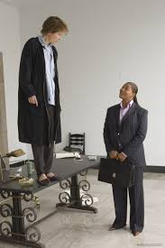
SYCHRONICITY
Stranger than Fiction, WATCH AND THE INMITGABLE PATH OF FATE http://www.youtube.com/watch?v=tfvwUlCQvkE
Bus Ride and Finally Talks to Pascal; ”How perfect” http://www.youtube.com/watch?v=B-HArlgWlQ4
Trailer: http://www.youtube.com/watch?v=fj4MC8Nqpjg

Slide 77
Theory (#3 of 6) Francis Crick: Dreaming is Like Defragmenting Your Hard Drive
"we dream in order to forget."
The brain is a machine that connects data in the same way as a matter of habit, (not always useful to do this)
When we sleep the brain fires more randomly and establishes new connections and pathways
Dreaming shuffles old connections that allows us to keep the important connections and erase the inefficient links
A good analogy here is the defragmentation of a computer's hard drive: Dreams are a reordering of connections to streamline the system

Slide 78
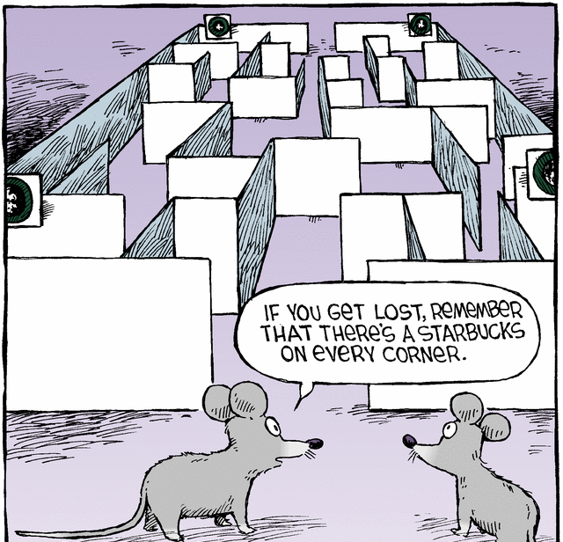
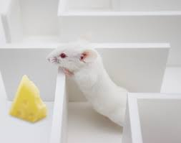
Theory (#2 of 6) Matt Wilson, MIT Center for Learning and Memory Dreams Create Wisdom
“Sleep turns a flood of daily information into what we call wisdom:
the stuff that makes us smart for when we come across future decisions”
we encode memory to long-term memory when we sleep
Dreams sort through memories, to determine which
ones to retain and which to lose.
His tests: He put rats in mazes during the day & recorded what neurons fired in what patterns as the rats negotiated the maze. In REM sleep, the same neuron patterns fired that had fired at important turning points in the maze.
In other words, he saw that the rats were dreaming of important junctures in their day.

Slide 79
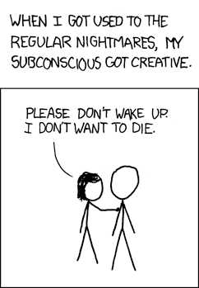
Theory #4 Ernest Hartmann: Tufts University Dreams are Like Psychotherapy
Ernest Hartmann focuses on the emotional learning that happens in dreams and believes it is a ‘safe place’ to confront our emotions in a different way
dreams puts our difficult emotions into pictures
In dreams, we deal with emotional content and make connections that we would not make if left to our more critical or defensive brains. (PFC is off)
In this sense, dreaming is like therapy on the couch: We think through emotional stuff in a less rational and defensive frame of mind.
Through that process, we come to accept truths we might otherwise repress.

Slide 80
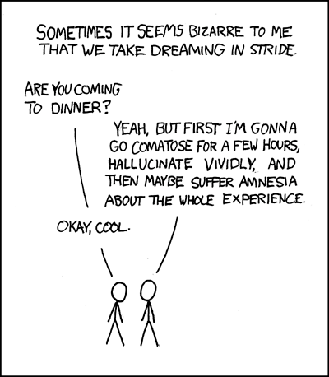
Theory #5: Absence of Theory
Dreams have no meaning and are random firings of the brain
The mind is still "functioning" and is producing images, but there's no conscious sense behind the film.
Perhaps it's only consciousness itself that wants to see some deep meaning in our brains at all times.

Slide 81
Theory #1 of 6 Antti Revonsuo: The Evolutionary Theory: We Dream to Practice Responses to Threatening Situations
Revonsuo and other evolutionary theorists argue that in dreams, we are actually rehearsing fight-and-flight responses, even though the legs and arms are not actually moving.
Our amygdala (the fight-or-flight) fires more often in REM sleep
brain fires very similar to when it’s threatened for survival.
the part of the brain that practices motor activity (running, punching) increases even though the limbs are still.
Dreams are an evolutionary adaptation:
We dream and rehearse behaviors of self-defense in the safety of nighttime isolation, which helps us improve in the real world.

Slide 82
How to remember your dreams
Before you go to sleep
1. Expect to remember your dreams, the same we interact with our friends
2. Review past dreams- do you want them to “complete?”
3. Get ready to record your dreams (have pen and paper handy, or a tape recorder)
4. Review the day, going back to the morning
5. Brain dump, to relax and reassure
6. Set the intention/ Confirm to yourself you want to remember your dreams & connect with your subconscious
7. Ask a Dream Question, write it down or draw a totem or mandala
Upon Waking:
1. Name it based on the strongest image or feeling
2. try to recall all that you can, start from the ending, backwards might help
3. think of an event that triggered the dream or relates to the dream
4. Don’t be discouraged if you can’t recall all of it
Daily
1. value each dream and keep a dream journal
2. accept all dreams, the good and the bad
3. consider recalling a skill to learn and improve
4. don’t compare recalling one over the other
5. if you recall it during the day, what triggered it (déjà vu?)
Dreams often occur in series. After you’ve recorded many of them, you’ll see a theme will continue over a few nights, if you learn from the dream the series will end or evolve to the next level. If your subconscious is trying to teach you something, the imagery will continue until you understand or put away and tried at a later time if you’re not ready to ‘face’ it. These kind of dreams are usually about your behavior, your actions and reactions in life and experience

Slide 83
How to lucid dream
Gestalt Method
Reflection
Active attitude: open dialogue with the characters
Set the intention
Embrace your dreams and your dream self (Gestalt Psychology)
Auto suggestion- an idea exclusively occupying the mind turns into reality
Control your life: Control your dreams
Yoga meditation/Dzogchen/Asian
Clear the mind, and wait for a vision or dream
Maintain a balanced life, a balanced mind
Dream question
Ask a question that you need to resolve (write it down)
Expect an answer
Ask for completion dreams

Slide 84
How to lucid dream, continued
Dream Helpers (in Japanese they’re Ketsune, for ex.)
Kabbalah
- Concentrate on an image, to fill the mind
- ( The opposite of Asian of meditating to empty the mind)
Electronic manipulation (not authentic b/c it’s manipulated)
- Lucidity Institute (masks and lights)
- Thinking Cap
- Dream Controller
Drug Induced:
hallucinations are random & chemical, not ‘authentic’ w/ personal meaning
drug induced hallucinations are Dangerous
not worth the risk of over dose !!!!!!!!!!!!!
(Melatonin is okay for two weeks)

Slide 85
Steps to Improve Lucid Dreaming
1. First you need to remember your dreams!!!
Make a habit of keeping a dream journal !!
2. Become more familiar with your dreams and their ‘style’
Ask yourself: “Am I dreaming?”
4. Learn to identify your dreams signals (dream helper/totem)
(When I see my __?_ I know I’m dreaming)
5. When something odd happens, or is impossible, - you’re dreaming!
6. Relax before sleep, remember to be patient, and tell yourself you will enjoy or learn from whatever you dream

Slide 86
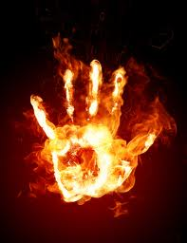
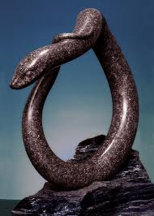
Four universal symbols: (archetypical)
1. House: you/your personality
Village or City: your greater self, family or community
2. Water: Source of Life ---Essential to life
Thirst
Serenity (or crashing waves)
Baptism
3. Fire: Opposites- passion life or destruction
Passion
Birth: Phoenix, transformational
Heat, light, comfort
Destruction
Fear
4. Snake: multiple meanings
(For ex. To Indians, they’re spiritual guides, to Christians they’re serpents)
-fertility
- healing/nurturing
-circle of life, shed your skin
-circles the staff as a symbol of the Medical Profession
-sin and evil temptation
- Forked tongue
Kekules dream about snakes helped him see carbon structure as a circle

Slide 87
Carl Jung
Analytical Psychology
House is the framework to understanding
the psyche, and dreams
Individuation
Collective Unconscious
Synchronicity
Dreams guide you to a wholeness
-offer solutions to problems
Everything can be paired as opposites
Ego (your sense of who you are)
Alter-ego/ shadow

Slide 88
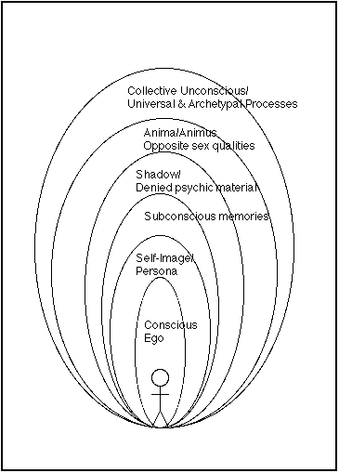
Jung’s Theory: Collective Unconscious
Personal unconscious
Personal Library
Archetypes
Puns, metaphors and personal myths

Slide 89
Collective unconscious
the sum of all thoughts, memories, impulses, desires and feeling of which you are
not aware
influence your emotions and behavior.
The collective unconscious is a way to organize and interpret our experiences,
to see how we are similar to each other, and become aware of each other
The collective unconscious is the repeating symbols, signs, elements and images
that carry and convey messages
Universal collective unconscious
Universal library
Archetypes
Magical realm
Shared experiences
Shared dreams
On the “same wave length.” resonating
Astral plane

Slide 90
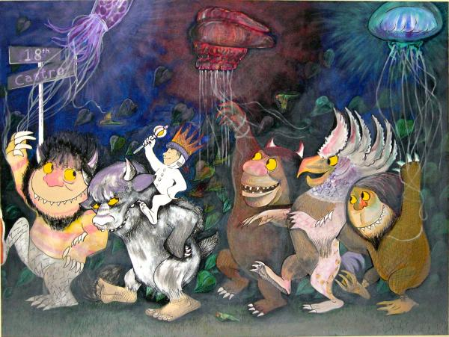
Common & Universal Themes of Dreams:
Being chased/chasing
Tests: failing or being unprepared/prepared, passing
- bad performance/ excellent performance
Naked or not fully dressed/ wrong clothes
Flying/dancing/floating
Falling/drowning and the fear of falling or drowning
Car trouble or house trouble/ smooth easy drive
-missing the boat/bus/train – being too late
Machinery is broken or malfunctioning/ or working great
Disasters- Manmade or natural / avoiding them
Telephone lines
Hurt, injured or dying/healing or good health
Losing a valuable possession/finding one
Being Lost or trapped

Slide 91
Major Archetypes:
Persona- the image we create
In the dream world, the persona is represented by the Self
-may or may not resemble you physically
-may or may not behave as your would.
Shadow- the image we don’t want the world to see
-you may think its ugly or unappealing, for example
-symbolizes weakness, fear, or anger.
Anima and Animus- the female and male aspects of yourself.
Divine child- your true self in its purest aspect
-symbolizes your innocence, your sense of vulnerability
-your helplessness
-represents your aspirations and full potential
Harper Simon: Wishes and stars
http://www.youtube.com/watch?v=d82Dz1DW2BM

Slide 92
Archetypes, cont.
Wise old man/woman- offers guidance and words of wisdom
Dream helper
Represented by a teacher, father, doctor, priest
An unknown authority figure
They appear in your dream to steer and guide you into the right direction.
Mother- a nurturing identity
mother, grandmother
Any nurturing figure in your dream who gives you a positive and reassuring
A river of life
Trickster -plays jokes to keep you from taking yourself too seriously
may appear in your dream when you have misjudge a situation.
uncertain about a decision or about where you want to go in life.
makes you feel uncomfortable or embarrassed
mocking you or exposing you to your vulnerabilities
take on subtle forms, sometimes even changing its shape.
Hero- the hero who lives inside you

Slide 94
The collective unconscious
Avatar: a movie about the collective unconscious

Slide 95
Jung’s Dream Theory of Amplification
Freud uses association and looks for lots of them to find meaning- Jung is the opposite and uses Amplification - concentrate on the image or action the way it is in the dream, and then dig down and explore the depth of it and the implications of that (not the breadth)
Amplification involves the use of myth, history, and cultural parallels in order to clarify
“turn up the volume” to bring understanding, especially if it’s difficult
Connects the dreamer to answers/meaning greater than himself- to understand it beyond his own persona self
(There is some disagreement with the idea of connecting a person to those with similar problems because sometimes a person needs to heal himself and not connect to a greater conscious in the process. Others argue it makes the person feel much grander than he is)

Slide 96
The house, as a metaphor
Carl Jung’s dream theory evolved from one of his own dreams about his house; he realized that the house is a metaphor for the person, his personality and his life
-could be used as a framework to analyze dreams
- -evolved to Analytical Psychology
Rene Magritte: a room with a view. Is that what our body is?
A whirlwind forming inside a room
& inside Jung’s mind?

Slide 97
Carl Jung Dream Journal - extraordinaire

Slide 98
A dragon
A burst of light

Slide 99
Jung drew many of these Mandala, starting in 1917 when he was treating British POWS

Slide 103
Carl Jung’s Red Book

Slide 106
A genie rises from out of a -?
Or is it a legendary bird?

Slide 107
A flame coming from a serpent’s mouth- a forked tongue, or is it a tree of life? Above ground, or below? Is the snake an erupting volcano?

Slide 108
A dragon
A burst of light

Slide 109
Carl Jung's first vision (awake):
“Europe covered in blood”
Foretelling of a machinated and bloody WWI.
Note the ship coming to their assistance from across the Atlantic
In the midst of a very successful career. ..”so profound it eventually caused the father of analytical psychology to undergo a series of waking fantasies. Traveling from Zurich to Schaffhausen, Switzerland, in October 1913, Jung was roused by a troubling vision of "European-wide destruction." In place of the normally serene fields and trees, one of the era's pre-eminent thinkers saw the landscape submerged by a river of blood carrying forth not only detritus but also dead bodies. When that vision resurfaced a few weeks later—on the same journey—added to the mix was a voice telling him to "look clearly; all this would become real." World War I broke out the following summer.

Slide 111
Man Searches for Meaning

Slide 112
The collective brain

Slide 113
Dancer:
http://www.youtube.com/watch?v=9CEr2GfGilw
Clive Waring:
http://www.youtube.com/watch?v=Vwigmktix2Y
MRI of Brain on Harry Potter:
http://www.youtube.com/watch?v=7yjHiVfMSHk&feature=BFa&list=UUbDdmTlTwoCUx2p7nScbUCw
MRI of Brain on Avatar
http://www.youtube.com/watch?v=KSKIkXvqruI&list=UUbDdmTlTwoCUx2p7nScbUCw&index=4&feature=plcp
Learning to fly:
http://www.youtube.com/watch?v=4p_f7Df2-oM
Over the Rainbow with Israel Z
http://www.youtube.com/watch?v=V1bFr2SWP1I
Akira Kurasowa
https://www.amazon.com/gp/video/library?ie=UTF8&ref_=sv_mov_8

Slide 114
MUSIC for listening Free falling john mayer live (great 4 minutes (10 sec, commercial) http://www.youtube.com/watch?v=20Ov0cDPZy8 Learning to Fly live : 5 minutes http://www.youtube.com/watch?v=4p_f7Df2-oM&feature=related sky sailing Brielle 4. minutes http://www.youtube.com/watch?v=_PkzsMak6P8&ob=nb_av2e In Dreams 2.5 minutes Roy Orbison http://www.youtube.com/watch?v=zbxsmcT7GOk MOVIE CLIPS/ USE FOR IMAGES and SYMBOLS
Eli stone http://www.youtube.com/watch?v=08tPHCdha34&feature=related
Harper Simon - Wishes and Stars http://www.youtube.com/watch?v=d82Dz1DW2BM&feature=related
1. Peach orchard esp. 3 minutes- 7 to understand http://www.youtube.com/watch?v=1qMqTZ-Jnbw&feature=related 2. Kurosowa w/ music from Enya. 3.5 minutes edited and merging of dreams with music by Enya Is Kuorsoawa asking himself: " Am i Van Gogh? " http://www.youtube.com/watch?v=sJ90m9y4fx8&feature=related
3. summary of movie DREAMS 2.5 minutes PHENEMOMINAL!!!!!! http://www.youtube.com/watch?v=oTRw66CnWLI&feature=related
Kurosowa Blizzard: Start at 2,50 – http://www.youtube.com/watch?v=5Af-DZkRyzk&feature=related
Part 3 trumpet music at 2,25 sees tent…
http://www.youtube.com/watch?v=cEDk5ysFiuw&feature=related
blizzard, not original - 7 minutes
http://www.youtube.com/watch?v=2TbDSi_K-FY&NR=1&feature=fvwp
Waking Life :http://video.google.com/videoplay?docid=7583894250854515095# Billy Joel river of dreams http://www.youtube.com/watch?v=hSq4B_zHqPM

Slide 115
Sleepsong- lord of the rings
http://www.youtube.com/watch?v=VjbCp7w5Oww
10 strange facts
http://www.youtube.com/watch?v=ByBdGvh5E08
Kurosowa w/ music from Enya. 3.5 minutes edited and merging of dreams with music by Enya. Is Kurosoawa asking himself: " Am I Van Gogh? " http://www.youtube.com/watch?v=sJ90m9y4fx8&feature=related
summary of movie DREAMS 2.5 minutes PHENEMOMINAL!!!!!! http://www.youtube.com/watch?v=oTRw66CnWLI&feature=related

Slide 116
Stranger than Fiction- synchronicity
http://www.youtube.com/watch?v=tfvwUlCQvkE

