Slide 1
Bose-Einstein Condensates The Coldest Stuff in the Universe
Hiro Miyake
Splash!
November 17, 2012

Slide 2
Outline
Atoms
Found by chance: Wavefunction
Place and Speed: Uncertainty principle
You are Fuzzy: de Broglie wavelength
Bose-Einstein Condensates
Coldest matter: BEC transition temperature
No room for two: Pauli exclusion principle
Make it happen: Experimental apparatus

Slide 3
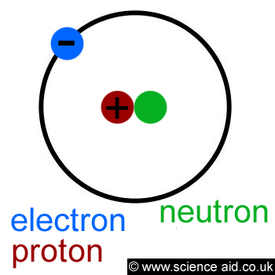
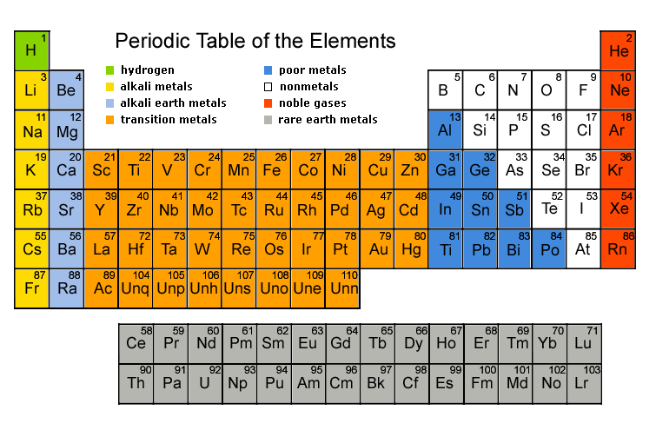
What Are Atoms?
All familiar objects in our universe are made from atoms
Atoms are made from electrons and the nucleus
They are so small, you can’t see them with your naked eye
They have weird properties!

Slide 4
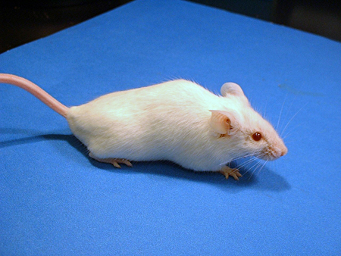
Quantum Weirdness
Small things can be in multiple places at the same time…
Small things can be in multiple places at the same time…
…until you look at them
Notes:
Orbital-type picture

Slide 5
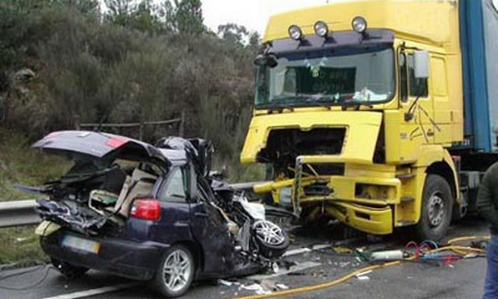
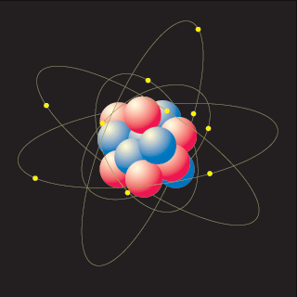
How do you look at something?
Bounce light off it
Suppose its very small….
The light will mess it up!
You only know what it looks like after its messed up
You can only know the probability where something might be!
Notes:
Light affects small objects a lot. Position velocity uncertainty.

Slide 6
Probability of a Die
If you have a six-sided die, you have a 1/6 probability you would get any of the numbers
You can make a plot like this:
P
1/6
N
1
2
3
4
5
6
http://en.wikipedia.org/wiki/Dice

Slide 7
Probability of a Particle
Now replace the number you expect on a die with the position of a particle
You have a 1/6 probability of finding a particle in 1 of 6 positions
That’s called the wavefunction of the particle!
P
1/6
x
1
2
3
4
5
6

Slide 8
Wavefunction of a Particle
The wavefunction is ψ(x)
The probability P that a particle will be found in between positions x and x+L is:
This could also be a possible wavefunction:
P
1/6
x
1
2
3
4
5
6

Slide 9
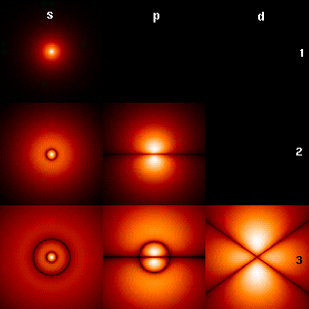
‘Real’ Wavefunction!
Wavefunction of an electron in a hydrogen atom
http://en.wikipedia.org/wiki/Hydrogen_atom

Slide 10
What does this mean?
Small objects exist everywhere
When you look at one, you know where it is, but not how fast its moving!
You can never know everything!
You can NEVER know exactly WHERE something is and exactly how FAST it’s moving at the same time
Notes:
Stm picture

Slide 11
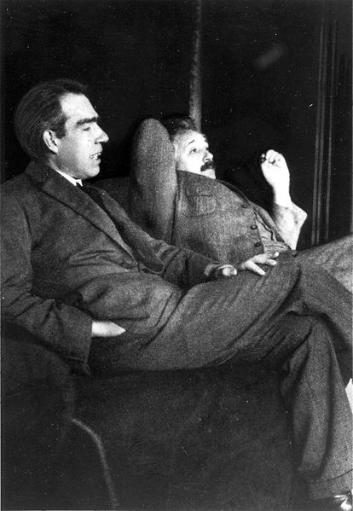
Philosophical Implications
How is it that we can’t know how fast things are moving and where they are at the same time?
Was it really somewhere and moving at some speed before I looked?
Did I change reality by looking?
What does it mean to “look?”
Niels Bohr (Copenhagen Interpretation)
vs.
Albert Einstein (Realist)
http://commons.wikimedia.org/wiki/Image:Niels_Bohr_Albert_Einstein_by_Ehrenfest.jpg

Slide 12
Δx = How much we don’t know about where it is
How much “fuzziness” is there?
Heisenberg Uncertainty Principle
Δv = How much we don’t know about how fast it is
m = Mass of the object
For very light objects, we have less information than for heavy objects!
Notes:
Delta x * delta p >= \hbar/2

Slide 13
Calculating Your Fuzziness
Thermal de Broglie Wavelength

Slide 14
How can you see these weird properties of atoms?
You can make the atoms really COLD!

Slide 15
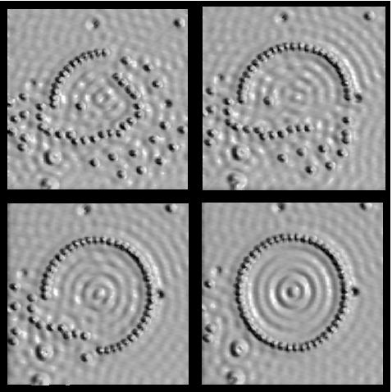
Why go COLD?
Things different from everyday intuition occur
You can see individual atoms
See weird states of matter: Bose-Einstein Condensation (BEC), Superfluidity, superconductivity
http://mrsec.wisc.edu/Edetc/background/STM/

Slide 16
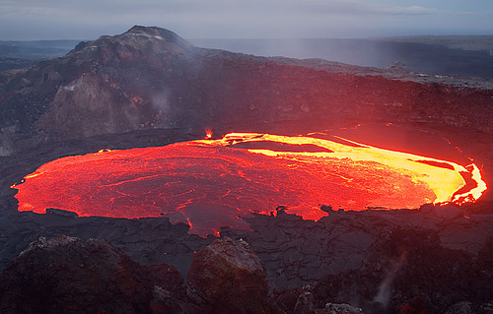
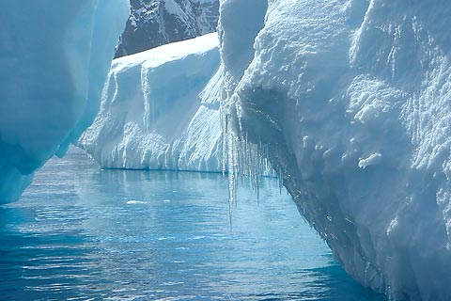
What is temperature?
Motion of atoms
Fast moving atoms are hot
Slow moving atoms are cold
http://www.flickr.com/photos/volcanoes/988326099/sizes/m/in/photostream/
http://www.treehugger.com/files/2009/12/melting-polar-ice-raise-sea-levels-4-feet-2100.php

Slide 17
What is “Ultracold”?
Everyday temperatures
32 °F = 0 °C = 273 Kelvin
Absolute zero
-460 °F = -273 °C = 0 Kelvin
Typical ultracold temperatures in lab
100 nanoKelvin, billionth the temperature of a nice day
Outerspace is 3 Kelvin = -454 °F
Colder than space by more than a millionth the temperature of space!
What happens at ultracold temperatures?
All atoms behave like one big atom!

Slide 18
Very Weird Fact About the World
Everything in this world is both a particle and a wave

Slide 19
High temperature
Lower temperature
Even lower temperature
Zero temperature
http://cua.mit.edu/ketterle_group/Nice_pics.htm

Slide 20
BEC Transition Temperature
λ = Thermal de Broglie wavelength

Slide 21
Laser Cooling of Atoms I
Shine light on atoms to slow them down
Zeeman slowing

Slide 22
Laser Cooling of Atoms II
Trap atoms in a valley (with light and magnets)
Lower the top of the hill slowly so atoms with a lot of energy escape (evaporative cooling)

Slide 23
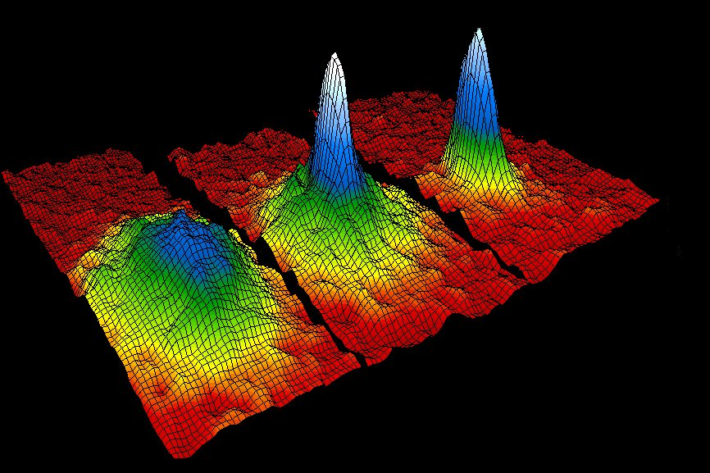
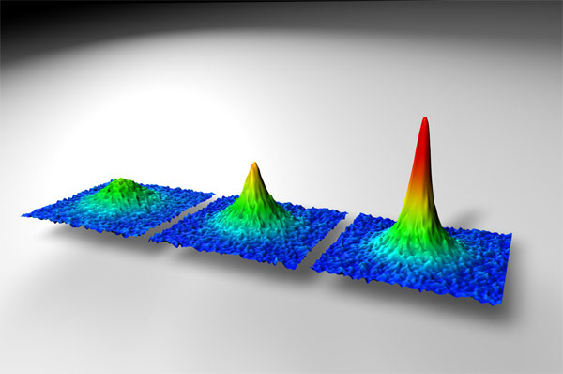
Ultracold Atoms!
Gas of atoms at a temperature of a few nanoKelvin
Very dilute. About atoms/
Normal solids about atoms/
Nobel Prizes
Laser cooling and atom trapping (1997)
Bose-Einstein condensates (2001)
http://cua.mit.edu/ketterle_group/Nice_pics.htm

Slide 24
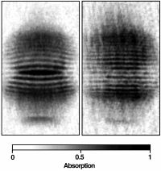
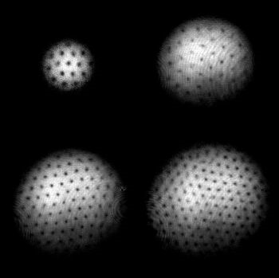
Cool Stuff with a BEC
You can interfere two BECs like a water wave
You can create holes in BECs by rotating it
http://cua.mit.edu/ketterle_group/Nice_pics.htm
http://cua.mit.edu/ketterle_group/projects_2001/vortex_lattice/vortex.htm

Slide 25
Two Types of Particles
Bosons: They like to be together
Bose-Einstein condensate
Fermions: They don’t like to be together
Degenerate fermi gases
Pauli Exclusion Principle

Slide 26
Which Atoms are Which?
The total number of electrons, protons and neutrons in an atom determines whether it’s a boson or fermion
If the total number is even, it’s a boson
If the total number is odd, it’s a fermion
Example: Rubidium-87 has 37 electrons, 37 protons and 50 neutrons. Is it a boson or a fermion?
Has to do with a quantity called spin, but that’s for another talk

Slide 27
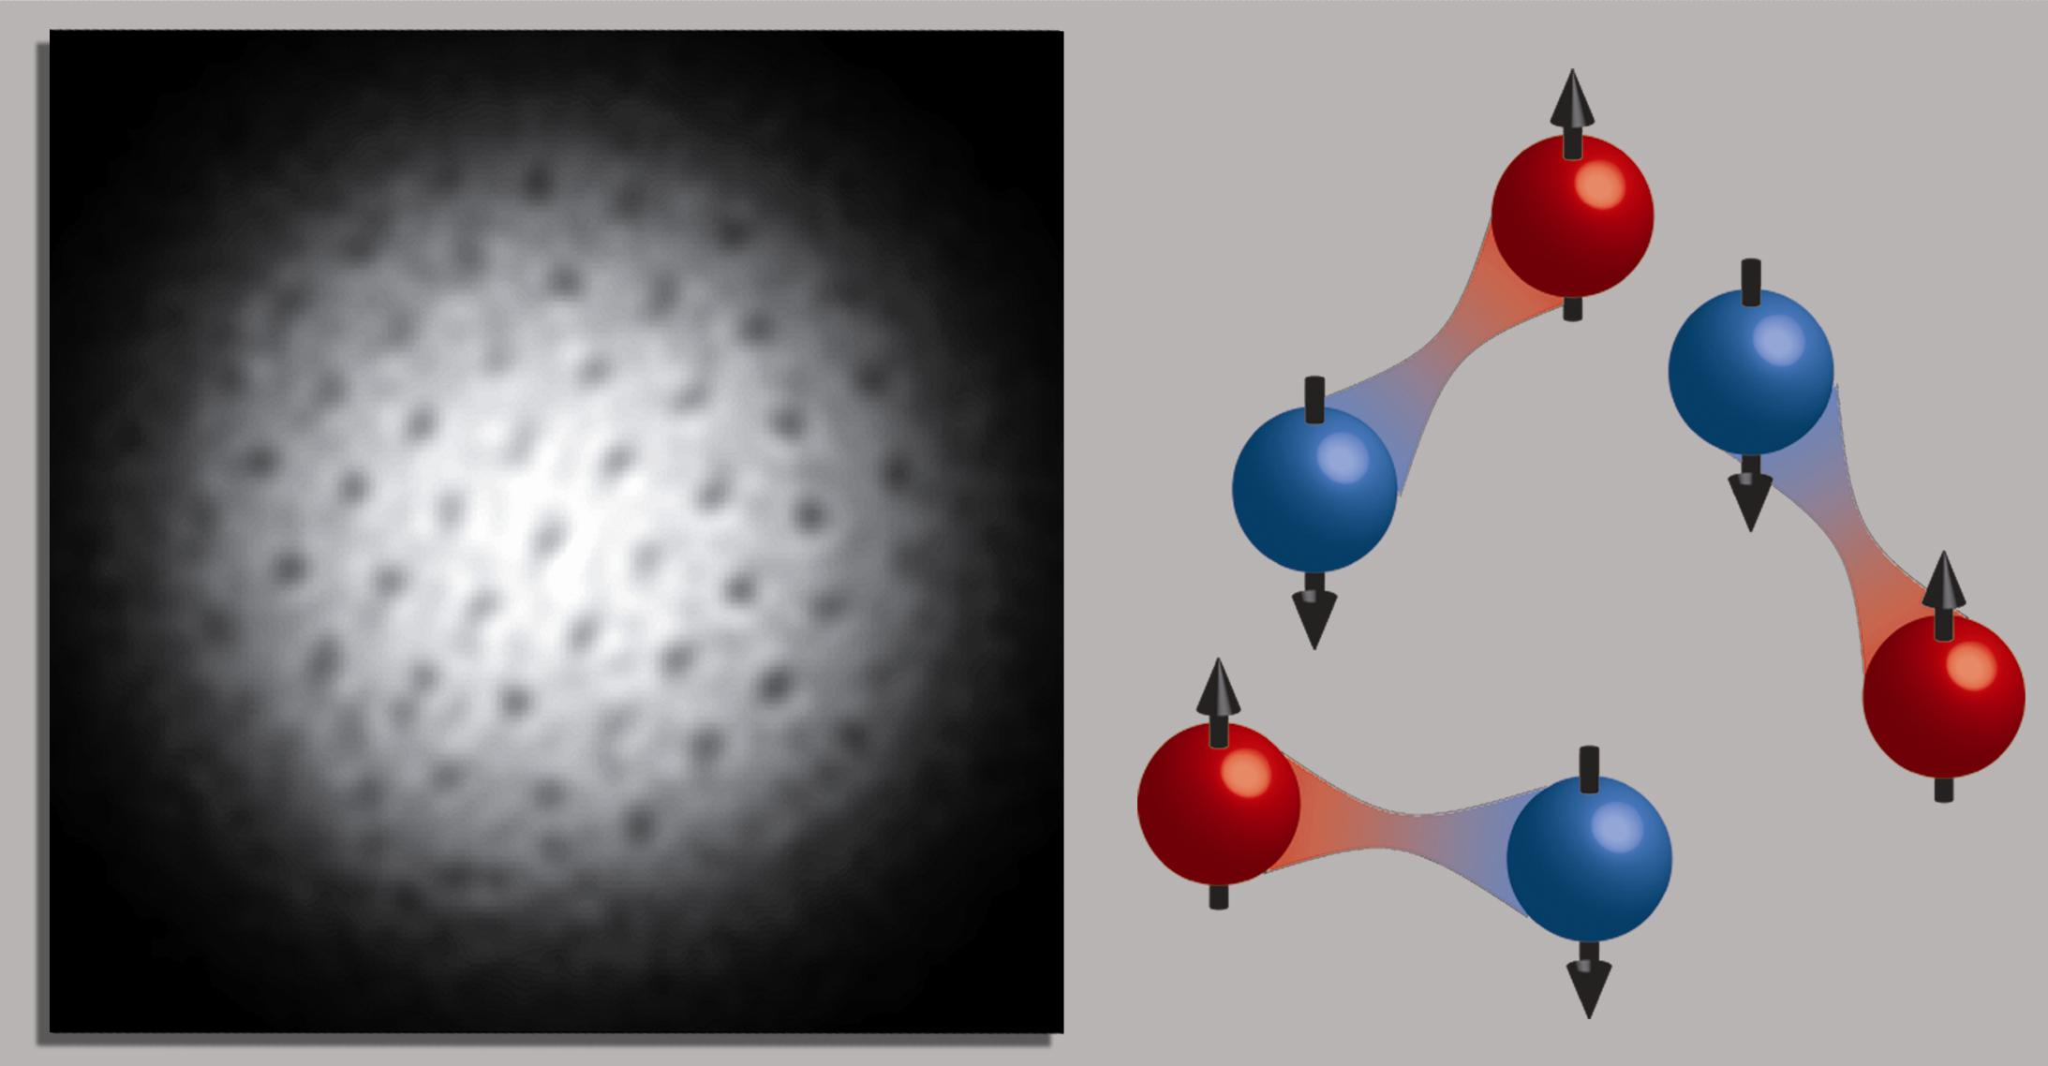
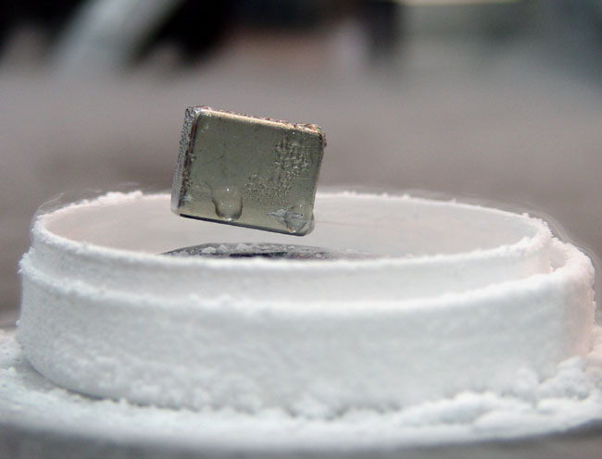
Fermions Can Form Bosons
Fermions in general don’t like to be together
But they can pair up and make a boson
Bosons like to be together and can become like a Bose-Einstein condensate!
Fermionic pairing
Superconductors
http://cua.mit.edu/ketterle_group/Nice_pics.htm

Slide 28
What Does It Take to Make It?
You need a lot of technologies to make a BEC
Lasers
Electronics
Vacuum
Etc.
Skills that are useful
Build things
Put things together
Trouble-shooting
Patience!

Slide 29
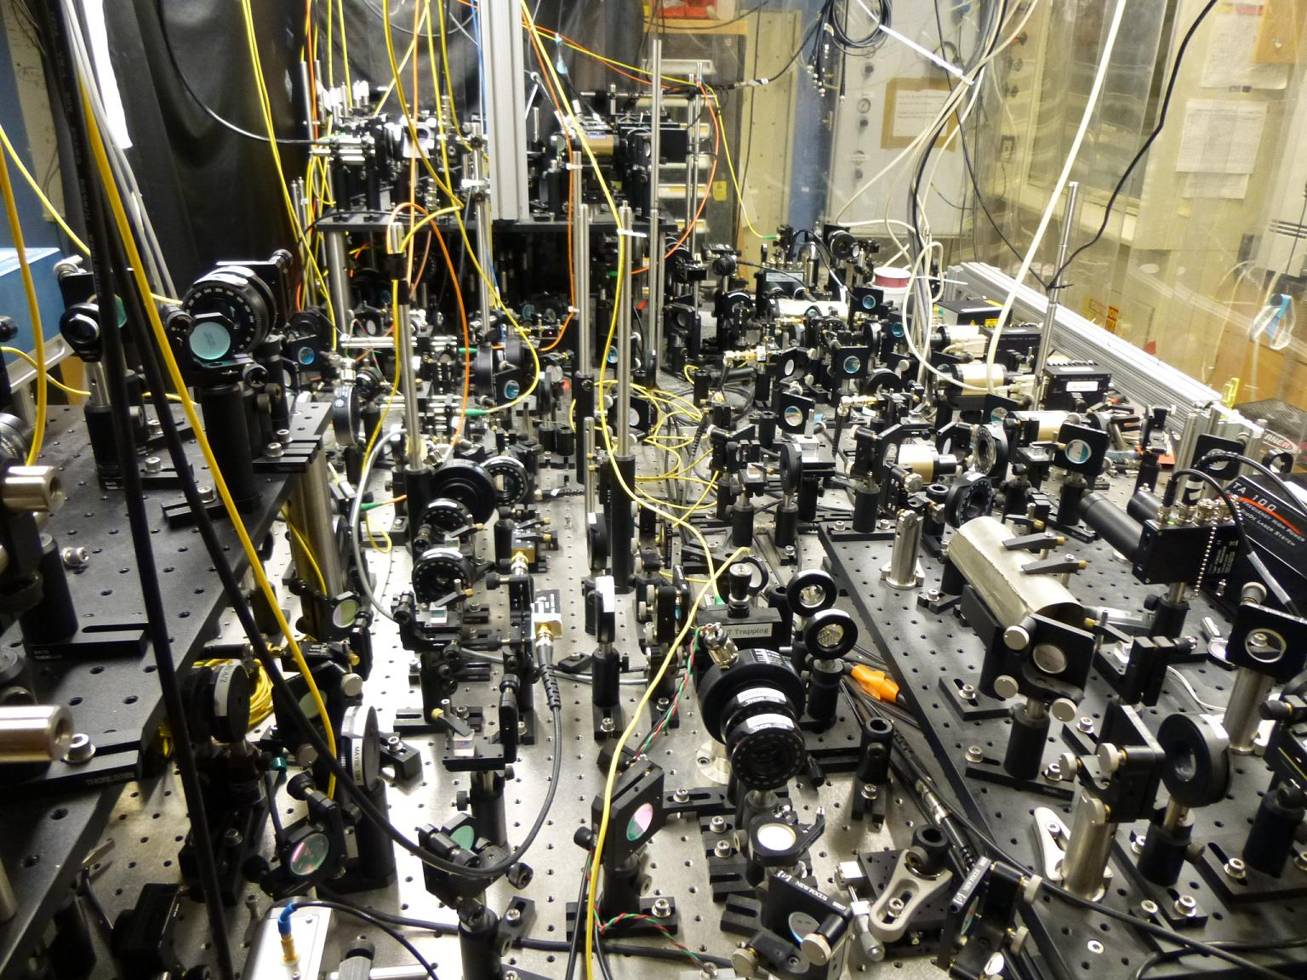
A Lot of Optics

Slide 30
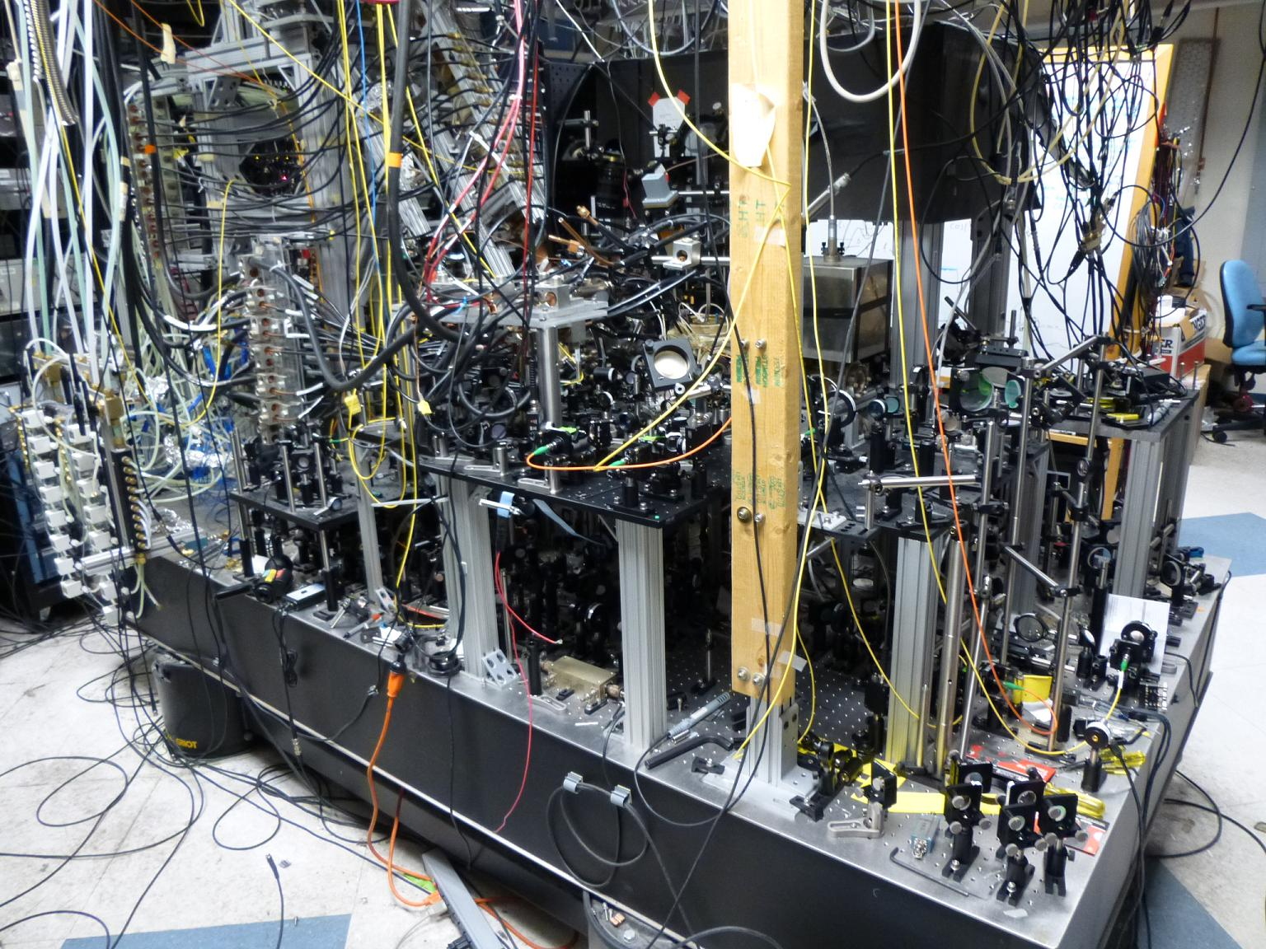
More Optics

Slide 31
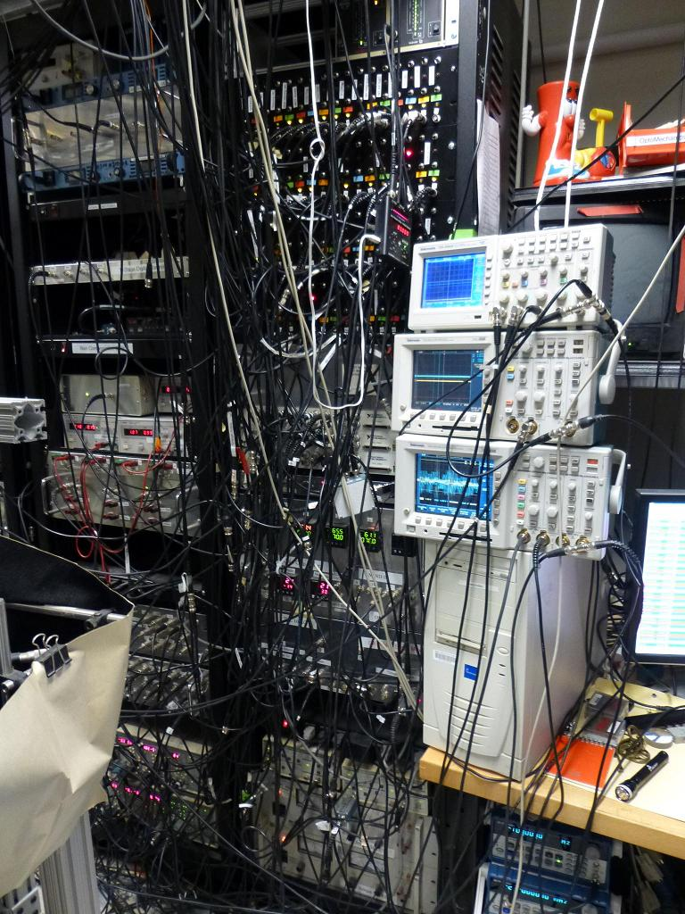
A Lot of Electronics
Need control
Laser powers
Electric currents
Beam shutters
Temperature
Etc.
Need good timing
Microsecond control

Slide 32
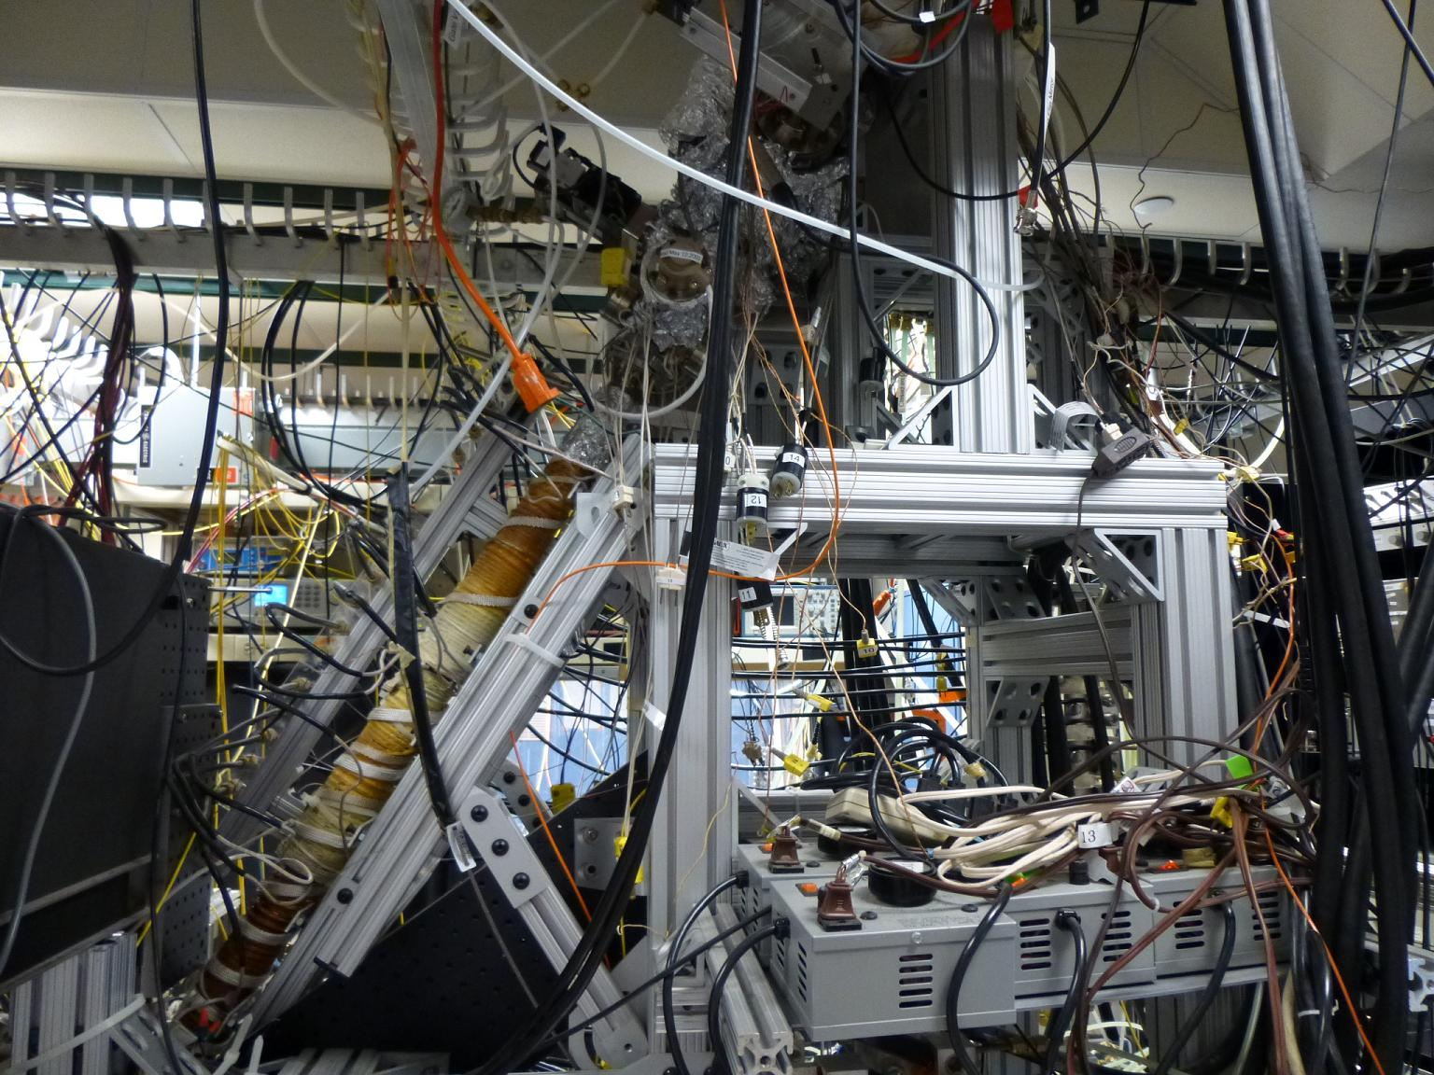
Atom Slowing

Slide 33
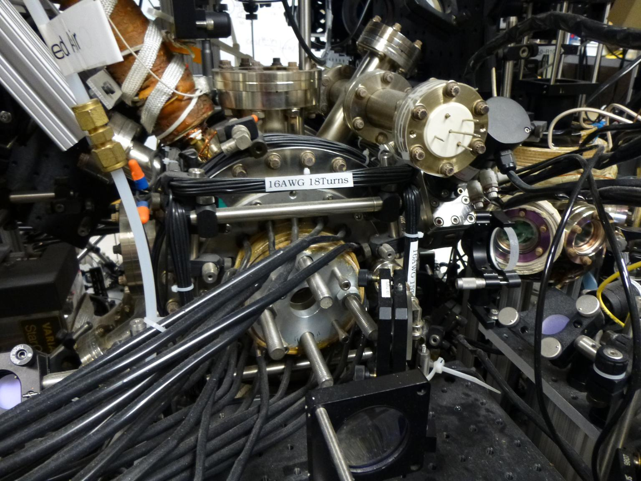
Atom Trapping

Slide 34
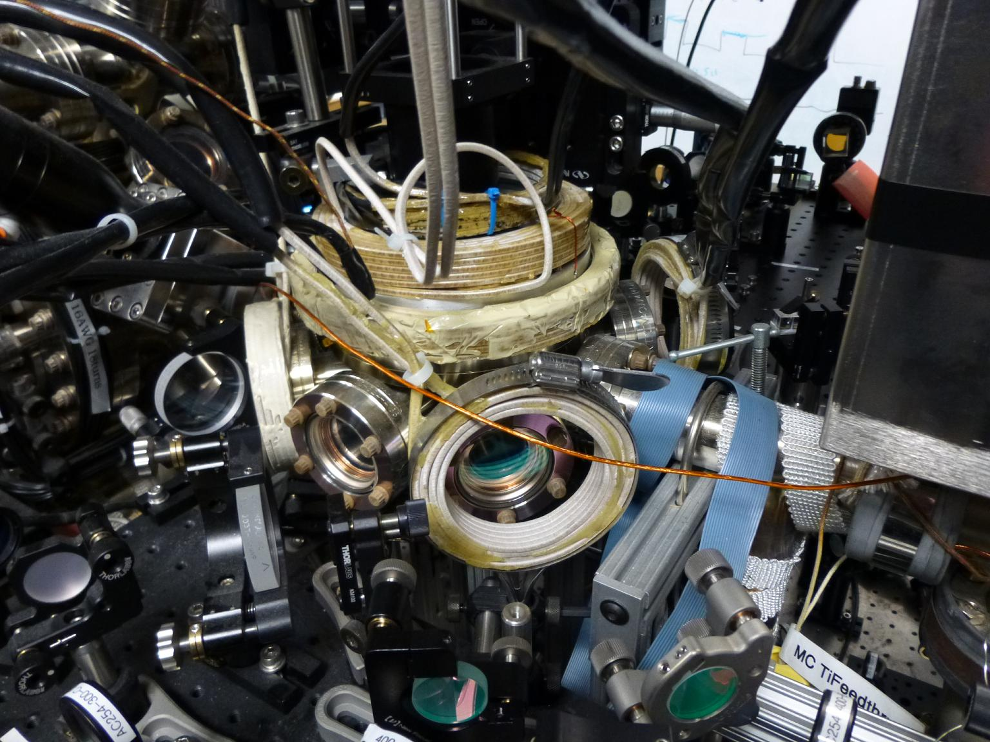
Atom Trapping and Probing

Slide 35
Summary of Bose-Einstein Condensates
You can only know the probability of where something is.
You can never know exactly the position and speed of an object.
Everything is fuzzy if you look close enough.
If atoms are cold enough, they can act like one giant atom.
Atoms at low temperatures have weird behavior.
If you like to build things, put things together and make things work, you can make a BEC too!
Even more interesting discoveries are yet to come!

Slide 36
Thank you!
hmiyake@mit.edu

