Slide 1
The Sickest Class You’ll Ever Take
Immunology 101
Priya Veeraraghavan and Sharon Wu

Slide 2
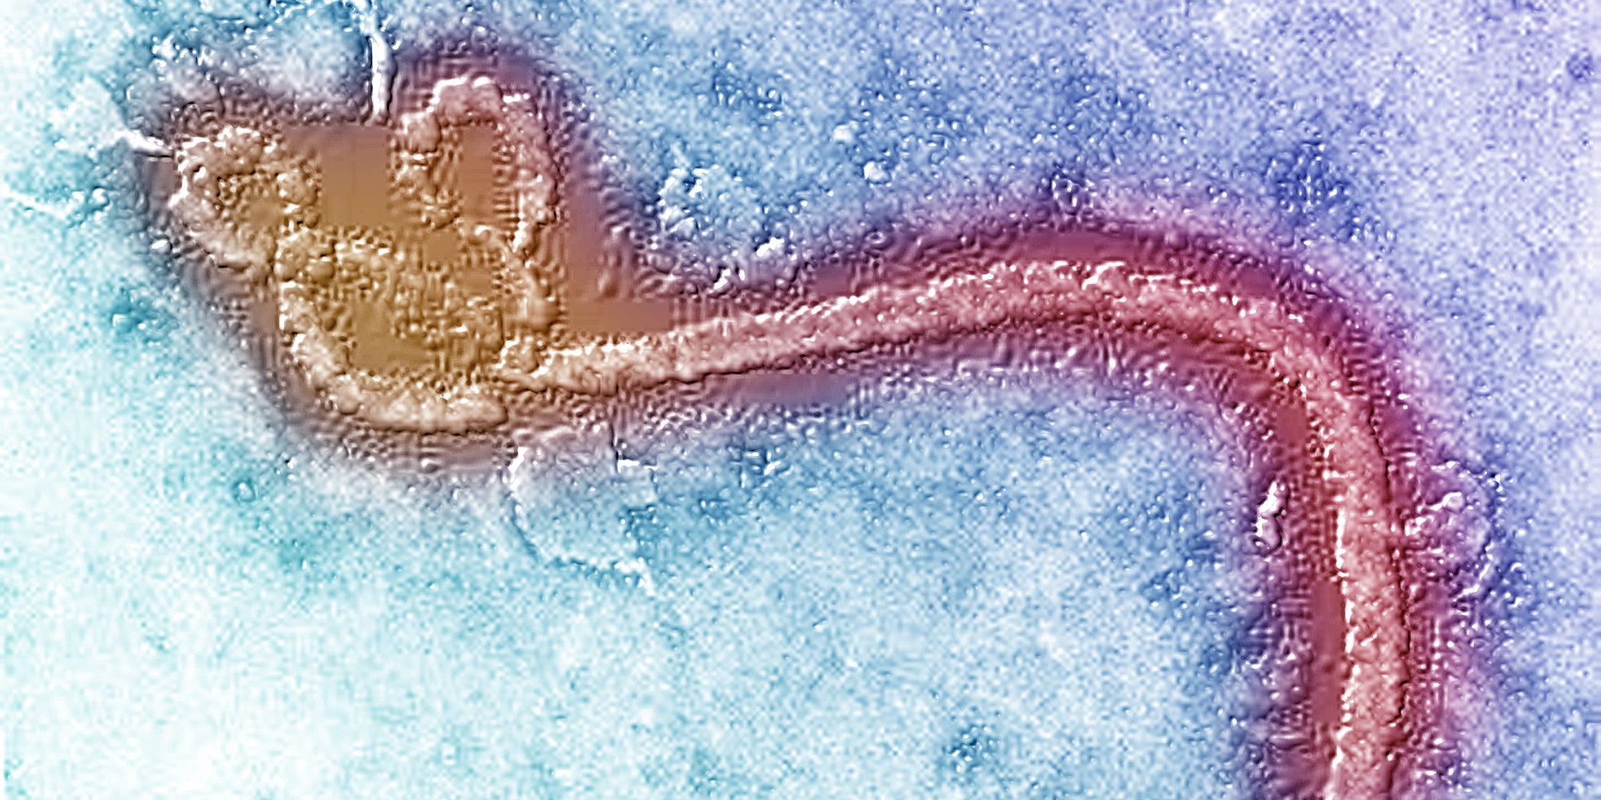
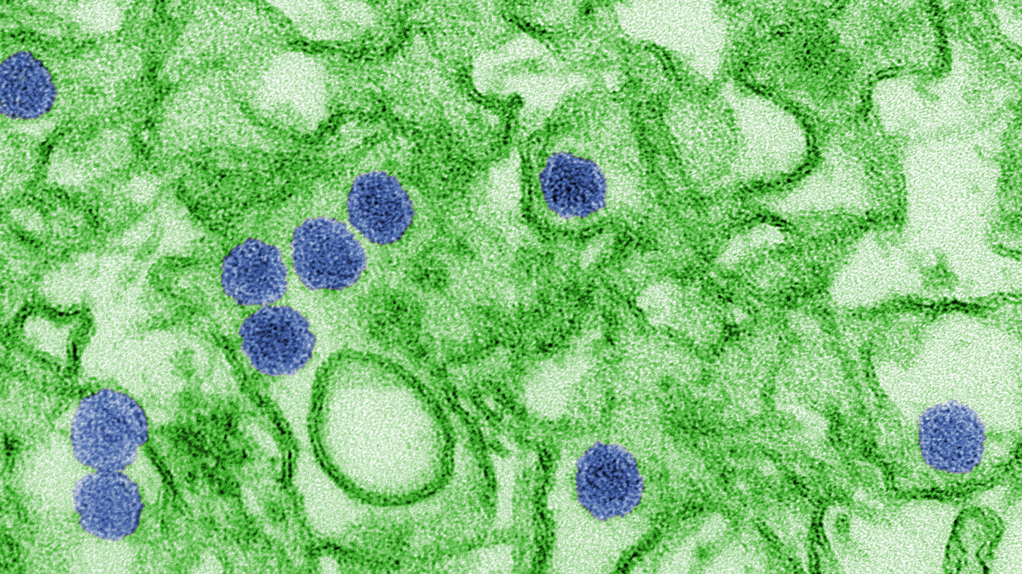
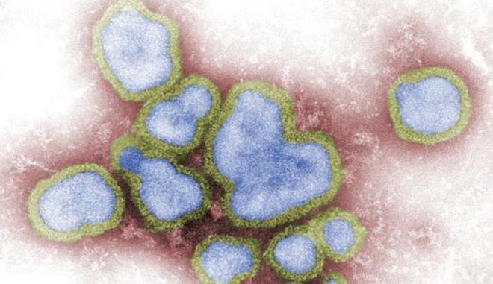
Ebola
Zika
Flu

Slide 3
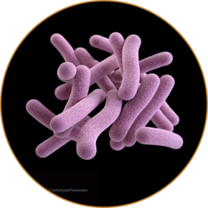
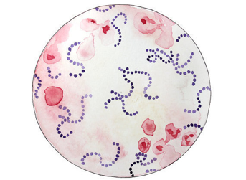
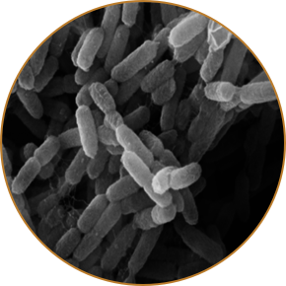
Streptococcus
Mycobacterium tuberculosis
Yersenia pestis

Slide 4
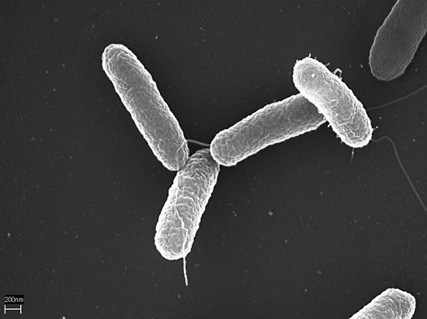
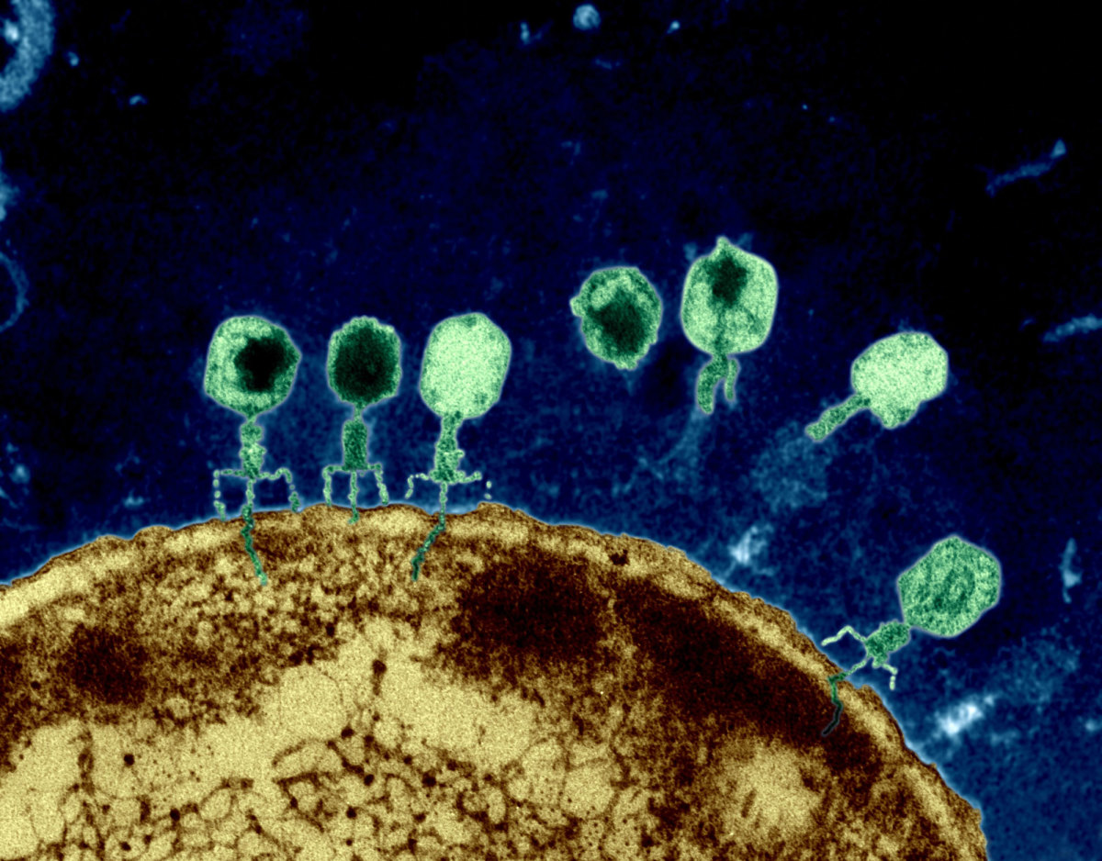
Types of Invaders
Bacteria: can be “good” or “bad”; co-exist in body with own cells
Viruses: generally “bad”; actively attack own cells
“Living” cell
Has all the
DNA and proteins it
needs to
survive and replicate
Infectious agent
Requires host cell and host proteins to replicate
Bacterium
(Salmonella)
Virus
(Bacteriophages)

Slide 5
Adaptive
Innate
Humoral
Cell-mediated
Dendritic cells
B cells
Cytotoxic T cells
Macrophages
Natural Killer cells
Plasma cells
Mast cells
T helper cells
Neutrophils

Slide 6
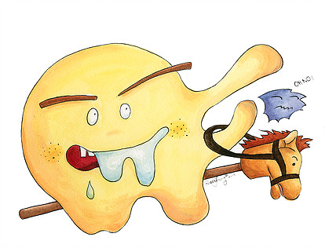
Macrophage
Recognize invaders with Toll-like Receptors (TLRs)
Eat, digest, and destroy them

Slide 7
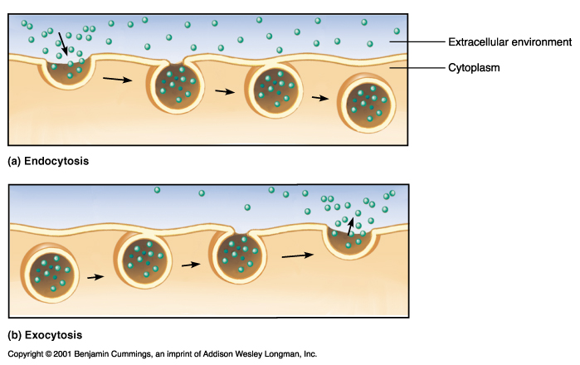

Slide 8
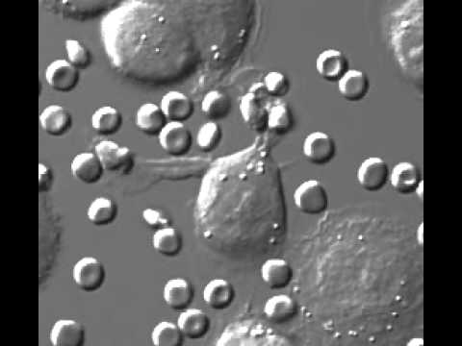
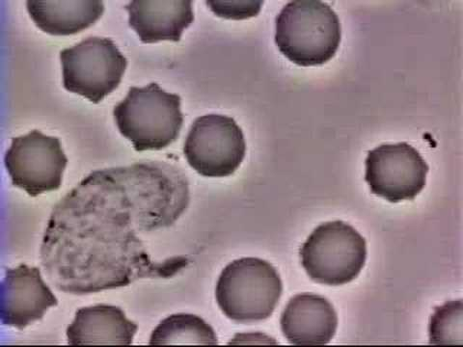
https://www.youtube.com/watch?v=I_xh-bkiv_c
https://www.youtube.com/watch?v=w0-0Bqoge2E

Slide 9
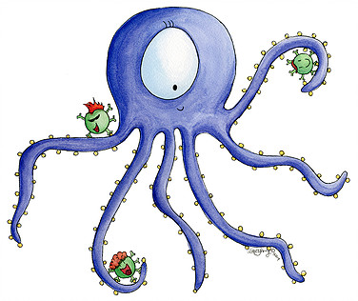
Dendritic cell
Recognize invaders with Toll-like Receptors (TLRs)
Eat and digest them
Display pieces of digested invader on surface so adaptive immune system cells can recognize invaders too

Slide 10
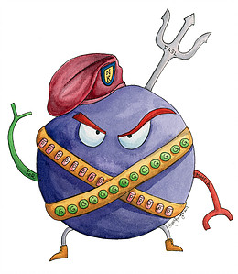
NK cell
Kill infected cells:
Poke holes (perforin)
Proteases released by NK cell enter infected cell and trigger apoptosis (cell death)
Kill bacteria:
Release molecules that disrupt bacterial cell wall

Slide 11
Infection 2
Adaptive
Response
Infection 1
Innate
Time

Slide 12
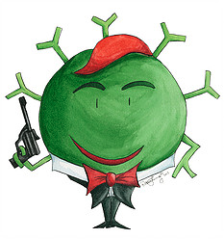
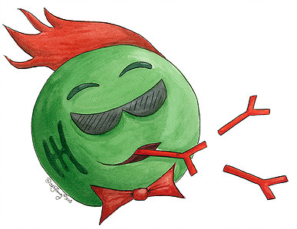



Slide 13
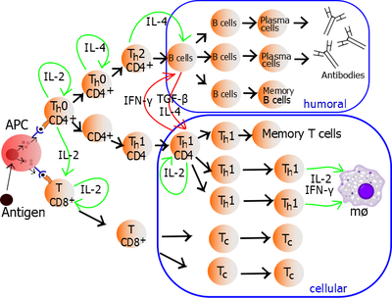

Slide 14
T helper
Recognize
Communicate with Dendritic Cells of Innate Immune System
Respond
Communicate with B cells
Other regulation
Remember
Memory T

Slide 15
B cell (and Plasma cell)
Recognize
Antigens with Antibodies
Response
Display to T helpers
Produce Antibodies
Remember
Memory B

Slide 16
T cytotoxic
Recognize
Dendritic cell presents evidence of infection
Finds infected cells with evidence
Respond
Kill infected cells

Slide 17
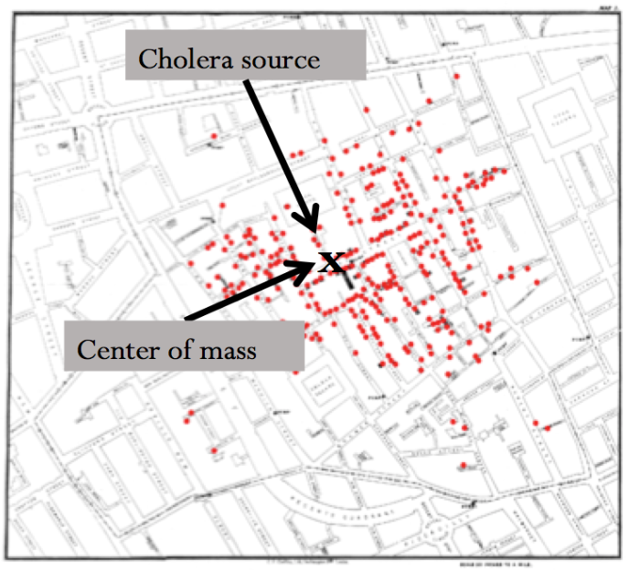
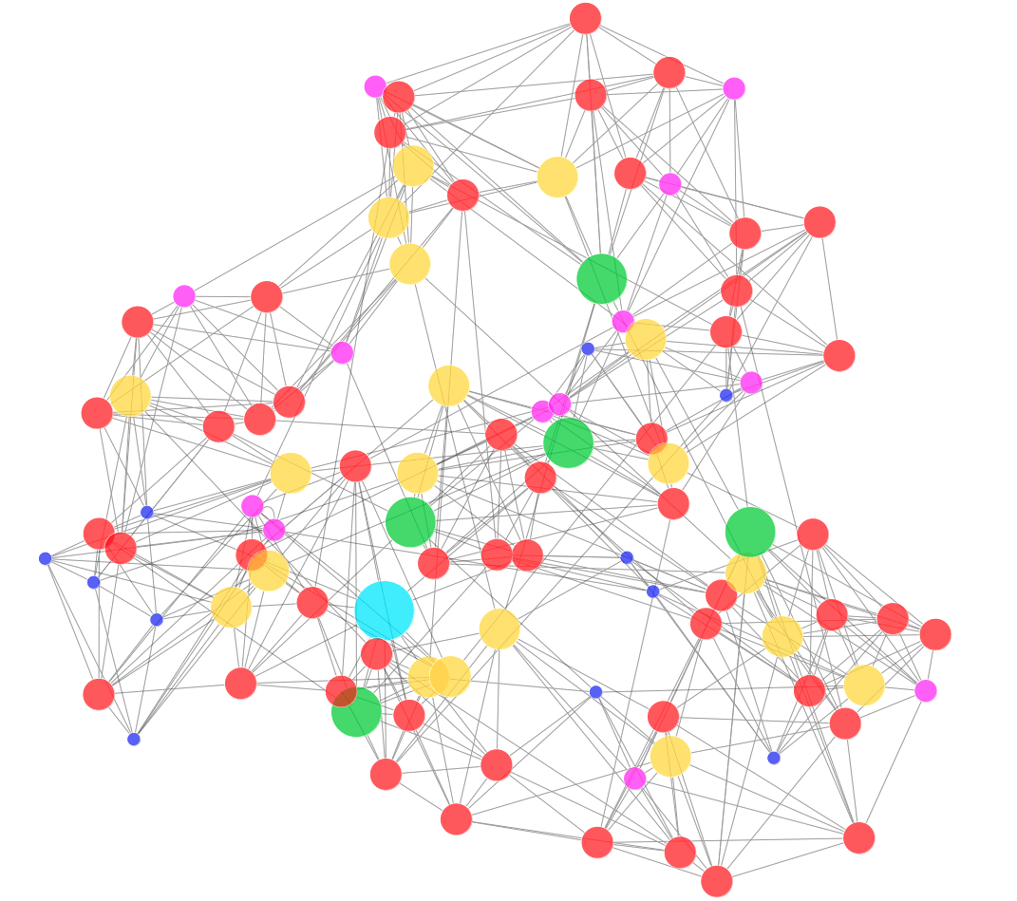
EPIDEMIC!

