Slide 1
Notes:
The notes start on slide ___, where I left off in lecture.

Slide 4
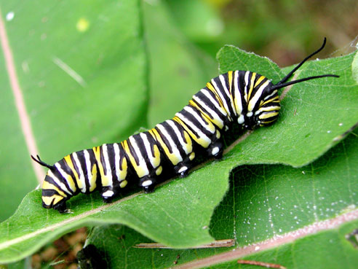

Slide 5
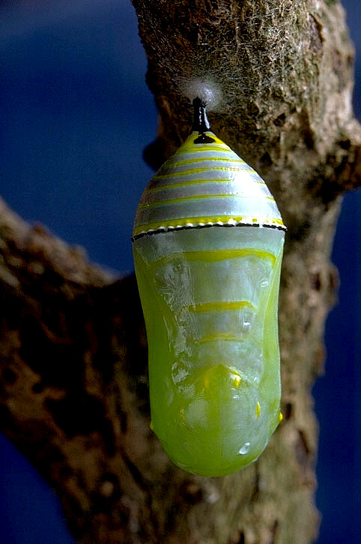

Slide 14
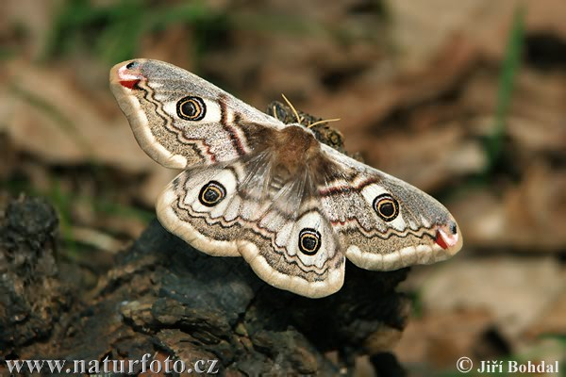

Slide 26
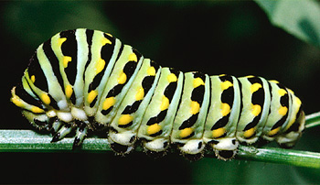

Slide 27
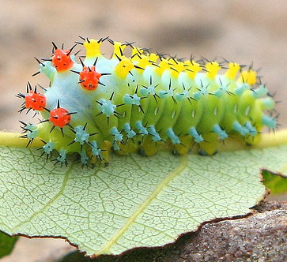

Slide 28
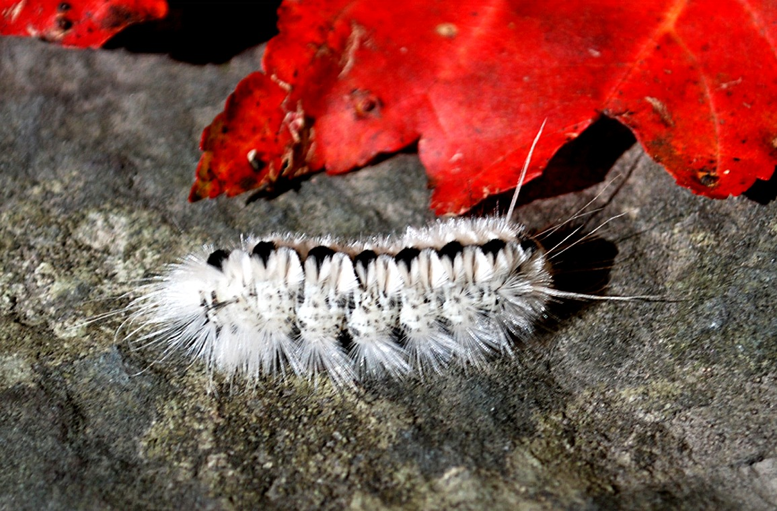

Slide 29
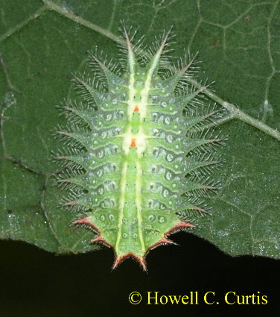

Slide 36
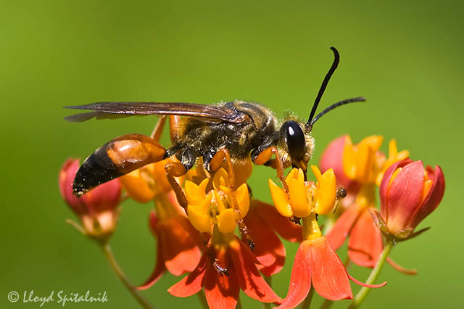

Slide 37
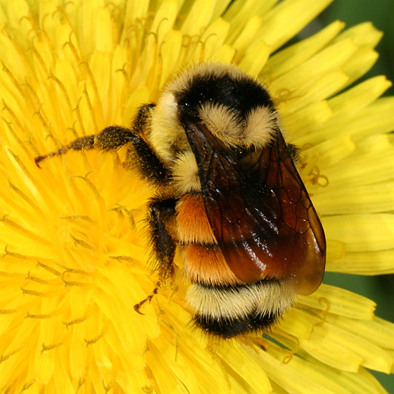

Slide 40
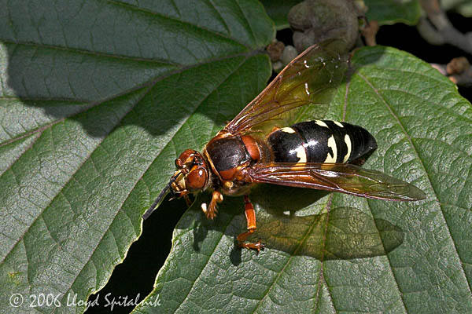

Slide 41
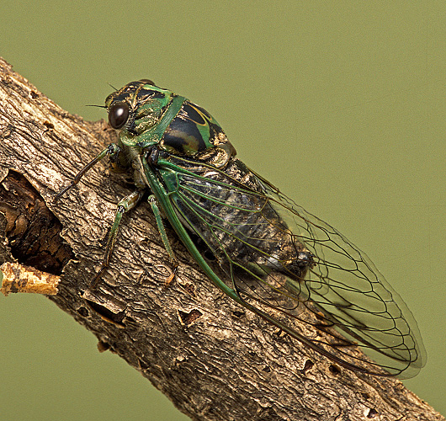

Slide 42
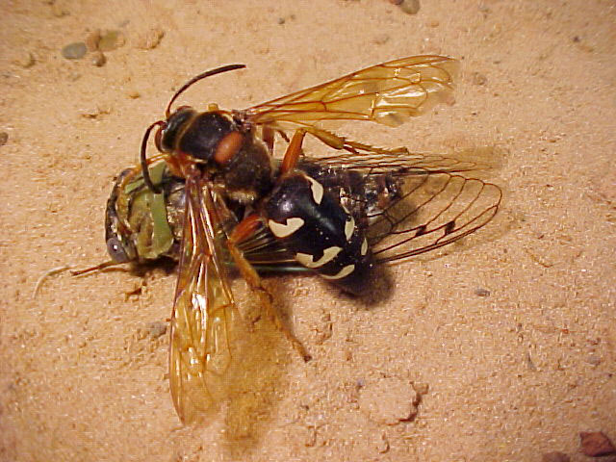

Slide 48
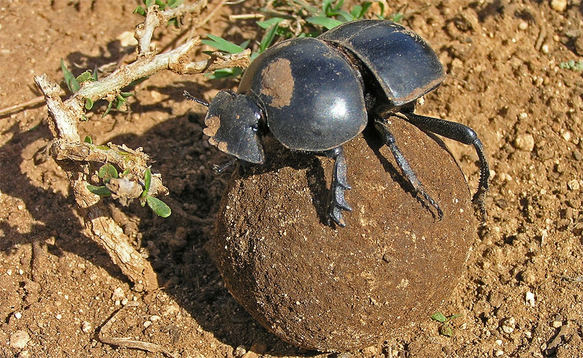

Slide 58
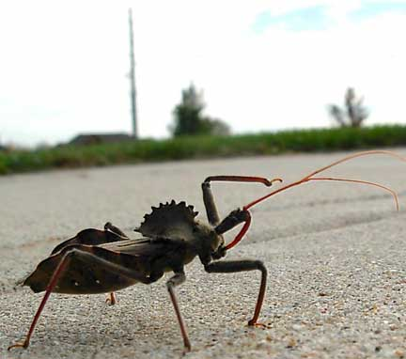

Slide 59
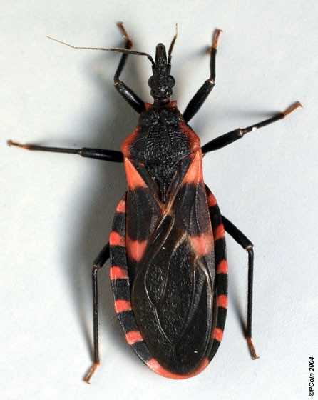

Slide 60
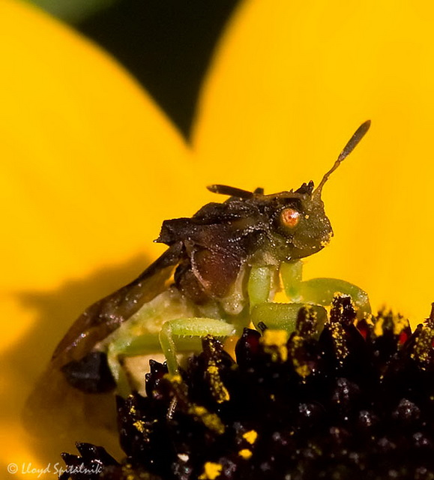

Slide 62
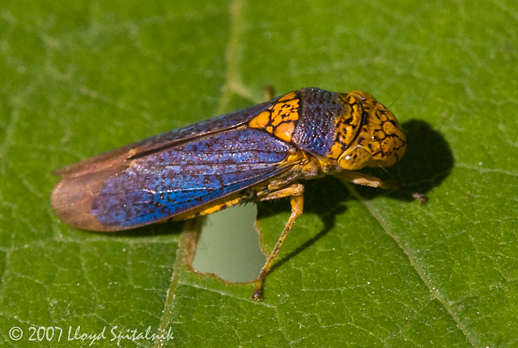

Slide 70
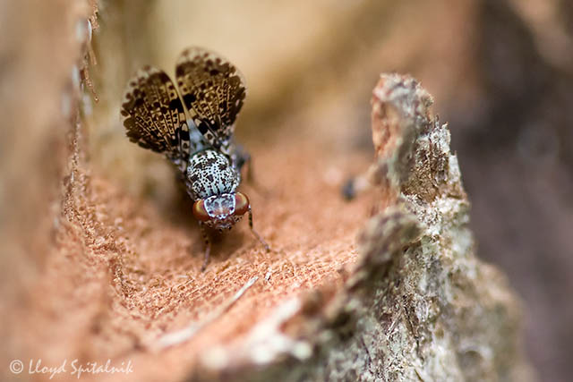

Slide 72
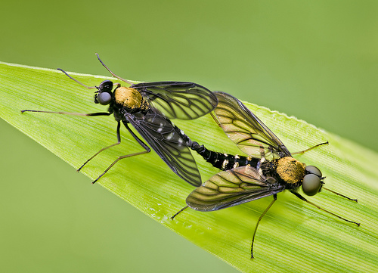

Slide 73
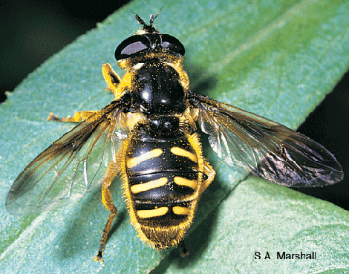

Slide 74
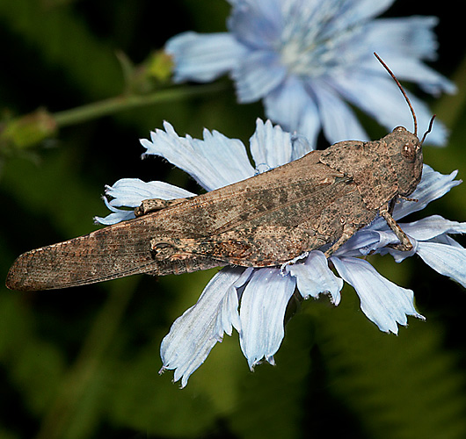

Slide 75
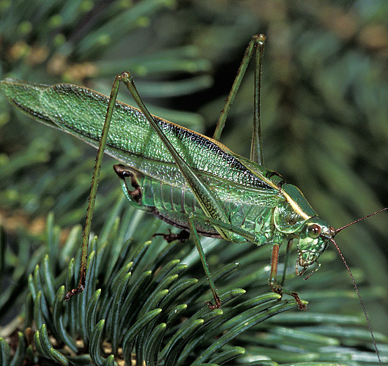

Slide 76
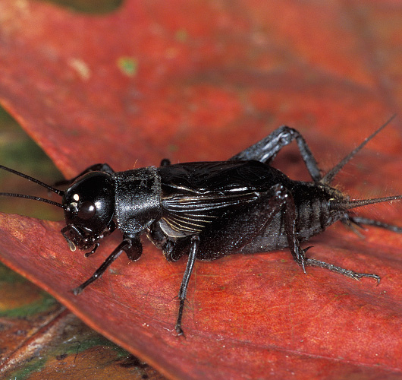

Slide 79
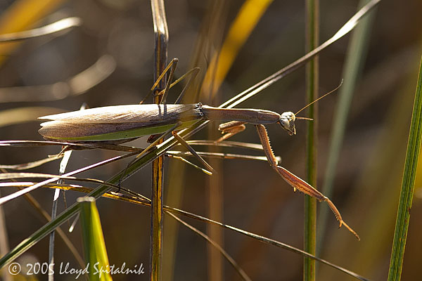

Slide 86
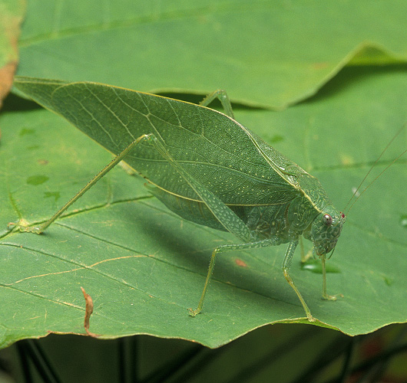

Slide 90
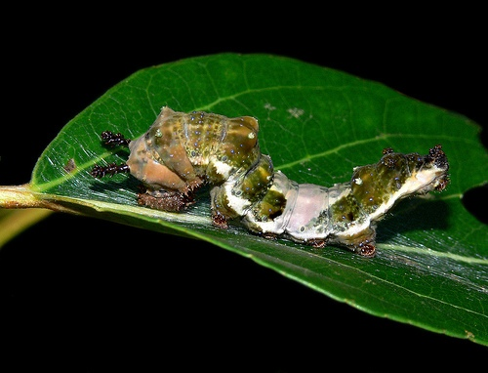

Slide 102
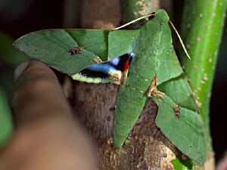

Slide 103
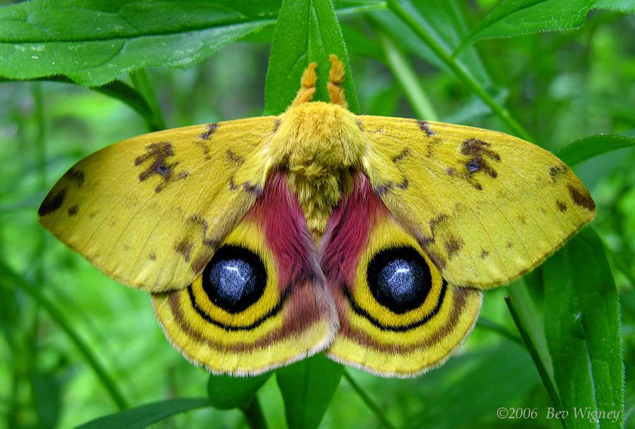

Slide 105
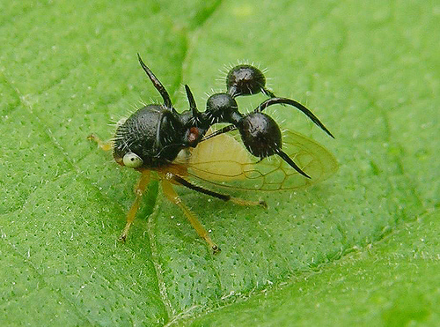

Slide 106
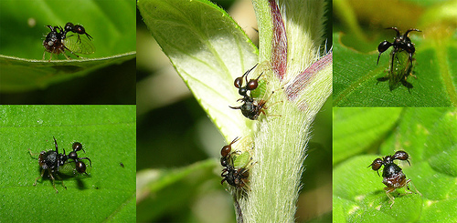

Slide 109
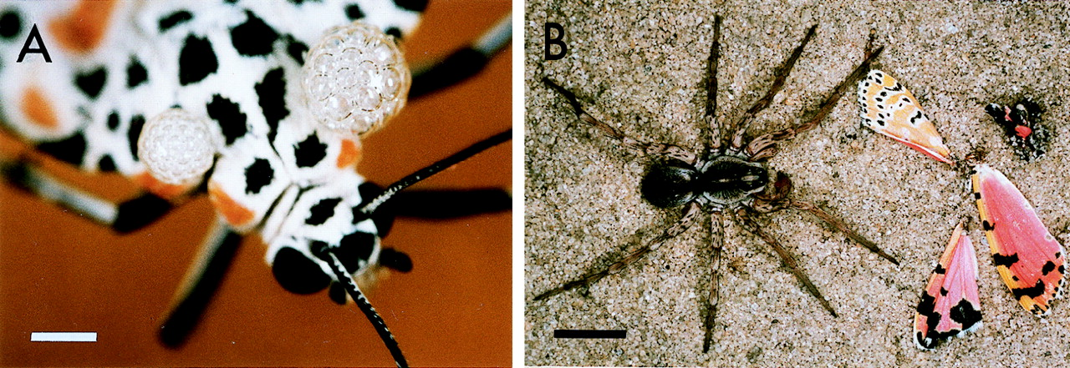
(A) Female Utetheisa emitting defensive froth
González A et al. PNAS 1999;96:5570-5574
©1999 by The National Academy of Sciences
Notes:
(A) Female Utetheisa emitting defensive froth. (Bar = 1 mm.) (B) Outcome of an encounter between a L. ceratiola spider and a PA-free Utetheisa from the − ♀ (− ♂) category. (Bar = 1 cm.)

Slide 110
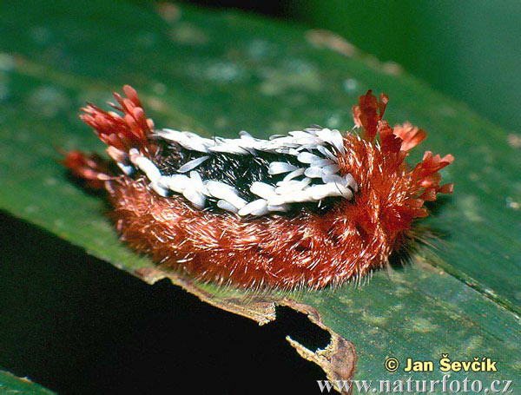

Slide 117
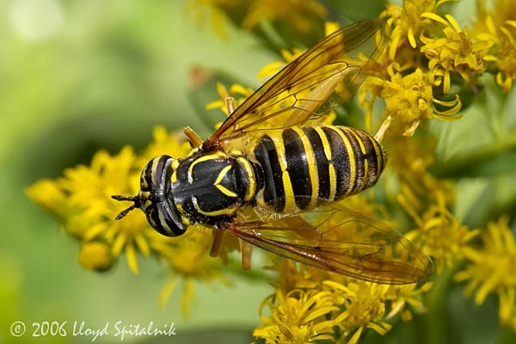

Slide 118
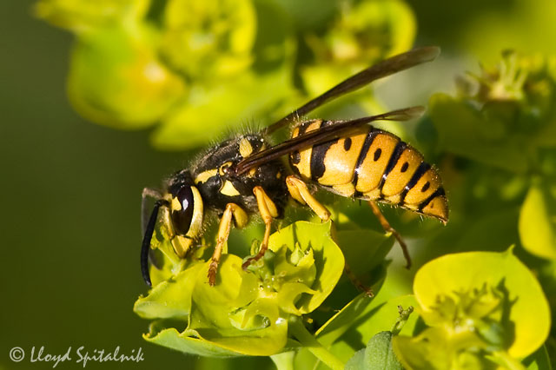

Slide 128
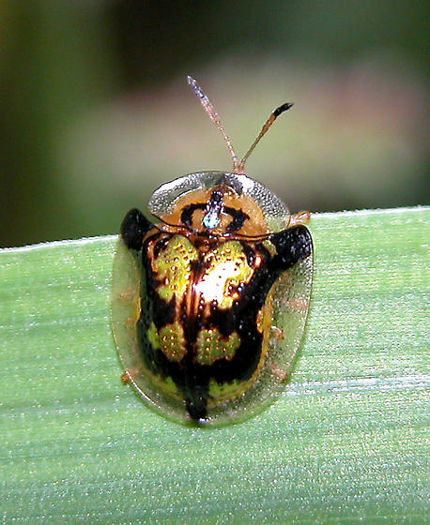

Slide 130
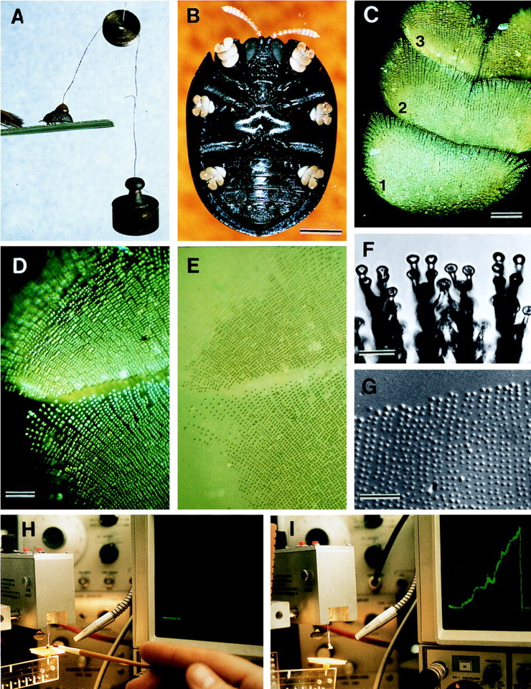
(A) Beetle withstanding a 2-g pull; brush strokes are causing the beetle to adhere with its tarsi
Eisner T, Aneshansley D J PNAS 2000;97:6568-6573
©2000 by National Academy of Sciences
Notes:
(A) Beetle withstanding a 2-g pull; brush strokes are causing the beetle to adhere with its tarsi. (B) Ventral view of beetle, showing yellow tarsi. (C) Tarsus (numbers refer to tarsomeres). (D) Tarsus in contact with glass (polarized epi-illumination). (E) Same as preceding, in nonpolarized light; contact points of the bristles are seen to be wet. (F) Bristle pads, in contact with glass. (G) Droplets left on glass as part of a tarsal “footprint.” (H and I) Apparatus diagrammed in Fig. 1. In H, beetle is on platform, before lift is applied (horizontal trace on oscilloscope); in I, the lift has been applied (ascending green trace) to point where beetle has detached (return of trace to baseline). [Bars = 1 mm (B), 100 μm (C), 50 μm (D), 10 μm (F), and 50 μm (G).]

Slide 131
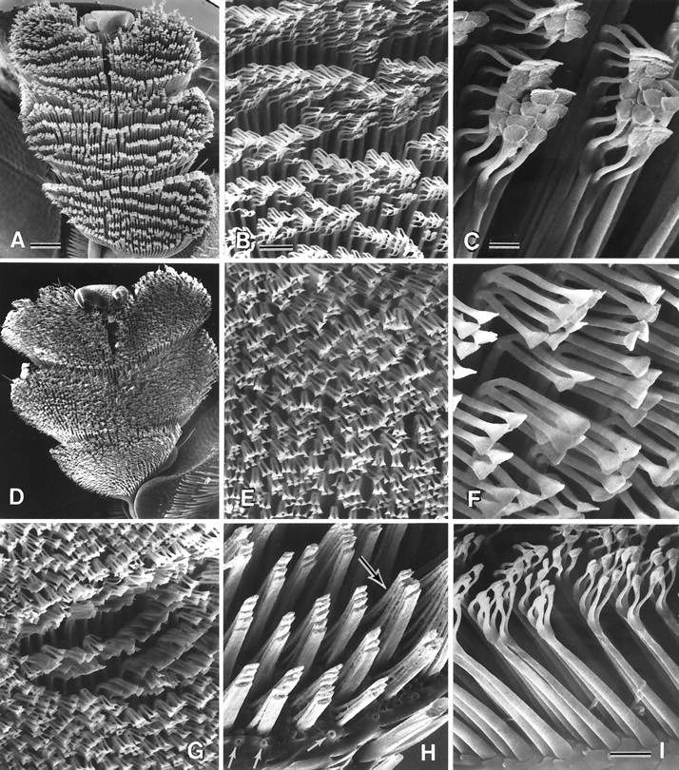
(A–C) Normal tarsus, and details thereof; the pads are stuck together in clusters (C), which are arranged in rows (A)
Eisner T, Aneshansley D J PNAS 2000;97:6568-6573
©2000 by National Academy of Sciences
Notes:
(A–C) Normal tarsus, and details thereof; the pads are stuck together in clusters (C), which are arranged in rows (A). (D–F) Comparable with preceding, but of a tarsus cleaned of oil by treatment with methanol/chloroform solution. (G) Comparable with E but with some of the bristles clustered where a droplet of oil has been applied. (H) Portion of tarsus where tips of bristles have been cut off, showing how bristle shafts are stuck together in groups; a substance, presumed to be oil, is seen between the bases of the bristles (upper arrow). Lower arrows point to pores from which tarsal oil is presumed to be secreted. (I) Bristles, in profile view, showing the component parts (shaft, bifurcated tip, pads) and oil pores between their bases. [Bars = 100 μm (A), 20 μm (B), 5 μm (C), 10 μm (I).]

Slide 132
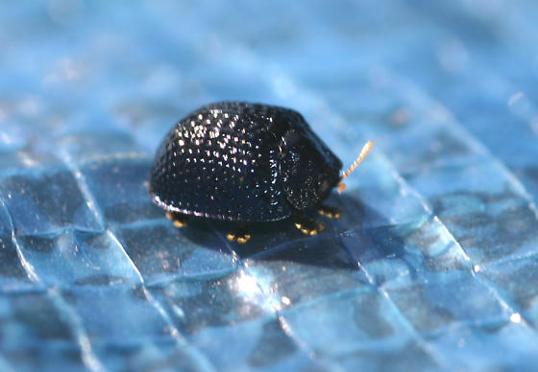

Slide 137
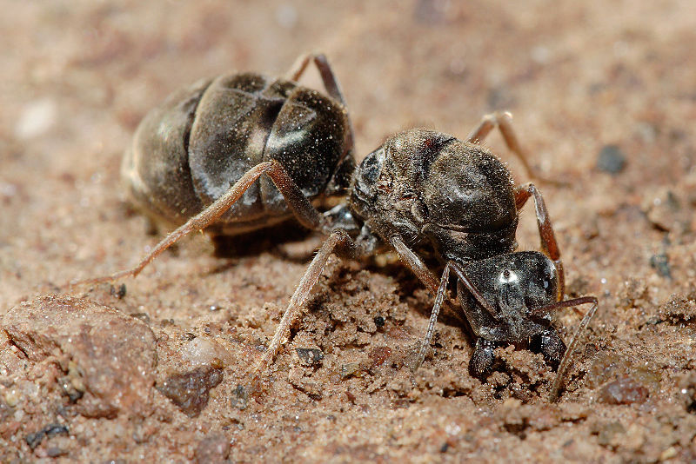

Slide 138
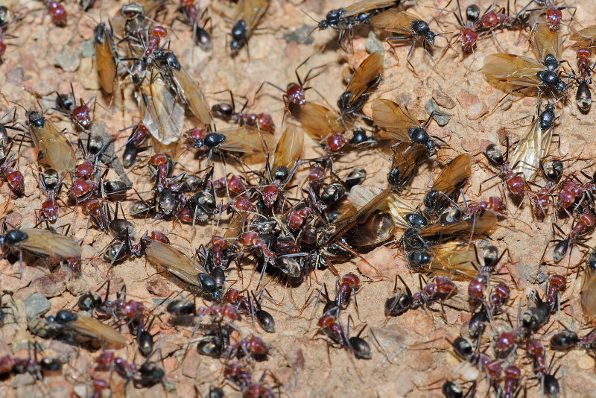

Slide 140
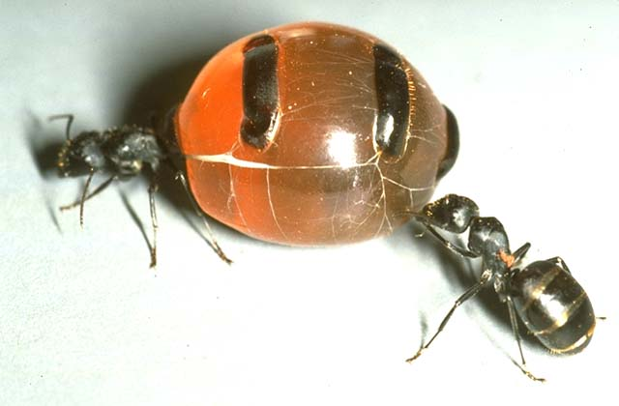

Slide 141
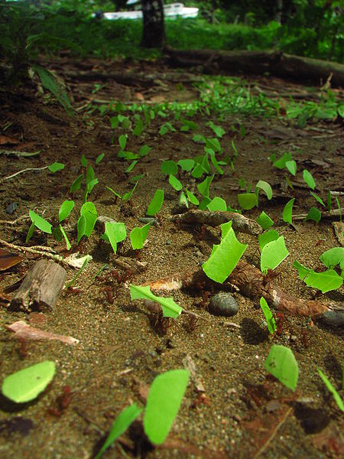

Slide 148
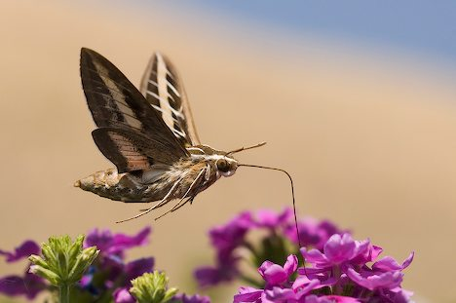

Slide 149
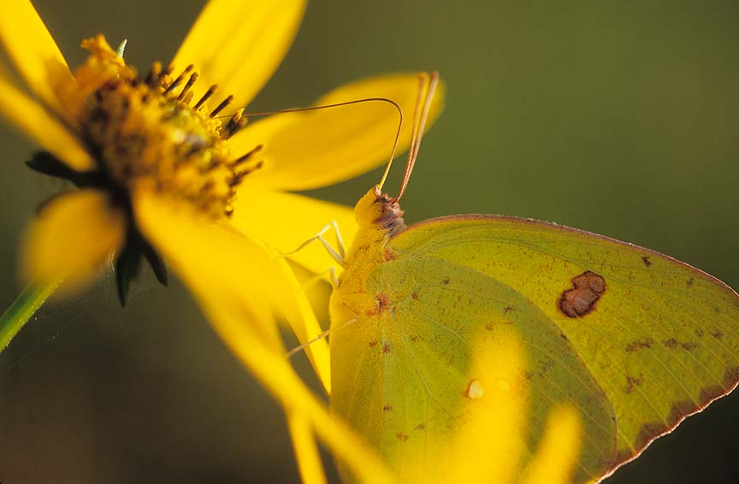

Slide 154
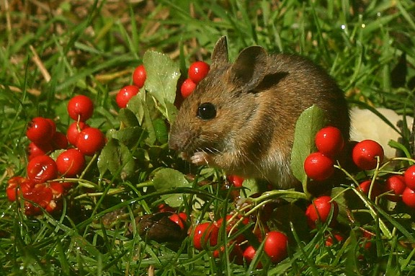

Slide 155
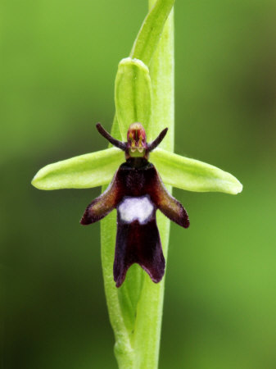

Slide 156
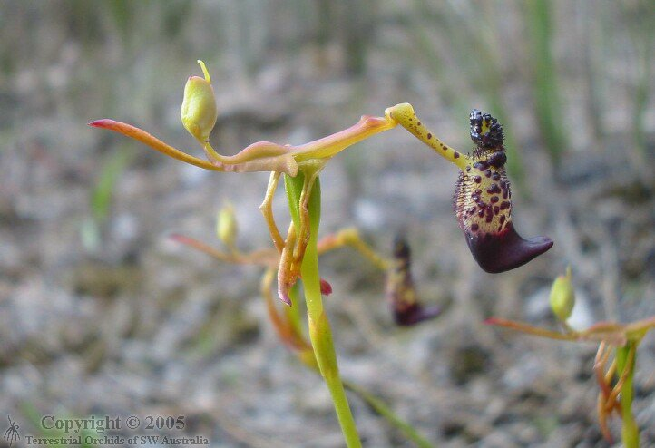

Slide 157
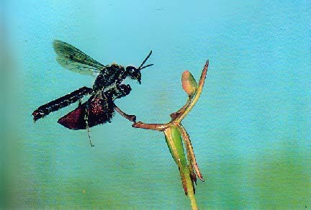

Slide 165
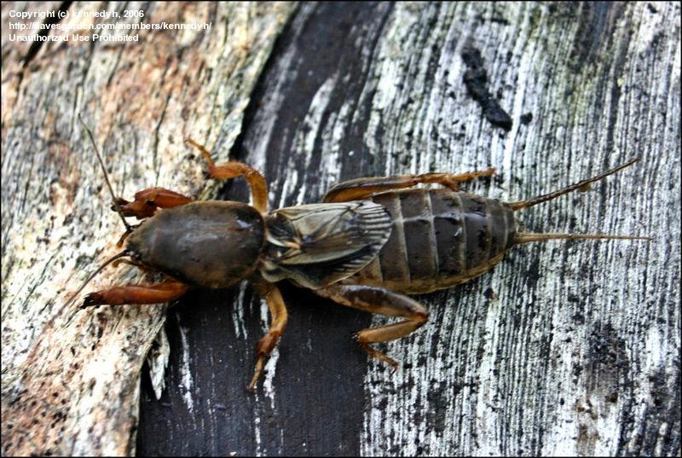

Slide 167
