Slide 1
The Physics of Information: Demons, Black Holes, and Negative Temperatures
Charles Xu
Splash 2013

Slide 2
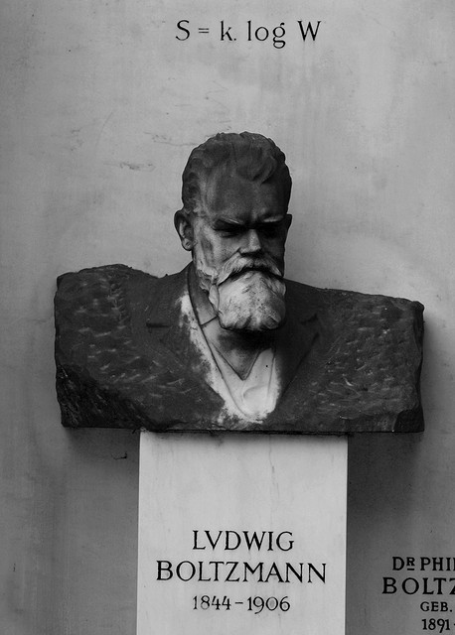
What’s entropy?
High school chem answer: “disorder”
Slightly better: our ignorance about “exact” state of system
Even better: S = k_{B} log Ω
Boltzmann’s constant
# of microstates

Slide 3
What’s entropy?
Macrostates vs. microstates: for ideal gas, (P,V,T,N) vs. (p_{i} ,q_{i}) for each molecule i
Second law of thermodynamics sez: ΔS ≥ 0
Now just a theorem of probability theory: closed system evolves from less probable to more probable (macro)states
Can actually observe brief decreases in entropy in microscopic systems!

Slide 4
Maxwell’s Demon

Slide 5
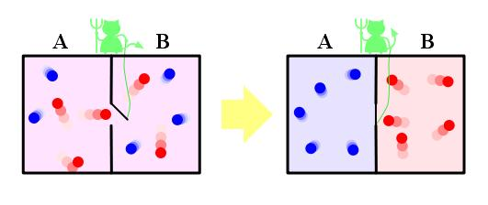
Maxwell’s Demon
Late 19th c. paradox: what if microscopic “demon” could lower the entropy of a gas by allowing only fast molecules to pass one way and slow ones the other?

Slide 6
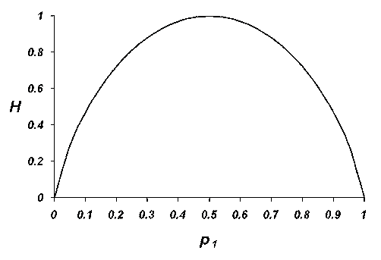
What’s information?
Shannon (1948): where p_{i} is probability of outcome/message i
Boltzmann: where p_{i} is probability of microstate i. Notice anything?

Slide 7
Resolutions to Paradox
Szilard (1929): Demon does work k_{B}T ln 2 for every bit of information gained, releasing one “bit” of entropy k_{B} ln 2 to environment as heat
Bennett et al. (1980s): Hold on, measuring a bit is reversible!
Landauer (1961): Actually, erasing a bit releases entropy k_{B} ln 2. Forgetting information takes work

Slide 8
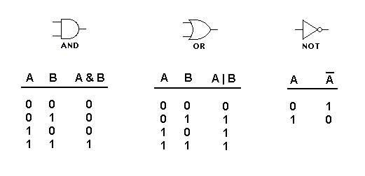
Reversible computation
AND, OR, NOT gates are computationally universal but AND and OR are irreversible:
Can instead use universal set of reversible gates: no heat output in principle!

Slide 9
Negative Absolute Temperature

Slide 10
What’s temperature?
In statistical mechanics, we simply define
Doesn’t look much like intuitive notion of temperature, but…

Slide 11
What’s temperature?
…it explains the Zeroth Law of Thermodynamics: systems in thermal equilibrium have same temperature
T₁
T₂
dE

Slide 12
Positive vs. negative
Most familiar systems: energy bounded below
Adding energy → more accessible microstates → higher entropy, so T > 0
But what if energy were instead (or also) bounded above? Then higher-energy macrostates have fewer microstates
Adding energy → lower entropy so T < 0

Slide 13
Positive vs. negative
Negative temperatures “hotter” than positive
Heat flows from low β = 1/k_{B}T to high β

Slide 14
Experimental implementation
Actually done for optical lattice of atoms!

Slide 15
Experimental implementation
In thermal equilibrium, can show probability

Slide 16
Black Hole Thermodynamics (and Black Holes as Computers)

Slide 17
Black Hole Entropy
Radius of black hole with mass M is
Black hole merger: surface area A > A₁ + A₂
In fact ΔA ≥ 0 in any isolated process, just like ΔS ≥ 0 in 2nd Law
Bekenstein and Hawking: black hole entropy
where

Slide 18
Hawking radiation
Using E=Mc² and 1/T = dS/dE: black hole must radiate at temperature
Eventually evaporates without new infalling matter: 10⁶⁷ years for 1 solar mass

Slide 19
S_{BH} as Information
Using earlier equivalence S = H, can interpret S_{BH} as a bound on the total information that can be stored in a given volume
Lloyd (2000): combine S_{BH} with quantum bound on information processing speed → 1 kg computer performs max of 10⁵⁰ ops/s
Lloyd (1999): universe as quantum computer → 10¹²⁰ ops on 10⁹⁰ bits since Big Bang

