Slide 1
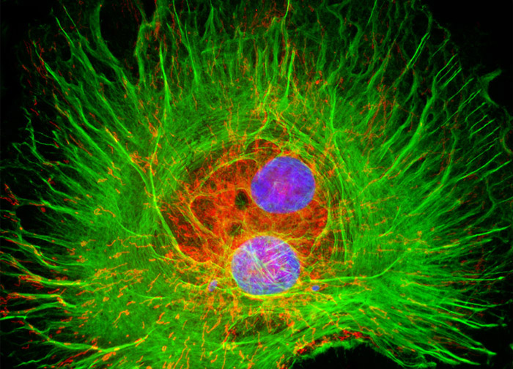
Introduction to Virology
nononononononononononononononononononononono…
Notes:
The nono in reference to the portrayal of a virus in the episode “Bound” in the tv series “Fringe”

Slide 2
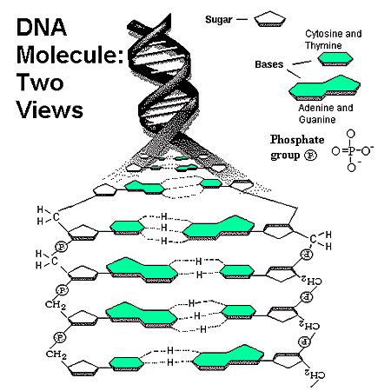
Building Blocks of Life
Lipids
Carbohydrates
Proteins
Nucleic Acids
Notes:
Nucleic acids MAKE UP DNA

Slide 3
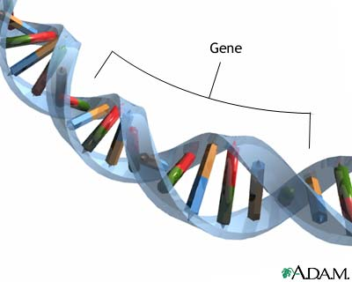
Nucleic Acid: Gene
Notes:
A million times your size
Cali to Colorado
Cell: lecture hall
Bacterium: car
Cholera: kill you in a day and a half: limo
Polio virus: lemon

Slide 4
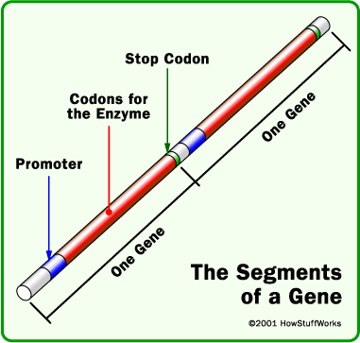
Nucleic Acid: Gene
Notes:
Nucleic acids- many many many
Gene, around 10,000 nucleic acids per gene, can be as few as 1000 or much larger
Usually one protein is produced for every gene. You are really defined by what proteins each cell makes, but proteins are determined by genes.

Slide 5
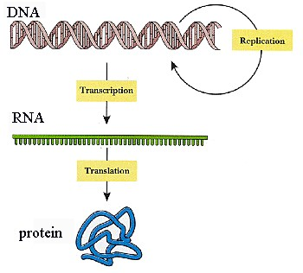
Notes:
A gene (strand of nucleic acids) is transcripted or copied onto an RNA template, the RNA will be translated from nucleic acid code into the corresponding protein.

Slide 6
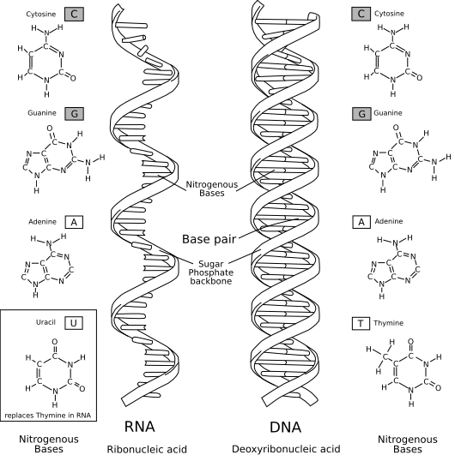
DNA vs. RNA
Notes:
Besides the obvious, deoxyribonucleic acid vs. ribonucleic acid:
DNA- very stable, always double stranded, lots of repair machinery to take care of any damage
RNA- much less stable, degrades more quickly and easily, shorter life span, minimal repair machinery so lots of opportunity for error.
RNA also has catalytic properties, it can perform reactions as well as carry genetic information. Very versatile.

Slide 7
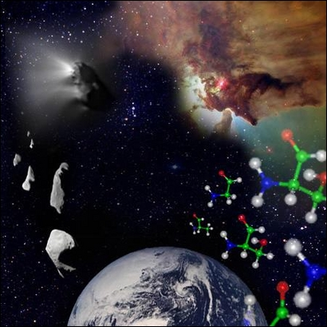
An RNA World?
Notes:
What is life anyway?
This is hard to define and ultimately comes down to your religion/beliefs.

Slide 8
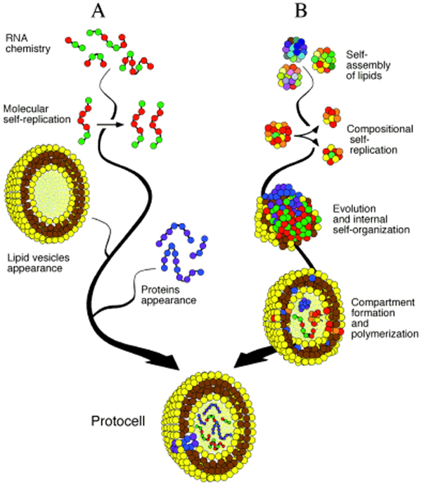
RNA contains genetic information and can carry out reactions!
Notes:
Because RNA can both carry information and perform reactions, it likely pre-dated DNA and many scientists believe the first life forms were RNA molecules surrounded by membranes, it’s a lot like a cell, no? RNA can replicate itself like DNA, it can carry out reactions like proteins, what is a cell besides DNA to make proteins and proteins to carry out reactions?

Slide 9
Virus Life Cycle
Attachment to a host cell.
Release of viral genes and possibly enzymes into the host cell.
Replication of viral components using host-cell machinery.
Assembly of viral components into complete viral particles.
Release of viral particles to infect new host cells.
Notes:
This is important to know when making drugs and treatments to target and destroy viruses.

Slide 10
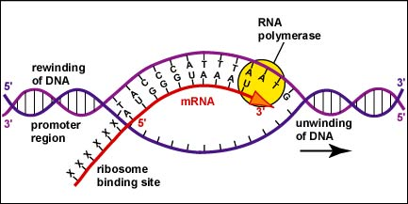
Key Machinery
RNA Polymerase
Notes:
You need protein to make more protein, the RNA polymerase is an example of RNA that carries out a reaction. The RNA polymerase copies the DNA sequence and makes an RNA template.

Slide 11
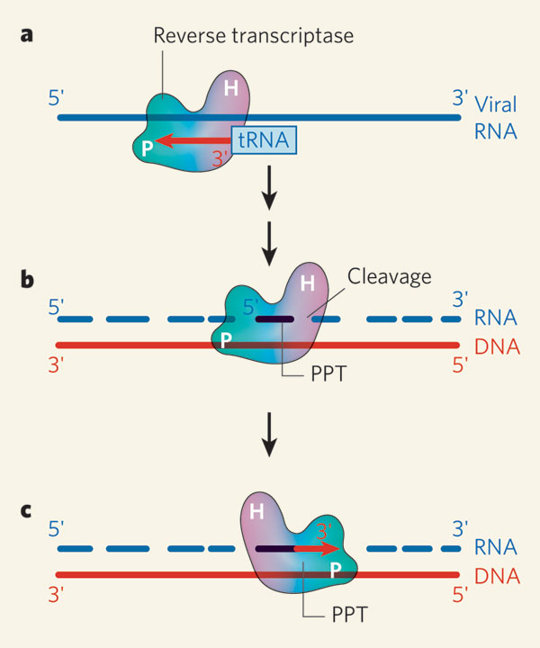
Key Machinery
Reverse
Transcriptase →
Notes:
Reverse transcriptase copies RNA and makes DNA. This is very strange, because the normal pattern is for DNA to be copied onto RNA. Viruses like HIV use reverse transcriptase to copy and put their genomes into the host genome.

Slide 12
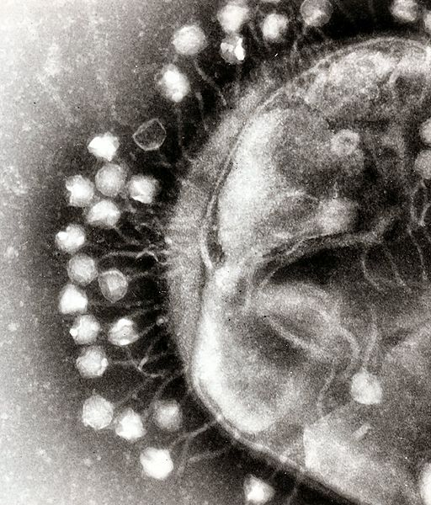
Kinds of Viruses
RNA
DNA
Retroviruses
Notes:
RNA viruses are made of RNA.
DNA of DNA.
Retroviruses are RNA but they use mechanisms like reverse transcriptase to copy and convert their genetic information into DNA to be inserted into the host genome. (see reverse transcriptase on previous slide)

Slide 13
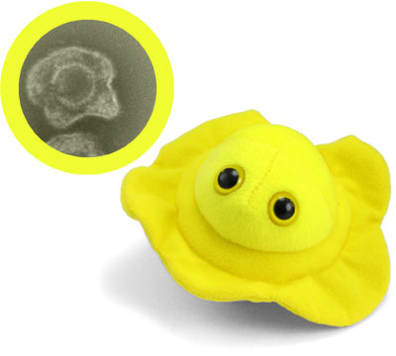
But…
Notes:
Herpes is actually a DNA virus. Isn’t it cute? Not all viruses are bad. The herpes virus is very bad, but 99.99999 percent of virus life forms out there can’t affect humans, instead they infect everything else from plants to animals, and even bacteria. Most viruses infect bacteria.

Slide 14
Considering Evolution
Notes:
Viruses have no incentive to kill their host, because then they die with the host. It is more advantageous for a virus to be non-hostile, or to encourage transmission, like how when you have the flu you cough, spreading your infected saliva and mucus to other hosts.

Slide 15
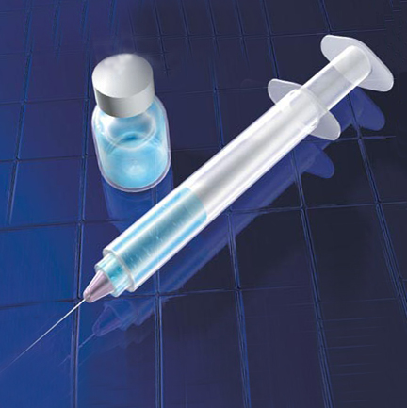
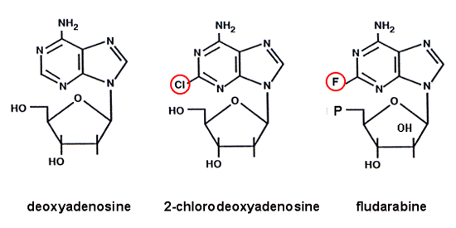
Antivirals/Treatments
Vaccination
Nucleoside analogues
Notes:
Nucleoside analogues copy the normal nucleic acids used to make up DNA (adenine, guanine, etc.) and when they are inserted into a new genome that is being copied they prevent the new strand of DNA from being elongated any further, preventing replication of a virus.
In addition to preventing elongation, they can also cause breaks once inserted.
Inhibit polymerase activity, get stuck inside the polymerase, so they break the machinery, like throwing a wrench into a bunch of moving gears.

Slide 16
A New Approach
Selection and Fitness
Fitness Expression
Viral Interaction
Notes:
FITNESS EXPRESSION
Viruses only can replicate if they are more genetically fit than other viruses. This is how viruses can evade normal treatments, because there will be mutants that are not affected by the antivirals and they will have the reproductive advantage over the other viruses.
BUT if a virus can’t express this fitness that enables it to survive, it might as well not be genetically superior and it will not reproduce.
This is very complicated and you might need to read up on it a lot more to understand this.

Slide 17
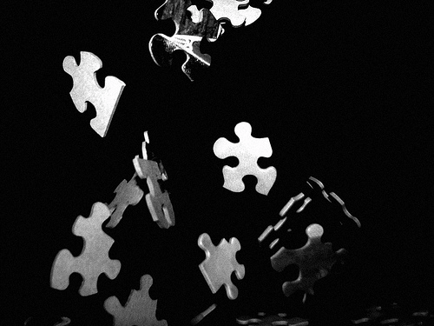
Think of it as if…
Notes:
If you are a champion jigsaw puzzle doer, (this is an analogy to a virus’s genetic fitness) you will have problems at the competition if all the other jigsaw puzzle doers are having a hard time and throw their jigsaw puzzle pieces into the air and some of them land on your table mixing with your puzzle pieces. Now you can’t finish the puzzle, and/or express your superior trait because others are interfering.

Slide 18
How do you ruin a party?
Notes:
Seriously, how do you ruin a party?

Slide 19
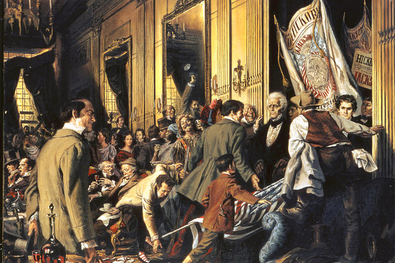
Notes:
You DO NOT stay home from the party.
You want to be the most obnoxious guest and cause complete chaos.

Slide 20
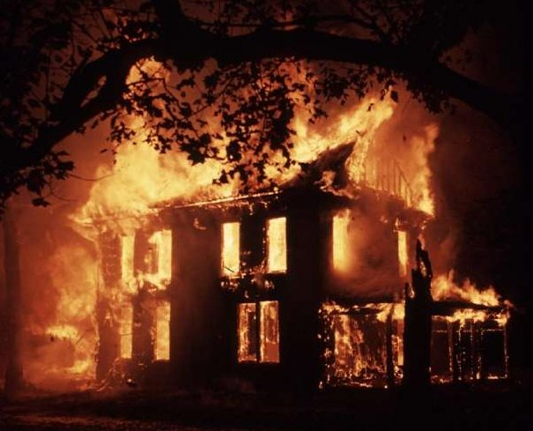
Notes:
This is chaotic huh? It only took one person being a jerk to ruin this party and house.

Slide 21
How does this apply?
Targeting different processes
Dominant Negative Mutation
Notes:
We didn’t have time to cover this. Google “dominant negative mutation” if you are curious.

Slide 22
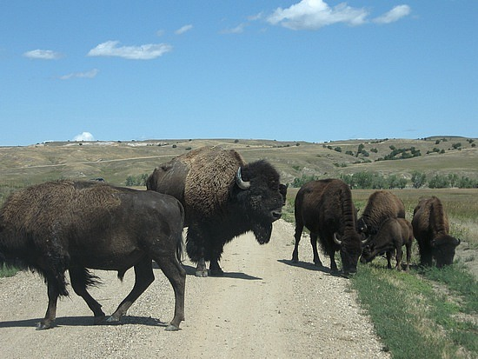
Like blocking a road?

Slide 23
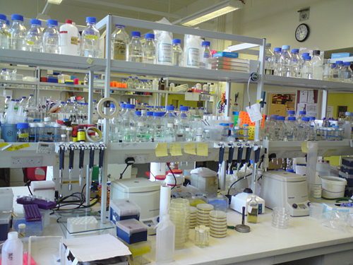
Development
Founder’s Effect
Cost of research
Introduction
of new
methods
Notes:
Funders don’t want to put lots of money into new ideas that may be risky, so instead they keep putting money into antivirals because we know they sort of work, even if they aren’t perfect.
Why antivirals in the first place? Well the people who started the whole field of virology way back when (the founders) thought antivirals were the way to go, so that’s what we’ve been doing ever since.

